Slide 1


Hands on Practice using the Microscopic Images to classify normal /abnormal precancerous cells with Sequential Convolutional Neural Network
GIAN Course “2541009 – Biological Cell Imaging for Diagnosis and Early Prediction of Cancer”
Tutorial 9 on
Date: 30th October, 2025
Demonstrated/presented by
Dr. Mrinal kanti bhowmik
Head and associate professor,
Department of Computer Science and Engineering,
Tripura University (A Central University),
Assisted by
Jagrita paul
Research scholar,
Department of Computer Science and Engineering,
Tripura University (A Central University),

Slide 2


Contents
Introduction
What is a Cell? Why do we do Image Classification. What is its importance?
Need for microscopic image classification in cell.
Types of Image Classification.
Datasets used in Microscopic Image Classification: (a) AGMC-TU Dataset (b)Herlev Dataset.
Why we’ve used VGG 16 for Image Classification?
Basics of VGG 16 Architecture.
Why VGG-16 is also called Sequential Convolution Network?
Diagrammatic Representation of microscopic cell image classification on AGMC-TU Dataset using VGG 16.
Data Augmentation Techniques.
Code Running Platform for AGMC-TU Dataset
Python Code snippet for binary class segmentation (In Colab).
Testing the trained model in a single image.
Diagrammatic Representation of microscopic cell image classification on Herlev Dataset using VGG 16.
Code Running Platform for Herlev Dataset
Python Code snippet for multi class segmentation (In Kaggle).
Testing the trained model in a single image from seven classes.
Conclusion.
References.

Slide 3
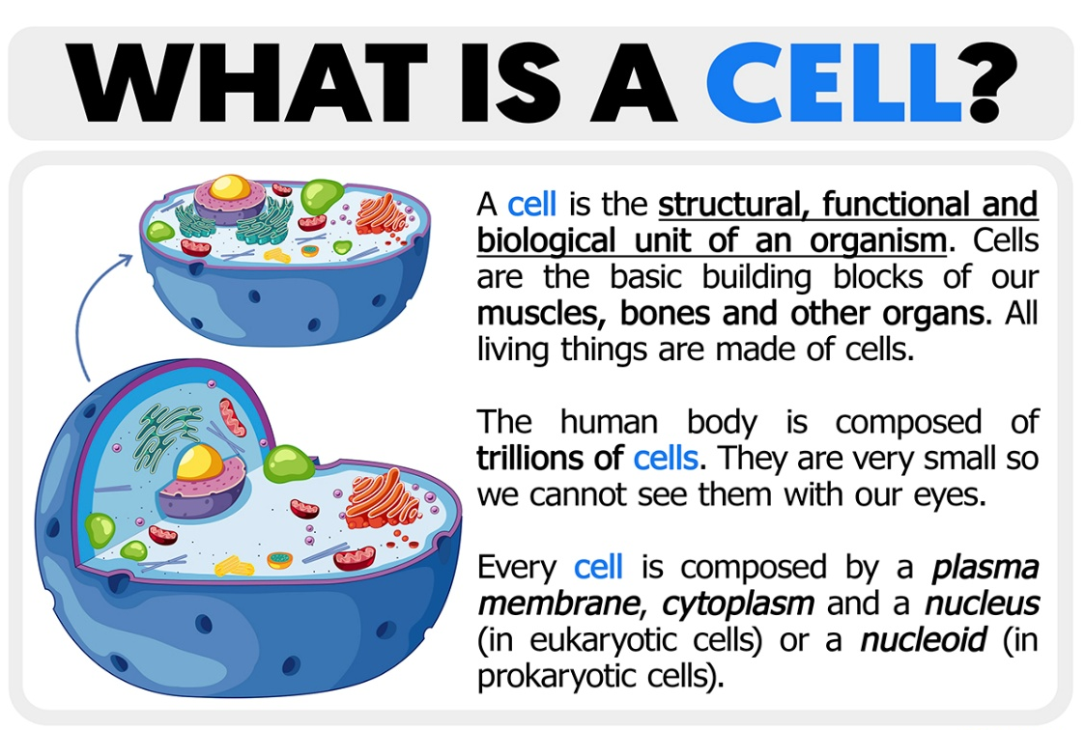
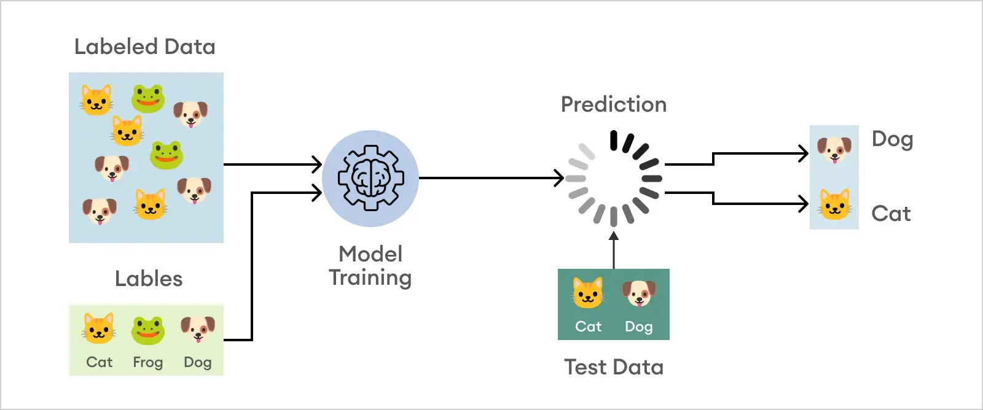
Introduction:
Importance of Image Classification:
Why do we need Image Classification? What is its importance in today’s generation?
Image classification is a fundamental task in computer vision involves assigning a category or label to an entire image based on its visual content.[2].
We need image classification to enable computers to "see" and understand images by assigning them to predefined categories.
For example,
Figure 1: Definition of a Cell [1]
Figure 2: Classification of an image using Machine Learning [3]

Slide 4
Why do we need for microscopic image classification in cell?
The need for microscopic cell image classification arises from its crucial role in automating cell-based analysis for applications like disease diagnosis, drug screening, and genetic research, which would otherwise be slow and prone to human error [4].
This technology provides objective, high-throughput, and efficient methods for identifying cellular abnormalities, studying the effects of drugs or genes, and classifying cell types based on their features.

Slide 5
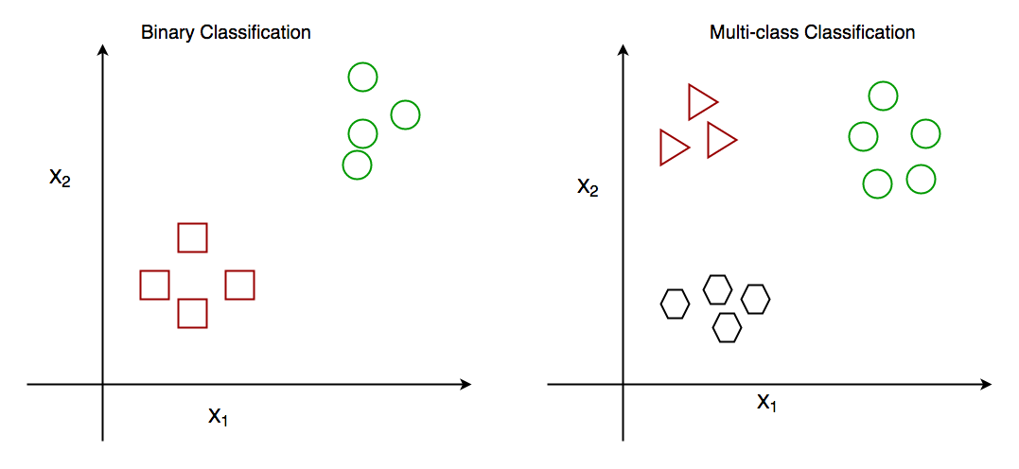
Types of image classification:
Depending on the problem at hand, there are different types of image classification methodologies to be employed. These are binary, and multiclass classification [5].
‍Binary:
Binary classification takes an either-or logic to label images, and classifies unknown data points into two categories.
When your task is to categorize benign or malignant tumors, analyze product quality to find out whether it has defects or not, and many other problems that require yes/no answers are solved with binary classification.‍
Multiclass:
Multiclass Classification, as the name suggests, categorizes items into three or more classes.
Basically, machine looks at the features in the image (like shape, color, or texture) and chooses in which class the picture is most likely to be based on the training it received.
Figure 3: Binary classification vs Multi class classification

Slide 6
Datasets for Microscopic Image Classification:
Here, we will be performing Image Classification for Microscopic data, where basically considered two datasets: the AGMC-TU Dataset and the Herlev Dataset.
For the AGMC-TU Dataset, a binary classification task is performed since it contains two categories of cell images.
In contrast, the Herlev Dataset is used for a multiclass classification task, as it comprises seven distinct classes of cervical cell images.
In this project, I have utilized the VGG-16 , a Deep Learning model for microscopic cell image classification.

Slide 7
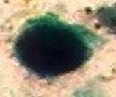
WHY VGG-16?
VGG16 is a convolutional neural network (CNN) architecture specifically designed for and widely used in image classification tasks [6].
It is one of the popular algorithms for image classification and is easy to use.
There are various other classification architectures but the main reason for choosing VGG-16 is that it offers a really good balance between accuracy, simplicity, and computational efficiency.
VGG16 has slightly fewer layers, but it performs almost equally well while training faster, especially on smaller datasets.
224×224×3
224×224×64
112×112×28
56×56×256
28×28×512
Convolution + ReLU
7×7×512
1×1×1000
Max Pooling
1×1×4096
Fully Connected + ReLU
14×14×512
softmax
Figure 5: VGG-16 Architecture

Slide 8
For my dataset and experimental setup, VGG16 provided excellent performance with less complexity. We have used the supervised learning technique here, using the pre-trained model weights of VGG-16.
Overall, VGG16 was the most practical and efficient choice, offering high accuracy with simpler implementation and faster training time.
We will be explaining about the VGG 16 model from next slide onwards. But to understand the basic concepts of VGG 16 , we need to understand about Convolutional Neural Network first.

Slide 9
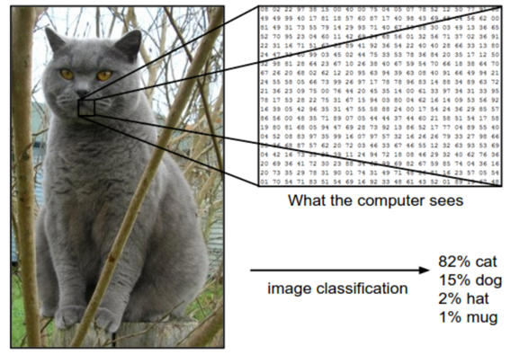
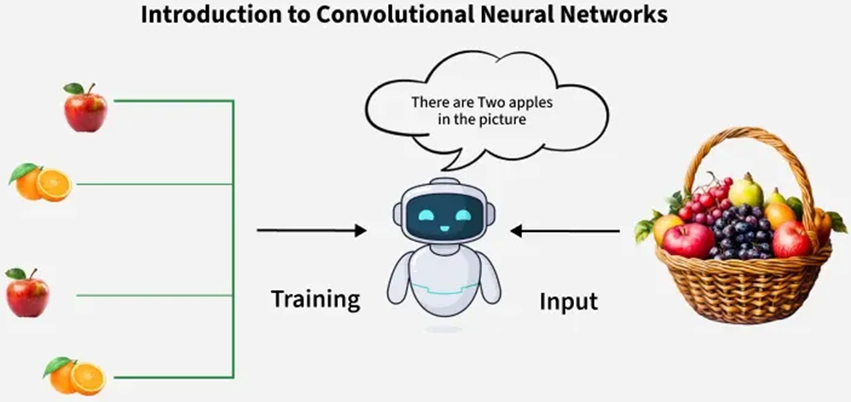
Imagine you have a photo — you can tell it’s a cat.
But how can a computer recognize it?
A computer only sees a grid of numbers (pixel values).
So, we build a model that learns to see shapes, edges, and textures just like our eyes, this is called a Convolutional Neural Network (CNN).
Figure 6: Images are three-dimensional arrays of integers from 0 to 255, of size Width x Height x 3. The 3 represents the three color channels Red, Green, and Blue [7].
Figure 7: Introduction to CNN [8].
VGG16 is one of the most famous CNNs, simple, deep, and powerful.

Slide 10
The VGG-16 model is a Convolutional neural network (CNN) architecture that was proposed by the Visual Geometry Group (VGG) at the University of Oxford, in their 2014 paper "Very Deep Convolutional Networks for Large-Scale Image Recognition“[9].
224×224×3
224×224×64
112×112×128
56×56×256
Convolution + ReLU
28×28×512
Max Pooling
7×7×512
1×1×1000
Fully Connected + ReLU
Pooling
Pooling
softmax
1×1×4096
Conv 3-1
14×14×512
Conv 3-2
Pooling
Conv 3-3
Conv 2-2
Conv-1 Layer has 64 number of filters,
Conv-2 has 128 filters,
Conv-3 has 256 filters,
Conv 4 andConv 5 has 512 filters.
Conv 2-1
Conv 1-1
Conv 1-2
Figure 5: VGG-16 Architecture

Slide 11
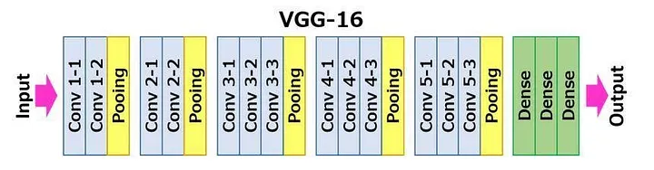
VGG16 Architecture:
The 16 in VGG16 refers to the 16 layers that have weights.
In VGG16 there are thirteen convolutional layers, five Max Pooling layers, and three Dense layers (which helps in decision making that the object belongs to which class), sum up to 21 layers but it has only sixteen weight layers i.e., learnable parameters layer (something that the neural network adjusts during training to minimize the loss function) [10].
Non-learnable layers like pooling do not have any weights or biases, they perform only fixed operations.
Figure 6: VGG-16 architecture[10]
Five Max Pooling layers just reduces the spatial size (which refers to the physical dimensions or extent of an object or phenomenon, including its length, area, or volume).
The convolution and max pool layers are consistently arranged throughout the whole architecture.
VGG16 takes input tensor size(an image) as 224, 224 with 3 RGB channel.
If we look at the number of filters that we can use, around 64 filters are available that we can double to about 128 and then to 256 filters. In the last layers, we can use 512 filters.

Slide 12
WHY VGG-16 is also called Sequential Convolutional Network?
VGG-16 is called a sequential CNN architecture because its layers are stacked one after another in a single, linear chain, with each layer having one input and one output.
Linear stack of layers:
In a sequential model, the output of one layer becomes the direct input of the next layer. VGG-16 follows this by arranging its 13 convolutional layers and 3 fully connected layers in a single line
No multiple inputs or outputs:
This sequential arrangement means the model is not designed to handle multiple inputs or outputs simultaneously. Data moves forward in one path from start to finish, which is ideal for simple image classification tasks
Figure 6: VGG-16 Layer-wise demonstrated [10]

Slide 13
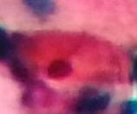
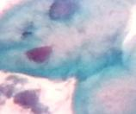
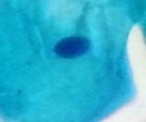
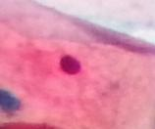
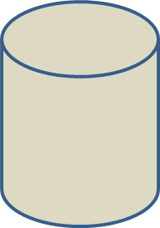
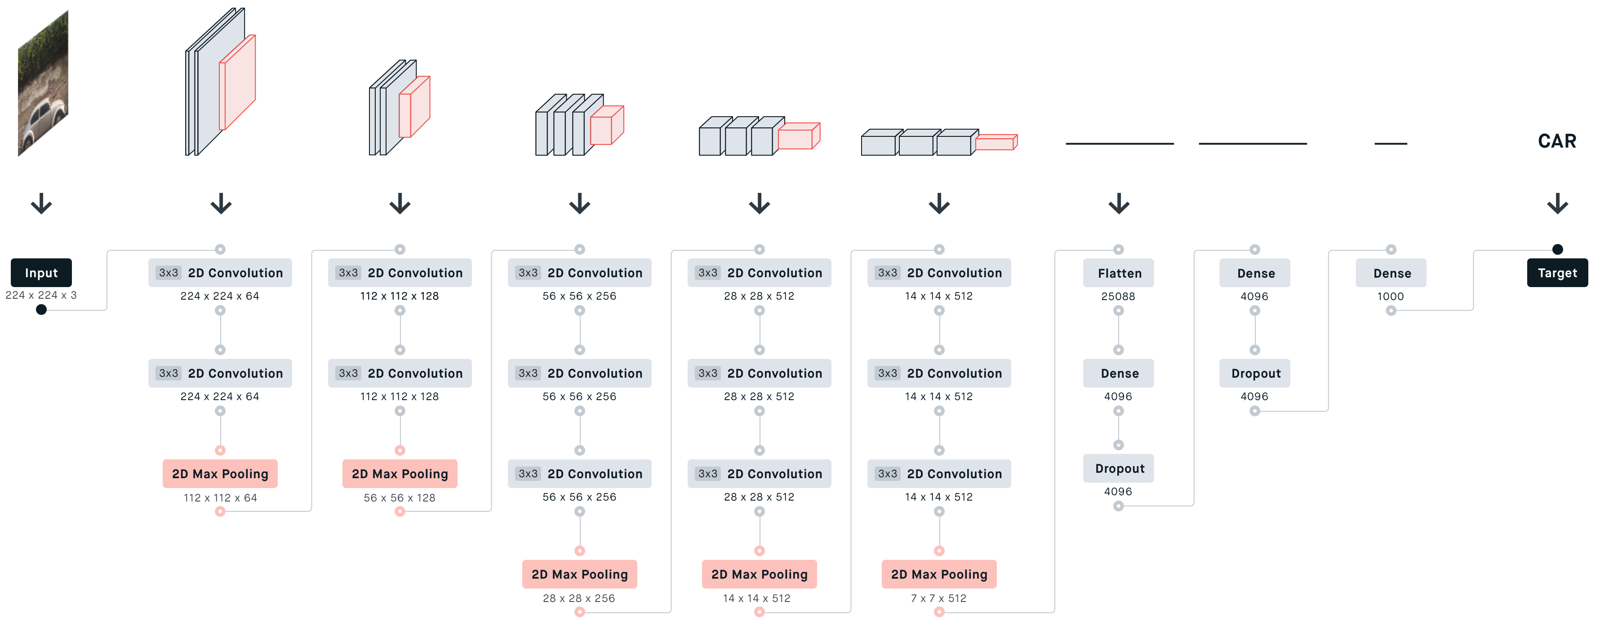
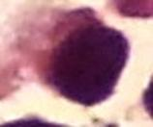
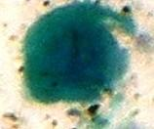
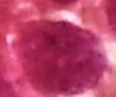
Diagrammatic Representation of microscopic cell image classification on AGMC-TU Dataset:
Normal Microscopic Cell
Normal Images as Input for training
Abnormal Microscopic Cell
Input Images
Collection of AGMC
-TU Dataset further used for Binary Classification
Abnormal Microscopic Cell
1
Abnormal Images as Input for training
VGG-16 Model
Figure 7: Demonstration of Hands on VGG-16 Architecture (AGMC-TU Binary Class dataset)

Slide 14
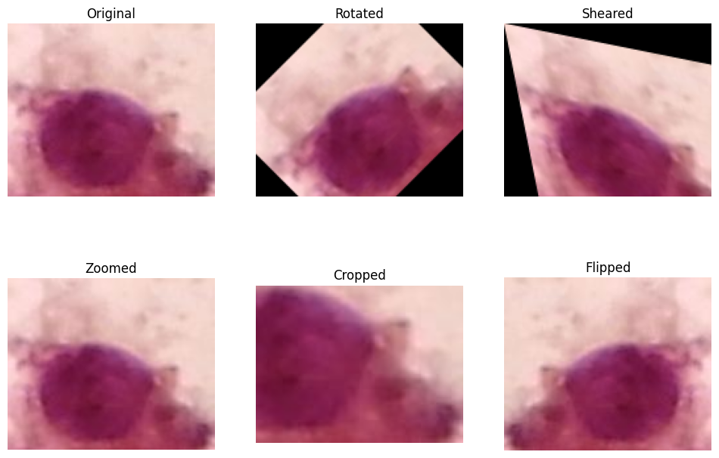
Data Augmentation Techniques:
Data augmentation is the process of increasing the amount and diversity of data.
We do not collect new data, rather we transform the already present data.
Most commonly used operations are-
1. Rotation
2. Shearing
Rotation
Shearing
Figure 8: Original Image of an abnormal microscopic cell

Slide 15
3. Zooming
4. Cropping
5. Flipping
Since the dataset contained a limited number of images, different augmentation operations were performed in both the datasets to increase the dataset size and enhance model performance.

Slide 16

Convolution Operation:
Let’s consider a tiny patch from that image image:
And a 3×3 edge detection filter (kernel) that detects edges:
Figure 9: Abnormal Microscopic Cell
When you apply a convolutional filter to an image, the output feature map’s height and width are determined by this formula:
where, W= Input size, F= Filter (kernel)size, P= Padding, S= Stride (how many pixels the filter moves each step)
= 2+1= 3
So the output is 3×3 (both width and height).

Slide 17

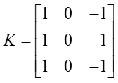
Multiply with filter 𝐾 element-wise, then add:
(1×1)+(2×0)+(3×(−1))+(4×1)+(5×0)+(6×(−1))+(7×1)+(8×0)+(9×(−1))
= 1−3+4−6+7−9=−6=1−3+4−6+7−9 =−6
Hence, Output(1,1) = –6
Multiply with filter 𝐾 element-wise, then add:
(4×1)+(5×0)+(6×(−1))+(7×1)+(8×0)+(9×(−1))+(1×1)+(2×0)+(3×(−1))
= -6
Hence, Output(2,1) = -6
Multiply with filter 𝐾 element-wise, then add:
(2×1)+(3×0)+(0×(−1))+(5×1)+(6×0)+(1×(−1))+(8×1)+(9×0)+(0×(−1))
= 14
Hence, Output(1,2) = 14
Multiply with filter 𝐾 element-wise, then add:
(5×1)+(6×0)+(1×(−1))+(8×1)+(9×0)+(0×(−1))+(2×1)+(3×0)+(4×(−1))
= 10
Hence, Output(2,2) = 10
Multiply with filter 𝐾 element-wise, then add:
(3×1)+(0×0)+(1×(−1))+(6×1)+(1×0)+(2×(−1))+(9×1)+(0×0)+(1×(−1))
= 14
Hence, Output(1,3) = 14
Multiply with filter 𝐾 element-wise, then add:
(6×1)+(1×0)+(2×(−1))+(9×1)+(0×0)+(1×(−1))+(3×1)+(4×0)+(5×(−1))
= 10
Hence, Output(2,3) = 10

Slide 18

Hence the Output feature map would be:
Multiply with filter 𝐾 element-wise, then add:
(7×1)+(8×0)+(9×(−1))+(1×1)+(2×0)+(3×(−1))+(6×1)+(7×0)+(8×(−1))
=-6
Hence, Output(3,1) = -6
Output feature map=
Multiply with filter 𝐾 element-wise, then add:
(8×1)+(9×0)+(0×(−1))+(2×1)+(3×0)+(4×(−1))+(7×1)+(8×0)+(9×(−1))
=4
Hence, Output(3,2) = 4
Interpretation:
The negative values (–6) mean the left edges are dark-to-light (left gradient).
The high positive values (14) mean there’s a strong edge in the vertical direction (right gradient).
So this 3×3 filter is acting like a vertical edge detector (like a Sobel filter).
Multiply with filter 𝐾 element-wise, then add:
(9×1)+(0×0)+(1×(−1))+(3×1)+(4×0)+(5×(−1))+(8×1)+(9×0)+(0×(−1))
= 14
Hence, Output(3,3) = 14

Slide 19
ReLU Activation:
After convolution,
we apply ReLU = Rectified Linear Unit to remove negative values.
f(x)=max(0,x)
Here, given the Output feature map=
After applying ReLU, I get,
ReLU(feature map)=​
Here all the negative values gets converted to 0 or positive values(greater than zero).

Slide 20

Pooling Operation:
Pooling reduces the image size by taking the maximum value in each small region.
(I)
Formula for pooling is given by:
y(i,j) = max x(m,n)
We know,
ReLU(feature map)=​
Top-left 2×2 region (after ReLU):
Where, max=14 -(from (I))
max=14
max=14
Therefore, the feature map be like-
produces a 2×2 pooled map:
$$\left[\begin{matrix}14 & 14 \\ 10 & 14\end{matrix}\right]$$
max=10
max=14

Slide 21
Flattening:
After several convolution and pooling layers, we get a small 3D feature map, Flattening means converting it into one long vector to pass it through the dense layers, hence flattening is an important step.
Converting the 2×2 matrix into one long vector gives us, [14,14,10,14]. Therefore, the flattened vector will be passed through the Fully Connected layers.

Slide 22
Softmax Activation Function:
The Softmax activation function is used in VGG-16, specifically in the final layer, for multi-class classification tasks. Here's how it functions:
Output Layer Transformation:
After the convolutional and fully connected layers, the VGG-16 model produces a set of raw, unnormalized scores (also known as "logits") for each of the possible output classes.
Probability Distribution Generation:
The Softmax function takes these raw scores as input and transforms them into a probability distribution over the classes. This means that for each input, the Softmax output provides a probability for each class, indicating how likely it is that the input belongs to that particular class

Slide 23
Code Running Platform for AGMC-TU Dataset:
There are various platforms to run Machine Learning or Deep learning code, for example Integrated Development Environments(IDEs) like Jupyter Notebooks, Spyder, VS Code and Cloud based platforms like Google Colab.
For this dataset (AGMC-TU Database), I have chosen to use Google Colab over other platforms. Google Colab is a free, cloud-based Jupyter notebook environment that comes pre-installed with many ML libraries.
The primary reason is that Colab provides free access to GPU and TPU resources, which significantly accelerates the training process of deep learning models.
In contrast, Jupyter Notebook and Spyder rely on the local system’s hardware, which can be limiting for computationally intensive tasks.

Slide 24
Python Code snippet for binary class segmentation (In Colab):
import tensorflow as tf
from tensorflow.keras import layers, models, Input
from tensorflow.keras.preprocessing.image import ImageDataGenerator
from tensorflow.keras.optimizers import Adam
import matplotlib.pyplot as plt
import numpy as np
import seaborn as sns
from sklearn.metrics import confusion_matrix, precision_score, recall_score, roc_curve, auc
import os
Importing the required libraries from scratch
data_dir = "/content/drive/MyDrive/AGMC-TU DATASET_downloaded/AGMC-TU DATASET"
train_dir = os.path.join(data_dir, "train")
test_dir = os.path.join(data_dir, "test")'
These paths point to the folders containing training and test images.
Defining training and test data directories uploaded in Google Drive
train_gen = ImageDataGenerator(
rescale=1./255,
rotation_range=20,
zoom_range=0.2,
width_shift_range=0.1,
height_shift_range=0.1,
horizontal_flip=True,
fill_mode="nearest",
validation_split=0.2 )
20% of train data used as validation
ImageDataGenerator is a Keras utility that helps you load, preprocess, and optionally augment images in batches
train = train_gen.flow_from_directory(
train_dir, target_size=(224,224),
batch_size=32, class_mode='binary', subset='training'
)
val = train_gen.flow_from_directory(
train_dir, target_size=(224,224),
batch_size=32, class_mode='binary', subset='validation'
)
test_gen = ImageDataGenerator(rescale=1./255)
test = test_gen.flow_from_directory(
test_dir, target_size=(224,224),
batch_size=32, class_mode='binary', shuffle=False
)
Loading images from the training directory and apply augmentation

Slide 25

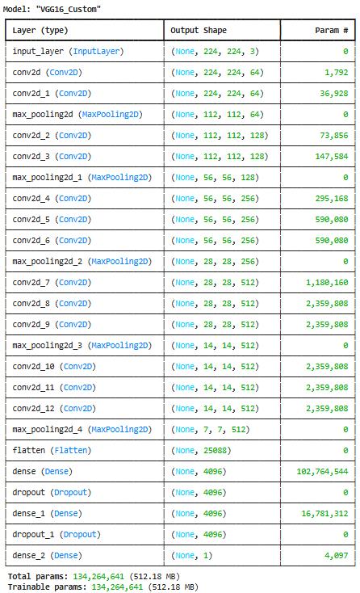
def VGG16(input_shape=(224,224,3), num_classes=1):
inputs = Input(shape=input_shape)
# Block 1
x = layers.Conv2D(64, (3,3), activation='relu', padding='same')(inputs)
x = layers.Conv2D(64, (3,3), activation='relu', padding='same')(x)
x = layers.MaxPooling2D((2,2))(x)
# Block 2
x = layers.Conv2D(128, (3,3), activation='relu', padding='same')(x)
x = layers.Conv2D(128, (3,3), activation='relu', padding='same')(x)
x = layers.MaxPooling2D((2,2))(x)
# Block 3
x = layers.Conv2D(256, (3,3), activation='relu', padding='same')(x)
x = layers.Conv2D(256, (3,3), activation='relu', padding='same')(x)
x = layers.Conv2D(256, (3,3), activation='relu', padding='same')(x)
x = layers.MaxPooling2D((2,2))(x)
# Block 4
x = layers.Conv2D(512, (3,3), activation='relu', padding='same')(x)
x = layers.Conv2D(512, (3,3), activation='relu', padding='same')(x)
x = layers.Conv2D(512, (3,3), activation='relu', padding='same')(x)
x = layers.MaxPooling2D((2,2))(x)
# Block 5
x = layers.Conv2D(512, (3,3), activation='relu', padding='same')(x)
x = layers.Conv2D(512, (3,3), activation='relu', padding='same')(x)
x = layers.Conv2D(512, (3,3), activation='relu', padding='same')(x)
x = layers.MaxPooling2D((2,2))(x)
# Fully Connected Layers
x = layers.Flatten()(x)
x = layers.Dense(4096, activation='relu')(x)
x = layers.Dropout(0.5)(x) #Dropout layer used to prevent overfitting
x = layers.Dense(4096, activation='relu')(x)
x = layers.Dropout(0.5)(x)
outputs = layers.Dense(num_classes, activation='sigmoid')(x)
model = models.Model(inputs, outputs, name="VGG16_Custom")
return model
model = VGG16(input_shape=(224,224,3))
model.compile(optimizer=Adam(1e-4), loss='binary_crossentropy', metrics=['accuracy'])
model.summary()
Output:

Slide 26
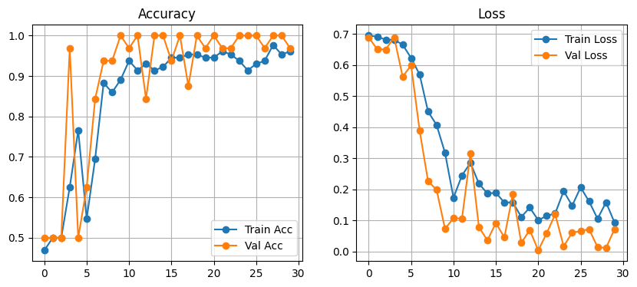
plt.figure(figsize=(10,4))
plt.subplot(1,2,1)
plt.plot(history.history['accuracy'], label='Train Acc', marker='o')
plt.plot(history.history['val_accuracy'], label='Val Acc', marker='o')
plt.legend(); plt.title('Accuracy'); plt.grid(True)
history = model.fit(train, validation_data=val, epochs=30)
Training the model
final_train_acc = history.history['accuracy'][-1]
final_train_loss = history.history['loss'][-1]
print(f" Final Training Accuracy: {final_train_acc * 100:.2f}%")
print(f" Final Training Loss: {final_train_loss:.4f}")
test_loss, test_acc = model.evaluate(test, verbose=1)
print(f" Final Test Accuracy: {test_acc * 100:.2f}%")
print(f" Final Test Loss: {test_loss:.4f}")
Training Accuracy:
Predicting Training Accuracy
Final Training Accuracy: 96.09%
Final Training Loss: 0.0932
Evaluation on Test set
plt.subplot(1,2,2)
plt.plot(history.history['loss'], label='Train Loss', marker='o')
plt.plot(history.history['val_loss'], label='Val Loss', marker='o')
plt.legend(); plt.title('Loss'); plt.grid(True)
plt.show()
Final Test Accuracy: 82.50%
Final Test Loss: 0.5465
Training Loss:
save_path = "/content/drive/MyDrive/vgg16_manual_30_epoch_model.h5"
model.save(save_path)
print(f" Model saved successfully at: {save_path}")
Saving the model path in drive

Slide 27
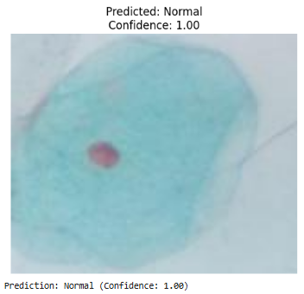
Testing the trained model in a single image:
from tensorflow.keras.preprocessing import image
from tensorflow.keras.models import load_model
import numpy as np
import matplotlib.pyplot as plt
import os
model_path = '/content/drive/MyDrive/vgg16_manual_30_epoch_model.h5'
assert os.path.exists(model_path), f"Model not found at: {model_path}"
model = load_model(model_path)
model.compile(optimizer='adam', loss='binary_crossentropy', metrics=['accuracy'])
img_path = '/content/drive/MyDrive/AGMC-TU DATASET_downloaded/AGMC-TU DATASET/test/Normal/images/d1 (47).jpg'
assert os.path.exists(img_path), f" Image not found at: {img_path}"
# Load image
img = image.load_img(img_path, target_size=(224, 224))
img_array = image.img_to_array(img) / 255.0 # normalize
img_array = np.expand_dims(img_array, axis=0) # shape: (1, 224, 224, 3)
prediction = model.predict(img_array, verbose=0)[0][0]
label = "Normal" if prediction > 0.5 else "Abnormal" plt.imshow(image.load_img(img_path))
plt.axis('off')
plt.title(f"Predicted: {label}\nConfidence: {prediction:.2f}")
plt.show()
print(f"Prediction: {label} (Confidence: {prediction:.2f})")
Summary:
In this experiment, we selected an image from the test dataset, which was not used during training.
The test dataset contains two categories: Abnormal and Normal images.
The image chosen for evaluation belongs to the Normal category from test folder, and the trained model accurately classified it as “Normal”, demonstrating its effectiveness in distinguishing between the two classes.
Output:
Figure 10: Output of a Normal Cell

Slide 28
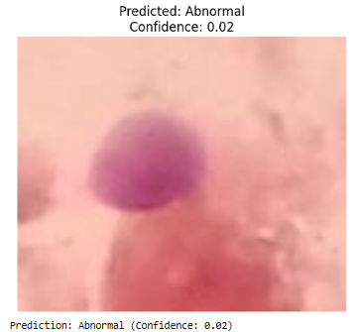
Testing the trained model in a single image:
Summary:
from tensorflow.keras.preprocessing import image
from tensorflow.keras.models import load_model
import numpy as np
import matplotlib.pyplot as plt
import os
model_path = '/content/drive/MyDrive/vgg16_manual_30_epoch_model.h5'
assert os.path.exists(model_path), f"Model not found at: {model_path}"
model = load_model(model_path)
model.compile(optimizer='adam', loss='binary_crossentropy', metrics=['accuracy'])
img_path = '/content/drive/MyDrive/AGMC-TU DATASET_downloaded/AGMC-TU DATASET/test/Abnormal/images/d1 (91).jpg'
assert os.path.exists(img_path), f" Image not found at: {img_path}"
# Load image
img = image.load_img(img_path, target_size=(224, 224))
img_array = image.img_to_array(img) / 255.0 # normalize
img_array = np.expand_dims(img_array, axis=0) # shape: (1, 224, 224, 3)
prediction = model.predict(img_array, verbose=0)[0][0]
label = "Normal" if prediction > 0.5 else "Abnormal"
plt.imshow(image.load_img(img_path))
plt.axis('off')
plt.title(f"Predicted: {label}\nConfidence: {prediction:.2f}")
plt.show()
print(f"Prediction: {label} (Confidence: {prediction:.2f})")
In this experiment, we selected an image from the test dataset, which was not used during training.
The test dataset contains two categories: Abnormal and Normal images.
The image chosen for evaluation belongs to the Abnormal category from the test folder, and the trained model accurately classified it as “Abnormal”, demonstrating its effectiveness in distinguishing between the two classes.
Output:
Figure 11: Output of a Abnormal Cancerous Cell

Slide 29





























Diagrammatic Representation of microscopic cell image classification on Herlev Dataset:
severe_dysplastic cells
normal_superficiel cells
Light_dysplastic cells
Input Images
Collection of Herlev Dataset further used for MultiClass Classification
carcinoma_in_situ
Moderate_dysplastic cells
7
normal_columnar cells
normal_intermediate cells
light_dysplastic cells
Figure 12: Demonstration of Hands on VGG-16 Architecture (Herlev Multiclass dataset)

Slide 30
Here, in Herlev Dataset the total number of images are 917. For training we are sending 643 images belonging to 7 classes. And for testing, 274 images.
Training
(643 images)
Testing
(274 images)
The 7 classes named as :
Carcinoma_in_situ (which consists of 105 images).
Light_dysplastic (which consists of 128 images)
Normal_columnar (which consists of 69 images)
Normal_intermediate (which consists of 49 images)
Moderate_dysplastic (which consists of 103 images)
Severe_dysplastic (which consists of 138 images)
Normal_superficiel (which consists of 51 images)
Carcinoma_in_situ (which consists of 45 images).
Light_dysplastic (which consists of 54 images)
Normal_columnar (which consists of 29 images)
Normal_intermediate (which consists of 21 images)
Moderate_dysplastic (which consists of 43 images)
Severe_dysplastic (which consists of 59 images)
Normal_superficiel (which consists of 23 images)

Slide 31
Code Running Platform for Herlev Dataset:
For this dataset, I have chosen to use Kaggle instead of Google Colab. The Herlev Database contains seven classes, making it a multiclass classification problem with a larger number of images and consequently longer training times.
Kaggle provides a more powerful GPU environment and allows longer execution durations compared to Google Colab, which has usage limits and runtime restrictions. Therefore, Kaggle is better suited for training this model efficiently.
Kaggle is highly beneficial, as it comes with the availability of free GPUs being a major advantage, especially for deep learning tasks.
It has access to powerful, free computing since Kaggle Notebooks provide free access to powerful GPUs (like the NVIDIA Tesla T4 and P100) and TPUs for a limited time each week.

Slide 32
Python Code snippet for multi class segmentation (In Kaggle):
import tensorflow as tf
from tensorflow.keras import layers, models, Input
from tensorflow.keras.preprocessing.image import ImageDataGenerator
from tensorflow.keras.optimizers import Adam
import matplotlib.pyplot as plt
import numpy as np
import seaborn as sns
from sklearn.metrics import confusion_matrix, classification_report
import os
Importing the required libraries from scratch
train_dir = '/kaggle/input/herlev-dataset/Herlev Dataset/train‘
test_dir = '/kaggle/input/herlev-dataset/Herlev Dataset/test‘
These paths point to the folders containing training and test images.
Defining training and test data directories
train_gen = ImageDataGenerator(
rescale=1./255,
rotation_range=20,
zoom_range=0.2,
width_shift_range=0.1,
height_shift_range=0.1,
shear_range=0.2,
horizontal_flip=True,
validation_split=0.15)
20% of train data used as validation
ImageDataGenerator is a Keras utility that helps you load, preprocess, and optionally augment images in batches
train = train_gen.flow_from_directory(
train_dir, target_size=(224,224),
batch_size=32, class_mode=‘categorical', color_mode=‘rgb’,
subset=‘training‘, shuffle=True
)
val = train_gen.flow_from_directory(
train_dir, target_size=(224,224),
batch_size=32, class_mode=‘categorical', subset='validation‘, shuffle=True
)
test_gen = ImageDataGenerator(rescale=1./255)
test = test_gen.flow_from_directory(
test_dir, target_size=(224,224),
batch_size=32, class_mode=‘categorical',
color_mode=‘rgb’,
shuffle=False
)
Loading images from the training directory and apply augmentation

Slide 33
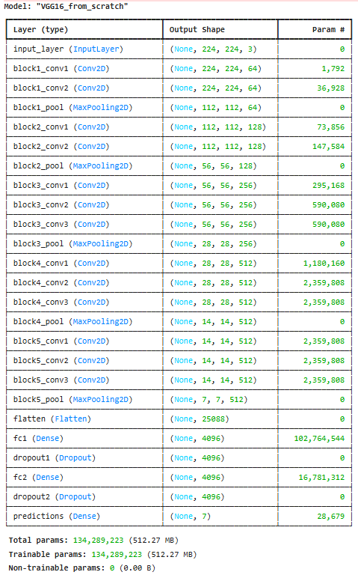
def VGG16_from_scratch(input_shape=(224,224,3), num_classes=7):
inputs = Input(shape=input_shape)
# Block 1
x = layers.Conv2D(64, (3,3), activation='relu', padding='same’, name='block1_conv1')(inputs)
x = layers.Conv2D(64, (3,3), activation='relu', padding='same' , name='block1_conv2')(x)
x = layers.MaxPooling2D((2,2))(x)
# Block 2
x = layers.Conv2D(128, (3,3), activation='relu', padding='same', name='block2_conv1')(x)
x = layers.Conv2D(128, (3,3), activation='relu', padding='same', name='block2_conv2')(x)
x = layers.MaxPooling2D((2,2), strides=(2,2), name='block2_pool')(x)
# Block 3
x = layers.Conv2D(256, (3,3), activation='relu', padding='same', name='block3_conv1')(x)
x = layers.Conv2D(256, (3,3), activation='relu', padding='same', name='block3_conv2')(x)
x = layers.Conv2D(256, (3,3), activation='relu', padding='same', name='block3_conv3')(x)
x = layers.MaxPooling2D((2,2), strides=(2,2), name='block3_pool')(x)
# Block 4
x = layers.Conv2D(512, (3,3), activation='relu', padding='same', name='block4_conv1')(x)
x = layers.Conv2D(512, (3,3), activation='relu', padding='same', name='block4_conv2')(x)
x = layers.Conv2D(512, (3,3), activation='relu', padding='same', name='block4_conv3')(x)
x = layers.MaxPooling2D((2,2), strides=(2,2), name='block4_pool')(x)
# Block 5
x = layers.Conv2D(512, (3,3), activation='relu', padding='same', name='block5_conv1')(x)
x = layers.Conv2D(512, (3,3), activation='relu', padding='same', name='block5_conv2')(x)
x = layers.Conv2D(512, (3,3), activation='relu', padding='same', name='block5_conv3')(x)
x = layers.MaxPooling2D((2,2), strides=(2,2), name='block5_pool')(x)
# Fully Connected Layers
x = layers.Flatten(name='flatten')(x)
x = layers.Dense(4096, activation='relu', name='fc1')(x)
x = layers.Dropout(0.5, name='dropout1')(x) #Dropout layer used to prevent overfitting
x = layers.Dense(4096, activation='relu', name='fc2')(x)
x = layers.Dropout(0.5, name='dropout2')(x)
outputs = layers.Dense(num_classes, activation='softmax', name='predictions')(x)
model = models.Model(inputs=inputs, outputs=outputs, name='VGG16_from_scratch')
return model
num_classes = len(train.class_indices) # should be 7 for Herlev
model = VGG16_from_scratch(input_shape=(224,224,3), num_classes=num_classes)
model.compile(optimizer=Adam(learning_rate=1e-4), loss='categorical_crossentropy', metrics=['accuracy'])
model.summary()
Output:

Slide 34
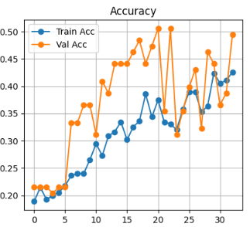
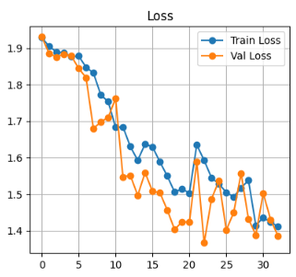
plt.figure(figsize=(10,4))
plt.subplot(1,2,1)
plt.plot(history.history['accuracy'], label='Train Acc', marker='o')
plt.plot(history.history['val_accuracy'], label='Val Acc', marker='o')
plt.legend(); plt.title('Accuracy'); plt.grid(True)
history = model.fit(train, validation_data=val, epochs=50)
Training the model
final_train_acc = history.history['accuracy'][-1]
final_train_loss = history.history['loss'][-1]
print(f" Final Training Accuracy: {final_train_acc * 100:.2f}%")
print(f" Final Training Loss: {final_train_loss:.4f}")
test_loss, test_acc = model.evaluate(test, verbose=1)
print(f" Final Test Accuracy: {test_acc * 100:.2f}%")
print(f" Final Test Loss: {test_loss:.4f}")
Training Accuracy:
Predicting Training Accuracy
Final Training Accuracy: 89.09%
Final Training Loss: 1.4112
Evaluation on Test set
plt.subplot(1,2,2)
plt.plot(history.history['loss'], label='Train Loss', marker='o')
plt.plot(history.history['val_loss'], label='Val Loss', marker='o')
plt.legend(); plt.title('Loss'); plt.grid(True)
plt.show()
Final Test Accuracy: 79.50%
Final Test Loss: 1.9082
Training Loss:
save_path = '/kaggle/working/vgg16_from_scratch_epoch_33_herlev.h5
'model.save(save_path)
print(f" Model saved successfully at: {save_path}")
Saving the model path in drive

Slide 35
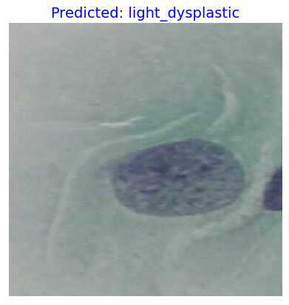
Testing the trained model in a single image from seven classes:
Summary:
In this experiment, we selected an image from the test dataset, which was not used during training.
The test dataset contains seven categories: Carcinoma_in_situ, Light_dysplastic, Normal_columnar, Normal_intermediate, Moderate_dysplastic, Severe_dysplastic, Normal_superficiel classes.
The image chosen for evaluation belongs to the Light dysplastic class from the test folder, and the trained model accurately classified it as “Light Dysplastic”, demonstrating its effectiveness in distinguishing between the seven classes.
from tensorflow.keras.preprocessing import image
import numpy as np
import matplotlib.pyplot as plt
img_path = '/kaggle/input/herlev-dataset/Herlev Dataset/test/light_dysplastic/153354858-153354901-002.BMP‘
img = image.load_img(img_path, target_size=(224, 224))
img_array = image.img_to_array(img) / 255.0
img_batch = np.expand_dims(img_array, axis=0)
pred = model.predict(img_batch)
class_names = list(train_generator.class_indices.keys())
pred_class = class_names[np.argmax(pred)
plt.imshow(img_array)
plt.axis("off")
plt.title(f"Predicted: {pred_class}", fontsize=14, color='blue')
plt.show()
Output:
Figure 13: Output of a Cell which belongs to light_dysplastic class

Slide 36
Conclusion:
In this work, I have focused on developing deep learning models for image classification tasks, covering both binary and multiclass problems.
The main objective was to accurately classify cervical cell images using two well-known datasets, the AGMC-TU and the Herlev datasets.
For the AGMC-TU dataset, our model successfully differentiated between normal and abnormal cervical cells, helping to identify potential signs of abnormality at an early stage.
On the other hand, for the Herlev dataset, which consists of seven distinct cell categories, our approach was able to classify each cell image into its correct category with high accuracy.
Overall, the results demonstrate that our models can effectively assist in automating the diagnostic process and contribute towards faster and more reliable cervical cancer screening.”

Slide 37
References:
https://www.worksheetsplanet.com/what-is-a-cell/
https://www.sciencedirect.com/topics/computer-science/image-classification
https://www.superannotate.com/blog/image-classification-basics
https://www.sciencedirect.com/science/article/pii/S2472555221000149
https://www.geeksforgeeks.org/computer-vision/what-is-image-classification/
https://www.geeksforgeeks.org/computer-vision/vgg-16-cnn-model/
https://machinelearning.technicacuriosa.com/introduction-to-computer-vision-part-1/
https://www.geeksforgeeks.org/deep-learning/convolutional-neural-network-cnn-in-machine-learning/
Simonyan, K., & Zisserman, A. (2014). Very deep convolutional networks for large-scale image recognition. arXiv preprint arXiv:1409.1556.
https://medium.com/@mygreatlearning/everything-you-need-to-know-about-vgg16-7315defb5918

Slide 38
Thank You

