Slide 1


Tutorial-6 on
Hands on Demonstration on Asymmetric Analysis and Characterization of Microscopic Imaging Modality for Cancer Abnormality Classification Using MATLAB
GIAN course “2541009 - Biological Cell Imaging for Diagnosis and Early Prediction of Cancer”
Date: 29th October, 2025
Demonstrated/Presented By
Dr. Mrinal Kanti Bhowmik
Head & Associate Professor
Computer Sc.& Engg. Department
Tripura University (A Central University)
Assisted by
Smt. Sarmistha Chakraborty
Research Scholar
Computer Sc.& Engg. Department
Tripura University (A Central University)

Slide 2
Outline
Asymmetric Analysis and Characterization
Shape Features
  Nucleus Area (NA)
  Nucleus Perimeter (NP)
  Nucleus Roundness (NR)
  Equivalent Diameter (ED)
  Major Axis Length (MAJ)
  Minor Axis Length (MIN)
  Elongation (EN)
  Eccentricity (ECC)
  Convex Area (CA)
  Solidity (SO)
  Extent (EX)
Reference

Slide 3
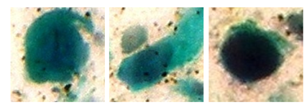
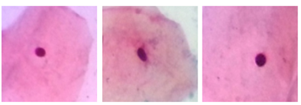
Asymmetric Analysis and Characterization
An effective approach to automatically detect abnormality in the Pap-Smear cells is to study the symmetry between the normal and abnormal cells i.e. asymmetric analysis[2].
Identification of changes in the nucleus contributes to the discrimination of normal and abnormal cells in Pap-smear images.
(a)
(b)
Figure 1: AGMC-TU Pap-Smear Cytological Image Dataset: (a) Abnormal (b) Normal [1]

Slide 4


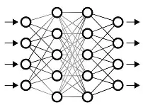


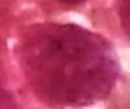

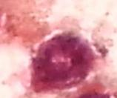


Asymmetric Analysis and Characterization
Normal Cell
Shape Features
or
or
Geometric descriptor
Abnormal Cell
Input image
Segmentation
Binary mask(ROI)
Classification
Figure 2: Asymmetric Analysis and Characterization

Slide 5
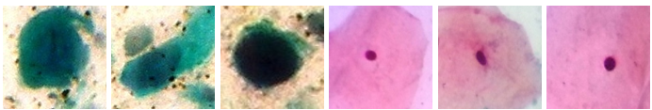
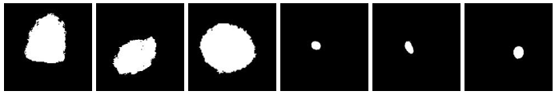
Segmentation
Cell nucleus can be segmented using state of the art image processing methods or deep learning-based approach.
Shape features of the cell nucleus region gives information about the asymmetric analysis between normal and abnormal cells.
Figure 3: AGMC-TU Pap-Smear Cytological Image Dataset [1]
Figure 4: Segmented Images of AGMC-TU Pap-Smear Cytological Image Dataset [3]

Slide 6

Shape Features
Asymmetric analysis and Characterization of cells can be done by shape feature extraction[3].
Shape-based asymmetric analysis forms the mathematical foundation for computer-aided diagnosis (CAD) systems in cervical cancer screening.
Shape Features
Nucleus Area (NA)
Nucleus Perimeter (NP)
Nucleus Roundness (NR)
Equivalent Diameter (ED)
Major Axis Length (MAJ)
Minor Axis Length (MIN)
Elongation (EN)
Eccentricity (ECC)
Convex Area (CA)
Solidity (SO)
Extent (EX)
Segmented ROI
Shape of ROI

Slide 7




Shape Features
1. Nucleus Area (NA):
The nucleus area was determined from the total number of pixels in the segmented region[3].
Normal Cell
Abnormal Cell
Segmented Nucleus
Interpretation:
Normal Nucleus: NA is Small.
Abnormal Nucleus: NP is large.
Area of Nucleus

Slide 8


Shape Features
2. Nucleus Perimeter (NP):
The nucleus perimeter was calculated by counting the number of boundary points [3].
Normal Cell
Abnormal Cell
Interpretation:
Normal Nucleus: NP is short.
Abnormal Nucleus: NP is longer.

Slide 9
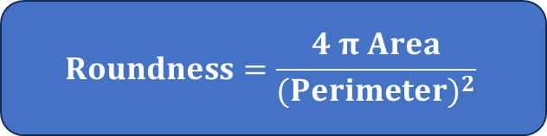
Shape Features
Round shaped Nucleus
Irregular shaped Nucleus
3. Nucleus Roundness (NR):
  The nucleus roundness was calculated as the ratio between the actual area of the nuclear and the length of the perimeter of the nuclear.
  Circle has the roundness value exactly 1.
  The roundness value signifies the deviation of the shape of a cell from the circular shape.
  The nuclear roundness sometimes called circularity has been calculated by using the formula: [3].
Normal Cell
Abnormal Cell
Interpretation:
Normal Nucleus: NR → 1.
Abnormal Nucleus: NR → 0.
$$Roundness=\frac{4 π Area}{{(Perimeter)}^{2}}$$

Slide 10
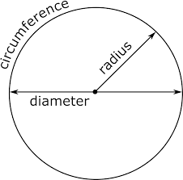

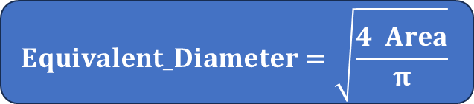
Shape Features
4. Equivalent Diameter (ED):
Equivalent diameter specifies the diameter of a circle with the same area as the region [3].
$$Equivalent_Diameter=\sqrt{\frac{4 Area}{π}}$$
$$Area=π {×Radius}^{2}$$
$$Area=π × {(\frac{Diameter}{2} ) }^{2}$$
$$Area=\frac{π×{Diameter}^{2} }{4}$$
4 $Area=π {×Diameter}^{2}$
$$Diameter=\sqrt{\frac{\text{4}Area}{π}}$$
Interpretation:
Normal Nucleus: ED is small.
Abnormal Nucleus: ED is large.

Slide 11

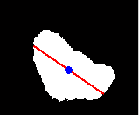
Shape Features
  5. Major Axis Length (MAJ):
  To find major axis length, a pair of points on the boundary is found whose Euclidean distance from each other is larger than any other pair of points on the boundary line. The line used to connect these two points is called major axis length [3].
Normal Cell
Abnormal Cell
Segmented Nucleus
Interpretation:
Normal Nucleus: MAJ is shorter.
Abnormal Nucleus: MAJ is longer.
Major Axis length of Nucleus

Slide 12
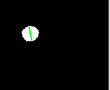
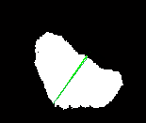
Shape Features
6. Minor Axis Length (MIN):
Minor Axis length is the axis perpendicular to the major axis length [3].
Normal Cell
Abnormal Cell
Segmented Nucleus
Interpretation:
Normal Nucleus: MAJ=MIN
Abnormal Nucleus: MAJ > MIN
Minor Axis length of Nucleus

Slide 13



Shape Features
7. Elongation (EN):
The elongation was calculated through minor axis length divided by major axis length.
Circle has the elongation value exactly 1.
From the elongation value, assumptions are generally made regarding how much a cell deviated from the circle [3].
The Elongation can be calculated by the given equation:
Normal Cell
Abnormal Cell
$$\text{Elongation}=\frac{Minor_Axis_Length}{\text{Major}\text{_}\text{Axis}\text{_}\text{Length}}$$
Interpretation:
Normal Nucleus: EN→ 1
Abnormal Nucleus: EN→ 0

Slide 14
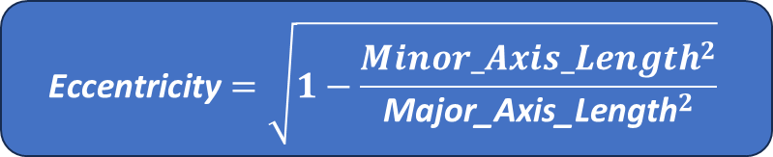
Shape Features
8. Eccentricity (ECC):
It defines to evaluate the deviation of the objects shape from a symmetric or regular circular shape.
It allows for tracking how much an abnormal cell nucleus differs from a normal cell nucleus.
The values of eccentricity vary between 0 to 1 [3].
$$\text{Eccentricity}=\sqrt{1−\frac{{Minor_Axis_Length}^{2}}{{\text{Major}\text{_}\text{Axis}\text{_}\text{Length}}^{2}}}$$
Interpretation:
Normal Nucleus: ECC→ 0
Abnormal Nucleus: ECC→ 1

Slide 15

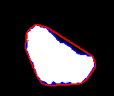
Shape Features
9. Convex Area (CA):
Convex area specifies the total number of pixels in the convex hull image[3].
Normal Cell
Abnormal Cell
Segmented Nucleus
Interpretation:
Normal Nucleus: CA→ Nucleus area
Abnormal Nucleus: CA >> Nucleus area
Convex hull

Slide 16
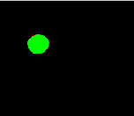
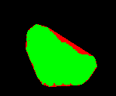
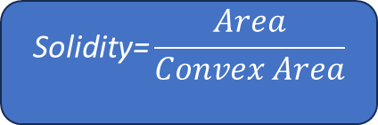
Shape Features
10. Solidity (SO):
Solidity describes the quantity of the common pixels in the convex hull and in the region [3].
$$\text{Solidity}\text{=}\frac{Area}{Convex Area}$$
Normal Cell
Abnormal Cell
Interpretation:
Normal Nucleus: SO → 1
Abnormal Nucleus: SO → 0

Slide 17
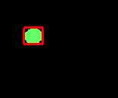
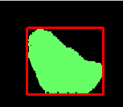
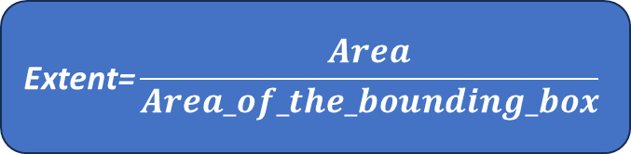
Shape Features
11. Extent (EX):
Extent defines the ratio of pixel in the region to pixels in the total bounding box [3].
$$\text{Extent}\text{=}\frac{Area}{Area_of_the_bounding_box}$$
Normal Cell
Abnormal Cell
Interpretation:
Normal Nucleus: EX→ 1
Abnormal Nucleus: EX →0

Slide 18
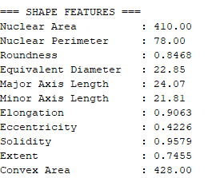
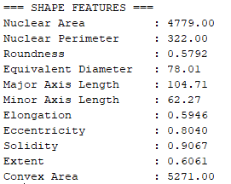
Shape Features
A sharp discrimination between normal and abnormal cell images for all shape features.
Normal Cell
Abnormal Cell

Slide 19
Shape Features
Table: Range of Eleven Shape Features Obtained from segmented image(normal and abnormal) and ground truth image(normal and abnormal) [AGMC-TU Pap smear cytology image Dataset]
Sl. No. | Shape Features | Range of Features Obtained From Segmented Image
 |  | Normal cell | Abnormal cell
1. | Nucleus Area (NA) | 107-1203 | 1534- 10239
2. | Nucleus Perimeter (NP) | 52-164 | 188-508
3. | Nucleus Roundness (NR) | 0.429-0.611 | 0.295- 0.602
4. | Equivalent Diameter (ED) | 11.672-39.137 | 44.194-114.178
5. | Major Axis Length (MAJ) | 15.725-46.069 | 47.633-137.198
6. | Minor Axis Length (MIN) | 8.760-35.179 | 32.094-99.896
7. | Elongation (EN) | 1.04-1.94 | 1.08-3.20
8. | Eccentricity (ECC) | 0.304-0.857 | 0.382-0.950
9. | Solidity (SO) | 0.91-0.98 | 0.87-0.97
10. | Extent (EX) | 0.163-0.869 | 0.273-0.785
11. | Convex Area (CA) | 112-1242 | 1618-10697

Slide 20
Shape Features

Slide 21
Shape Features

Slide 22
Shape Features

Slide 23
Shape Features

Slide 24
Shape Features

Slide 25
Shape Features

Slide 26
Shape Features

Slide 27
Shape Features

Slide 28
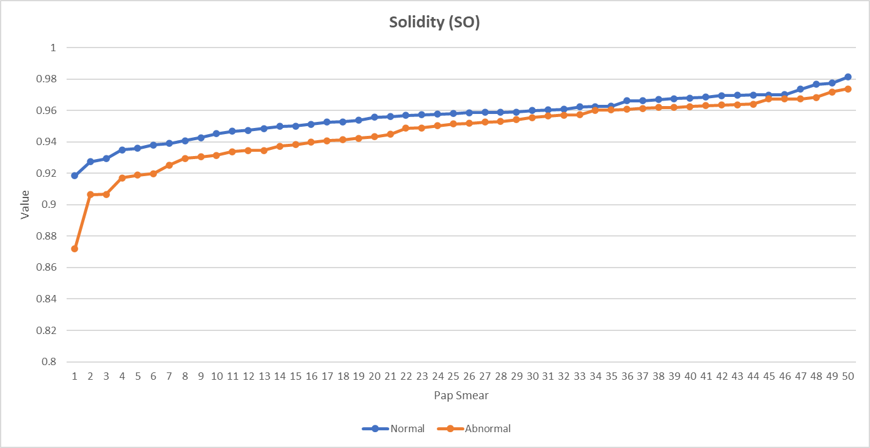
Shape Features

Slide 29
Shape Features

Slide 30
Shape Features

Slide 31
Shape Features for Classification
From the AGMC–TU Pap-Smear Cytological Image Dataset, six nucleus shape features provide the clearest discrimination between normal and abnormal cells.
Normal Cell
Shape Features
Nucleus Area (NA)
Nucleus Perimeter (NP)
Equivalent Diameter (ED)
Major Axis Length (MAJ)
Minor Axis Length (MIN)
Convex Area (CA)
or
Abnormal Cell
Figure 5: Shape Features for Classification

Slide 32
Reference
[1] Link: AGMC-TU Dataset
[2] Bhowmik, M. K., Roy, S. D., Nath, N., & Datta, A. (2018, August). Nucleus region segmentation towards cervical cancer screening using AGMC-TU Pap-smear dataset. In Proceedings of the International Conference on Pattern Recognition and Artificial Intelligence (pp. 44-53).
[3] Bhowmik, M. K., Nath, N., Datta, A., & Ghosh, A. K. (2017). Shape feature based automatic abnormality detection of cervico-vaginal pap smears. Journal of Image and Graphics, 5(2).

Slide 33


Thank You…

