Slide 1


Hands on Demonstration using the Microscopic Images to Segment or Extract the suspicious Region of Interest from the Holistic Microscopic Images for Abnormality
Detection
GIAN course “2541009 - Biological Cell Imaging for Diagnosis and Early Prediction of Cancer”
Tutorial-4
Date: 28th October, 2025
Demonstrated/Presented By
Dr. Mrinal Kanti Bhowmik
Head & Associate Professor
Computer Sc.& Engg. Department
Tripura University (A Central University)
Assisted by
Shri. Saswata Sarkar
Research Scholar
Computer Sc.& Engg. Department
Tripura University (A Central University)

Slide 2
Content
Introduction
Importance of Nucleus Segmentation in Microscopic Images
Deep Learning-Based Analysis of Microscopic Cell Images
Why Choose U-Net?
Nucleus Segmentation from Microscopic Images Using Deep Neural Network
  Working of Convolution Block
Demonstration of Hands on U-Net Architecture
  Practical Explanation of U-Net using Python
References

Slide 3
Introduction
Cervical cancer is among the leading causes of cancer-related deaths in women.
Early detection through microscopic imageis critical[1].
Manual examination of microscopic images is time-consuming and subjective.
Automation using deep learning based image segmentation enhances accuracy and efficiency.
Process of separating cell structures (nucleus, cytoplasm, background) in microscopic images[1].
Focuses on extracting nucleus region, which provides diagnostic features[1].

Slide 4
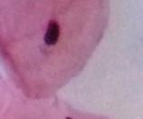
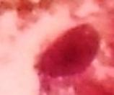
Importance of Nucleus Segmentation in Microscopic Images
Early-stage detection is critical in cervical cancer, as the disease is highly treatable when diagnosed before invasion[1].
Cytological analysis of microscopic images helps identify precancerous changes by examining nuclear morphology which changes in size, shape, chromatin texture, and nucleus-to-cytoplasm ratio are vital diagnostic indicators[1].
The nucleus region contains the most discriminative features for differentiating between normal, and malignant cells.
Therefore, precise segmentation of the nucleus is a foundational step in:
  Feature extraction for classification
  Reducing human subjectivity in visual screening
  Automating diagnostic pipelines for large-scale screening programs
Fig. 1: Normal Microscopic Cell Image [1]
Fig. 2: Abnormal Microscopic Cell Image[1]

Slide 5
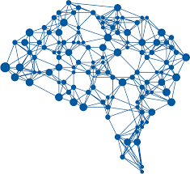
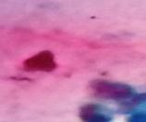
Deep Learning-Based Analysis of Microscopic Cell Images
Classification Task
What is in the image?
Output: Normal cell
Detection Task
What and where nucleus present in the image of cell?
Output: Finds nuclei and draw bounding box
Input Image
Deep Neural Network
Segmentation Task
What, where, and which pixels of nucleus present in the image of cell?
Output: Pixel-wise binary mask for nuclei region
Our Task
Fig. 3: Comparative Overview of Deep Learning Tasks in Cell Image Analysis — Classification, Detection, and Segmentation

Slide 6
Why Choose U-Net for Microscopic image Nucleus Segmentation?
Biomedical Focus:
Specifically designed for medical image segmentation by Olaf Ronneberger, Philipp Fischer, and Thomas Brox (2015)[2]; performs effectively even with limited microscopic image data.
Encoder–Decoder Design:
Encoder extracts hierarchical features; decoder reconstructs fine pixel-level maps with skip connections for accurate boundaries.
Pixel-Level Precision:
Provides dense segmentation distinguishing each pixel as nucleus or background, handling overlaps effectively.
Robust to Variability:
Performs well under uneven staining, illumination differences, noise, and overlapping cytoplasm due to multi-scale feature learning.
Efficient & Practical:
Lightweight architecture; enables fast training and real-time inference for clinical diagnostic use.

Slide 7
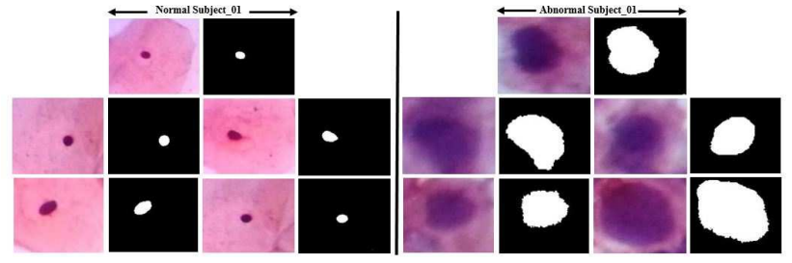
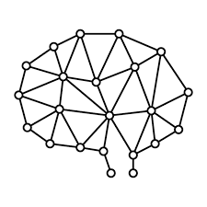
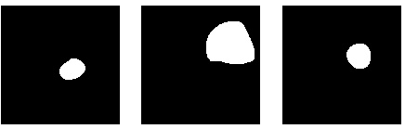
Nucleus Segmentation from Microscopic Images Using Deep Neural Network
Microscopic Image dataset
Deep neural Network (U-Net) for Segmenting nuclei region of Cytological Image
Segmented Nuclei region of Cytological image
Deep Neural Network
Convolution Block
Convolution Block
Convolution Block
Segmentation
Visual Images
Convolution Layer
ReLU Activation
Pooling
Convolution Layer
ReLU Activation
Pooling
Convolution Layer
ReLU Activation
Pooling
Sigmoid Activation
………
Convolution Layer
Fig. 4: The working flow of Nucleus Segmentation from microscopic images[1]

Slide 8
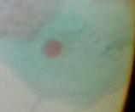
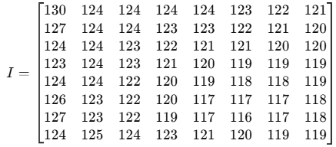



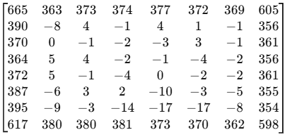
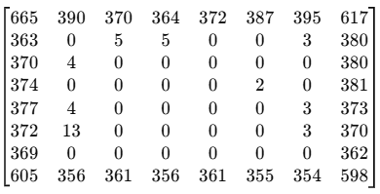

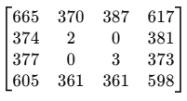
Continue
Convolution Block
Convolution Layer
ReLU Activation
Pooling
Working of Convolution Block
Pixel Value 8×8 patch
.
Filter
Convolution operation
8×8 patch
Convolution 8×8 feature map
Max Pooling (2,2)
Convolution Layer
ReLU Activation
Pooling
Output feature of one Convolution block of 8×8 patch

Slide 9
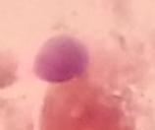
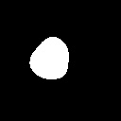
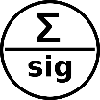
Demonstration of Hands on U-Net Architecture[2]
64 64
64 64
128 ×128 × 3
128 ×128 × 1
128×128 ×64 @2
128×128 ×64
128 128
128 128
Input Image
128×128 ×128
Output Image
64×64 ×128 @2
64×64 ×128
64×64 ×128 @2
64×64 × 64
256 256
256 256
64×64 ×256
32×32 ×256 @2
32×32 ×256
32×32×128
32×32 ×256 @2
512 512
512 512
16×16×512 @2
32×32 ×512 @2
16×16×512
Concatenation
1024 1024
16×16×512 @2
Upsampling or Maxpooling
16×16×256
Downsampling or Convolution Transpose
8×8×512
16×16×1024
8×8×1024 @2
Convolution
@2
Two times Convolution
Sigmoid Activation
Fig.: The diagrammatic representation of U-Net architecture [2]

Slide 10
128×128 ×64 @2
Continue
Block 1
Input size: 128 × 128 × 3
After 2 Convolution: 128 × 128 × 64
After MaxPooling (2×2): 64 × 64 × 64
Details: Two 3×3 Conv2D operations (@2) + 1 MaxPooling operation
128 ×128 × 3
128×128 ×64 @2
Block 2
Input size: 64 × 64 × 64
After 2 Convolution: 64 × 64 × 128
After MaxPooling (2×2): 32 × 32 × 128
Details: Two 3×3 Conv2D operations (@2) + 1 MaxPooling operation
64×64 ×128 @2
Encoder or Downsampling
64×64 × 64
64×64 × 64
64×64 ×128 @2
32×32 ×256 @2
Block 3
Input size: 32 × 32 × 128
After Convolution: 32 × 32 × 256
After MaxPooling (2×2): 16 × 16 × 256
Details: Two 3×3 Conv2D operations (@2)+ 1 MaxPooling operation
32×32 ×256 @2
32×32×128
32×32×128
Block 4
Input size: 16 × 16 × 256
After Convolution: 16 × 16 × 512
After MaxPooling (2×2): 8 × 8 × 512
Details: Two 3×3 Conv2D operations (@2) + 1 MaxPooling operation
16×16×512 @2
16×16×256
16×16×256
16×16×512 @2
8×8×1024 @2
Block 5 (BottleNeck Layer)
Input size: 8 × 8 × 512
After Convolution: 8 × 8 × 1024
Details: Two 3×3 Conv2D operations @2(no pooling here)
8×8×512
8×8×512
8×8×1024 @2

Slide 11
Block 9
Input size: 64 × 64 × 128
After UpSampling (2×2): 128 × 128 × 128
Concatenate with encoder Block 1 output:
(128 × 128 × 64) → 128 × 128 × (128 + 64) = 128 × 128 × 192
After Convolution: 128 × 128 × 64
Details: Two 3×3 Conv2D operations @2 after concatenation
Continue
128×128 ×64
128 ×128×192
128×128 ×64
Block 8
Input size: 32 × 32 × 256
After UpSampling or Covolution-Transpose (2×2): 64 × 64 × 256
Concatenate with encoder Block 2 output:
(64 × 64 × 128) → 64 × 64 × (256 + 128) = 64 × 64 × 384
After Convolution: 64 × 64 × 128
Details: Two 3×3 Conv2D operations @2 after concatenation
128×128 ×128
Decoder or Upsampling
64×64 ×128
64×64 ×128
64×64 ×128 @2
64 ×64× 384
Block 7
Input size: 16 × 16 × 512
After UpSampling or Covolution-Transpose(2×2): 32 × 32 × 512
Concatenate with encoder Block 3 output:
(32 × 32 × 256) → 32 × 32 × (512 + 256) = 32 × 32 × 768
After Convolution: 32 × 32 × 256
Details: Two 3×3 Conv2D operations @2
after concatenation
64×64 ×256
32×32 ×256
32×32 ×256
32×32 ×256 @2
32 × 32 × 768
512 512
32×32 ×512
16×16×512
16×16×512
Block 6
Input size: 8 × 8 × 1024
After UpSampling or Covolution-Transpose (2×2): 16 × 16 × 1024
Concatenate with encoder Block 4 output:
(16 × 16 × 512) → 16 × 16 × (1024 + 512) = 16 × 16 × 1536
After Convolution: 16 × 16 × 512
Details: Two 3×3 Conv2D operations @2
after concatenation
16×16×512 @2
16×16×1536
8×8×512
16×16×1024
8×8×1024 @2

Slide 12
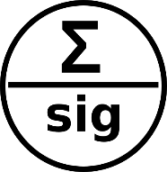
Continue
Binary mask generation
128 ×128 × 3
128 ×128 × 1
128 × 128 × 64
Encoder
Decoder
….
Output Image
Input Image
Block 9
Input size: 128 × 128 × 64
Conv2D (1×1, sigmoid activation): 128 × 128 × 1
Purpose: Generates final segmentation mask (pixel-wise probability)

Slide 13
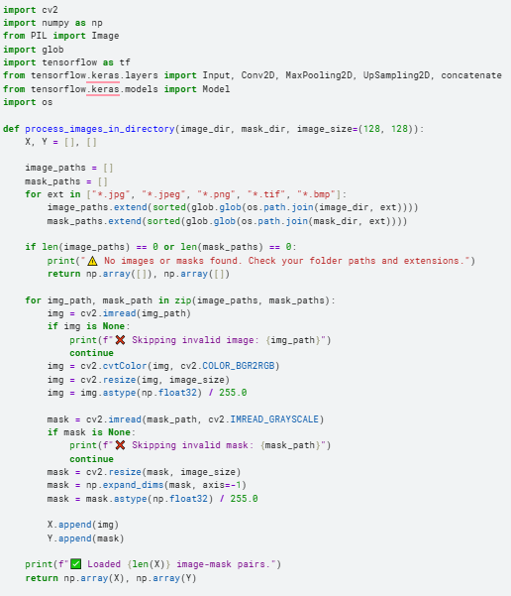
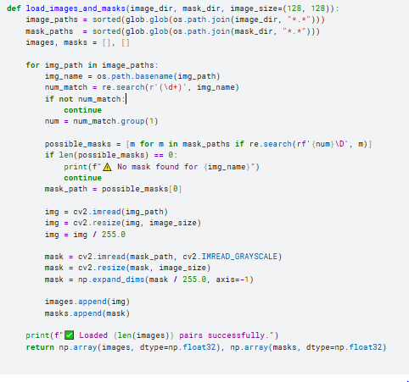
Practical Explanation of U-Net using Python

Slide 14
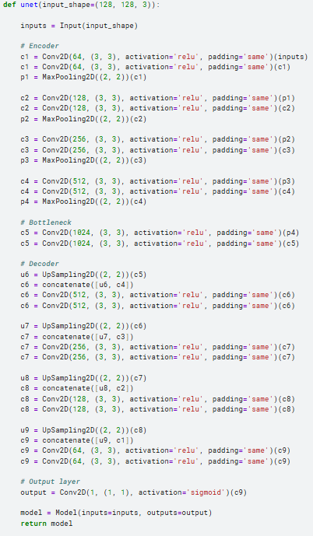
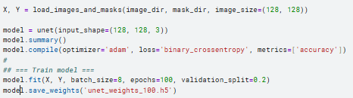
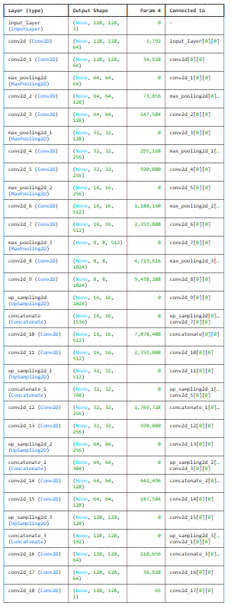
Continue
Training U-Net model

Slide 15
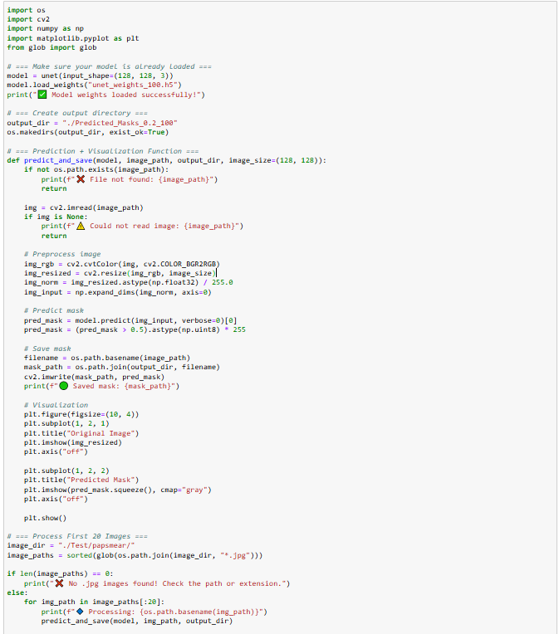
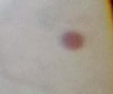

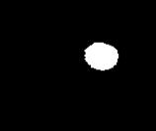
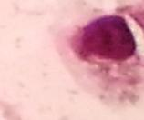
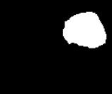
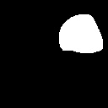
Continue
Testing code using trained weights of U-Net model
Microscopic Images
Ground Truth
U-Net Predicted mask
Fig. : Visualization result of Microscopic image Testing Sample

Slide 16
References
Sourav Dey Roy, Priya Saha, Niharika Nath, Abhijit Datta, and Mrinal Kanti Bhowmik, "AGMC-TU Pap-Smear Cytological Image Dataset: Creation, Annotation, and Analysis towards Early Detection of Cervical Cancer", in The 10th IEEE International Conference on Healthcare Informatics (THE PREMIER FORUM FOR ADVANCES IN HEALTHCARE INFORMATICS), Rochester, Minnesota, USA, to be published by IEEE, held on 11th-14th June, 2022, pp. 42-47, DOI: 10.1109/ICHI54592.2022.00018.
Ronneberger, O., Fischer, P., & Brox, T. (2015, October). U-net: Convolutional networks for biomedical image segmentation. In International Conference on Medical image computing and computer-assisted intervention (pp. 234-241). Cham: Springer international publishing.

