Slide 1
TUTORIAL 1:
Cell/ Tissue Staining Techniques and Imaging

Slide 2
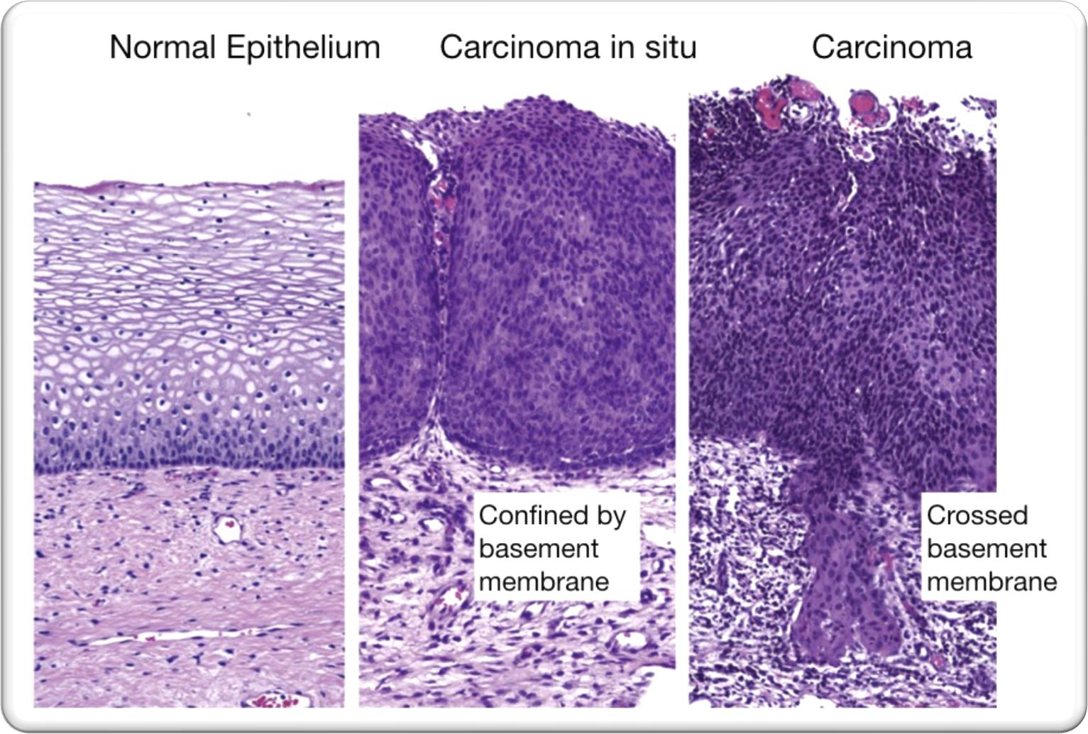
H&E staining
  Hematoxylin (purple)-Stains Nuclei
  Eosin (pink)
    Stains Cytoplasm
    And Extracellular matrix
Gold standard for physicians to
diagnose disease
Helps to visualize cells
Look for pattern differentiation

Slide 3
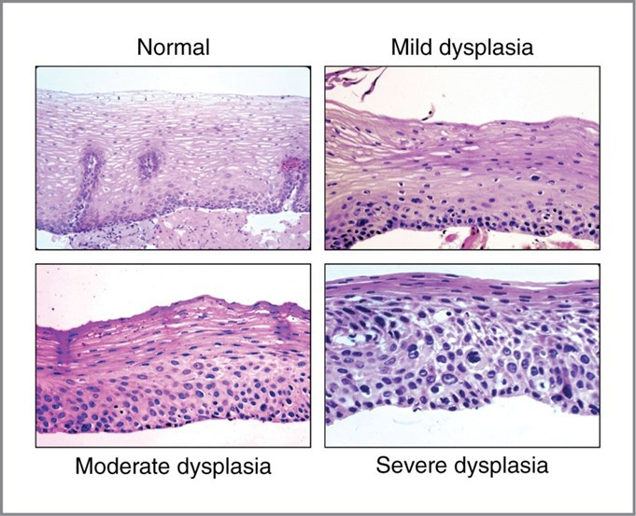
Dysplasia – epithelial dysplasia
A disturbance of growth, which is usually considered to be pre-malignant.
Evidenced by:
Pleomorphism of cells (variation in size and shape);
Hyperchromatic nuclei and increased mitotic activity;
Loss of polarity (orientation) of cells;
Disordered maturation
No invasion

Slide 4
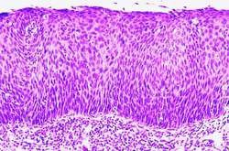
Dysplasia – epithelial dysplasia
Severe changes of dysplasia indicate a diagnosis of intra-epithelial carcinoma or carcinoma-in-situ
The cervix epithelial
cells have lost their regular stratified
pattern, have high nucleus to cytoplasm rations and show increased mitotic activity = cervical intraepithelial neoplasia
Epithelial cells
Basement membrane Stroma

Slide 5
Neoplasia
Neoplasia is new, uncontrolled growth of cells that is not under physiologic control.
A "tumour" or "mass lesion" is simply a "growth" or "enlargement" which may not be neoplastic (such as a granuloma).
The term "cancer" implies malignancy, but neoplasms can be subclassified as either benign or malignant.

Slide 6
Stains used for cytology/histology and adjunct methods
Hematoxylin & Eosin (H&E) — routine histology stain for tissue biopsies.
Papanicolaou (Pap) stain — standard for cervical and many exfoliative cytology smears.
Romanowsky-type stains (Wright, Giemsa, Diff‑Quik) — commonly used for blood, bone marrow, FNAC smears, and rapid on‑site evaluation.
Fixed‑smear cytologic variants (Alcohol fixation vs air‑dry) — determines choice between Pap and Romanowsky stains.
Special stains for specific substances:
Periodic acid–Schiff (PAS) — glycogen, mucopolysaccharides, fungal elements.
Alcian blue / Mucicarmine — mucin detection (e.g., adenocarcinomas).
Choice of stain depends on specimen type, fixation, and diagnostic question.

Slide 7
Exfoliative cytology …

Slide 8
WHY DO exfoliative cytology
Cancer detection in suspected cases
Cervix – cervical smears
Bladder – urine deposits
Bronchus – sputum or brushing or washing
Serous effusions – aspirate
Breast – fine needle aspiration
Skin scrapings – for basal cell carcinoma
Screening of population at suspected risk
Cervical smears from normal women
Stool samples from over 60s people for colon cancer

Slide 9
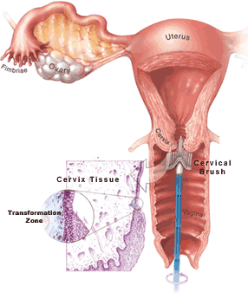
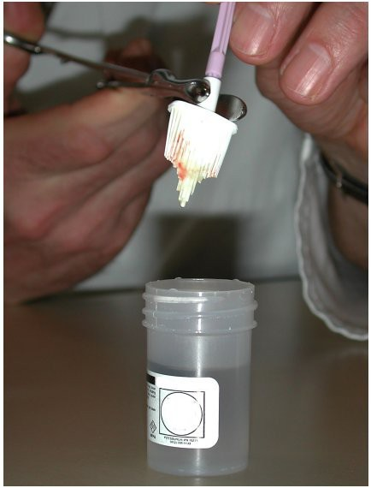
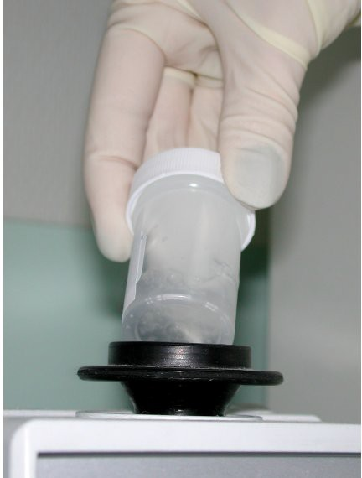
Liquid based cytology (LBC)
Cervical Cytology Slide preparation
Brush sampling (CervexTM ) Drop into dilution
Vortex mix
Aim to suspend cells

Slide 10
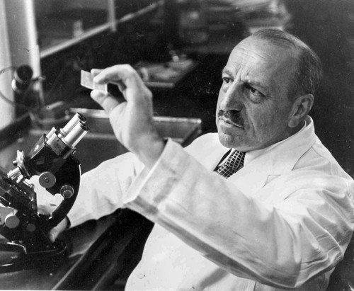
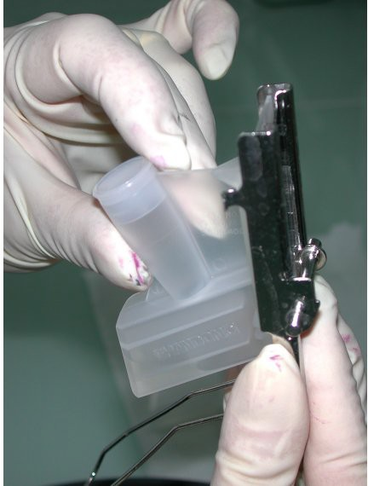
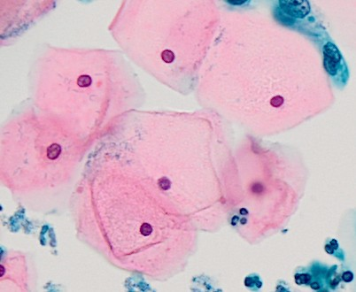
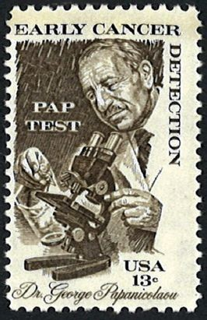
cytospin slide
Georgios Papanicolaou-
invented "Pap smear"
Assembling slide and sample holder
Papanicolaou stain
Mature (squamous cells) pink
1883-1962
Portrait on Greek 10,000
drachma banknote.

Slide 11
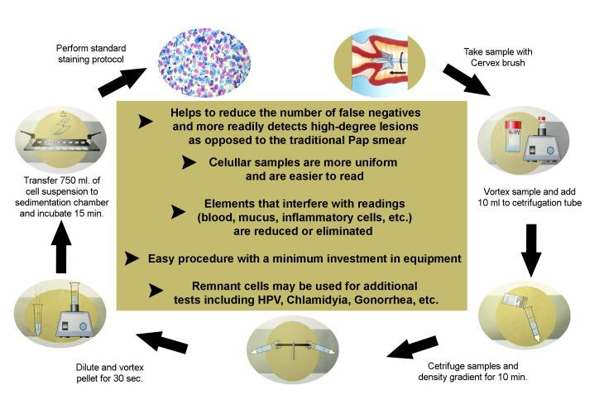
Principles of liquid based cytology (LBC)
cytospin slide 2min video

Slide 12
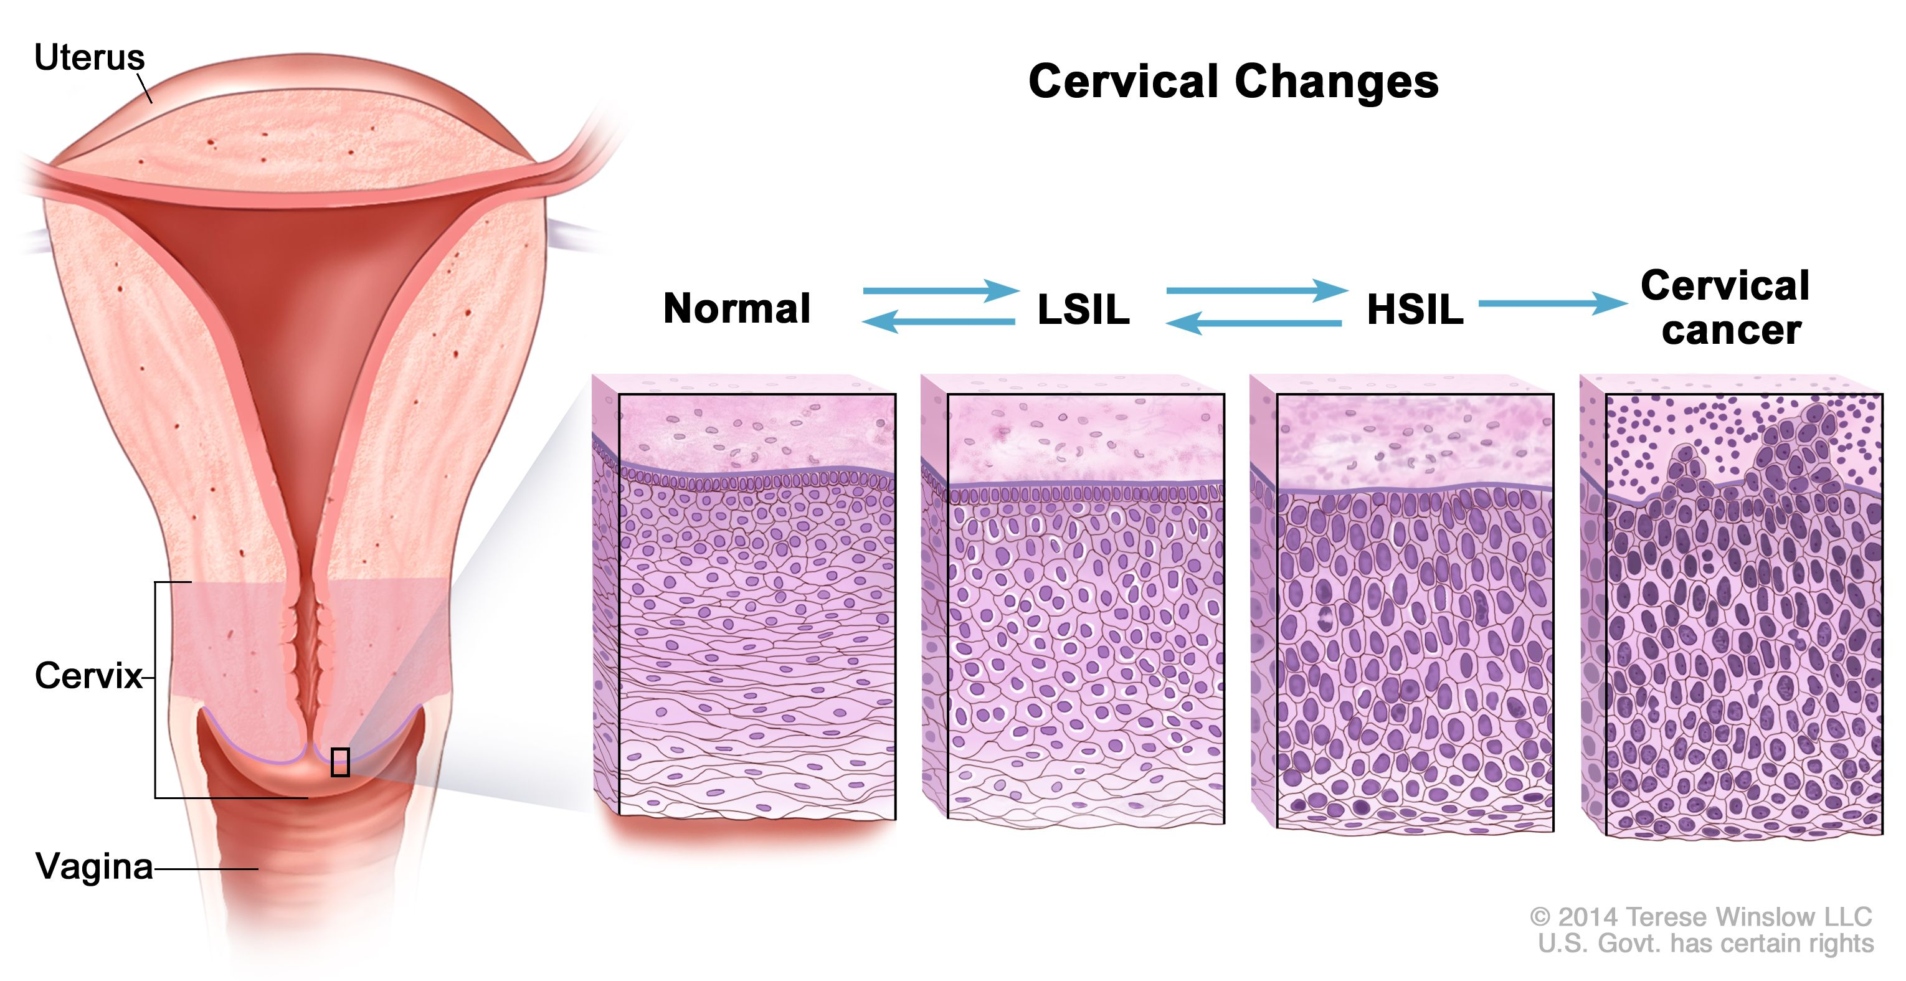

Slide 13
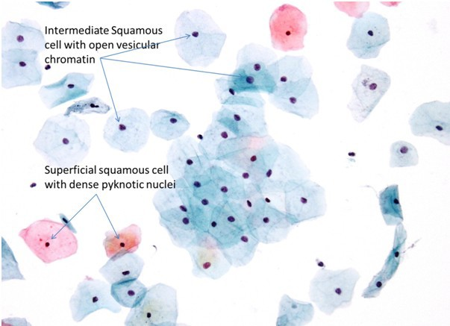
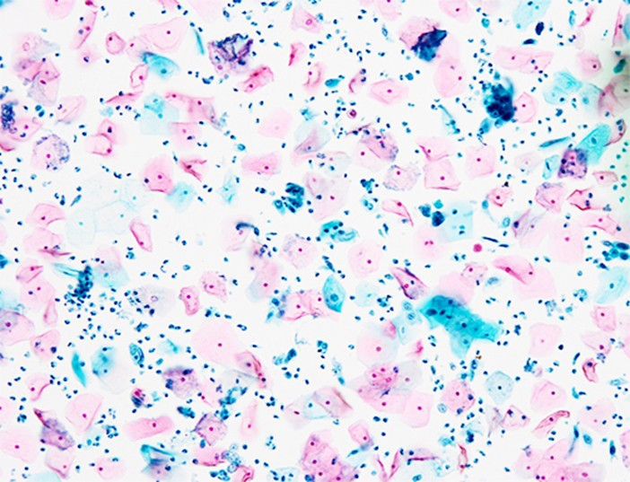
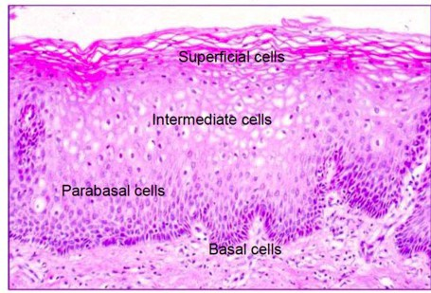
PAP stain
Pink or orange cells:
Mature, keratinized, superficial squamous cells appear pink to orange because of the eosin stain used in the Pap stain.
Blue or green cells:
Metabolically active, Less mature cells.
Intermediate squamous and parabasal cells

Slide 14
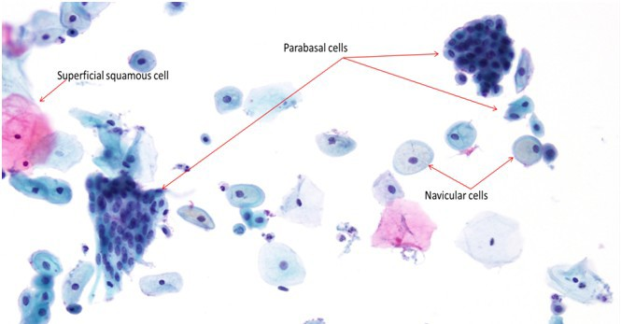
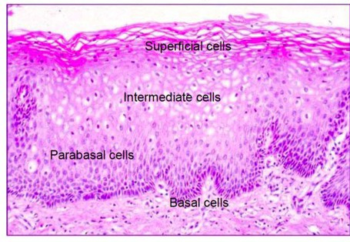
Typical appearance PAP stain:
Many basal (blue) cells
Few mature (pink) cells

Slide 15
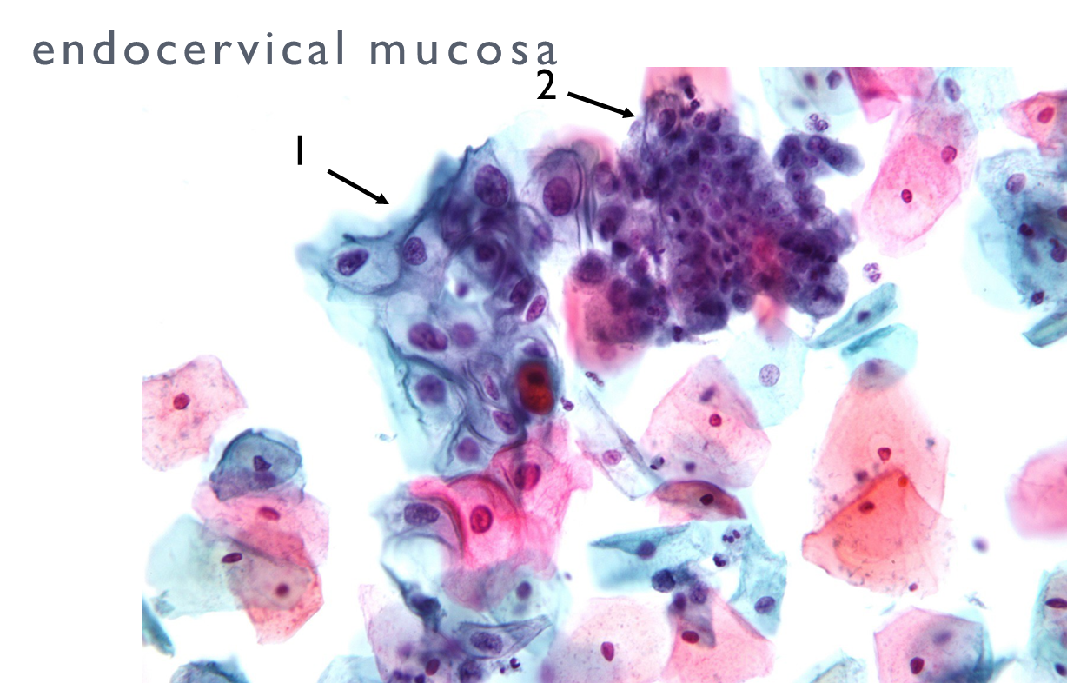
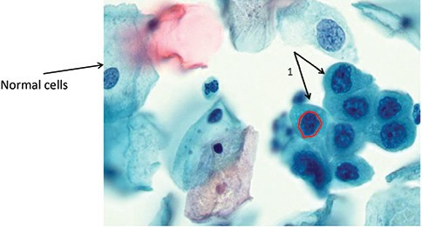
ABNORMAL CELL in PAP TEST
High-Grade Squamous Intra-epithelial Lesion (HGSIL)
low-grade intraepithelial lesion (LSIL) and
benign

Slide 16
Dysplasia – epithelial dysplasia
A disturbance of growth, which is usually considered to be pre-malignant.
Evidenced by:
Pleomorphism of cells (variation in size and shape);
Hyperchromatic nuclei and increased mitotic activity;
Loss of polarity (orientation) of cells;
Disordered maturation
No invasion

Slide 17
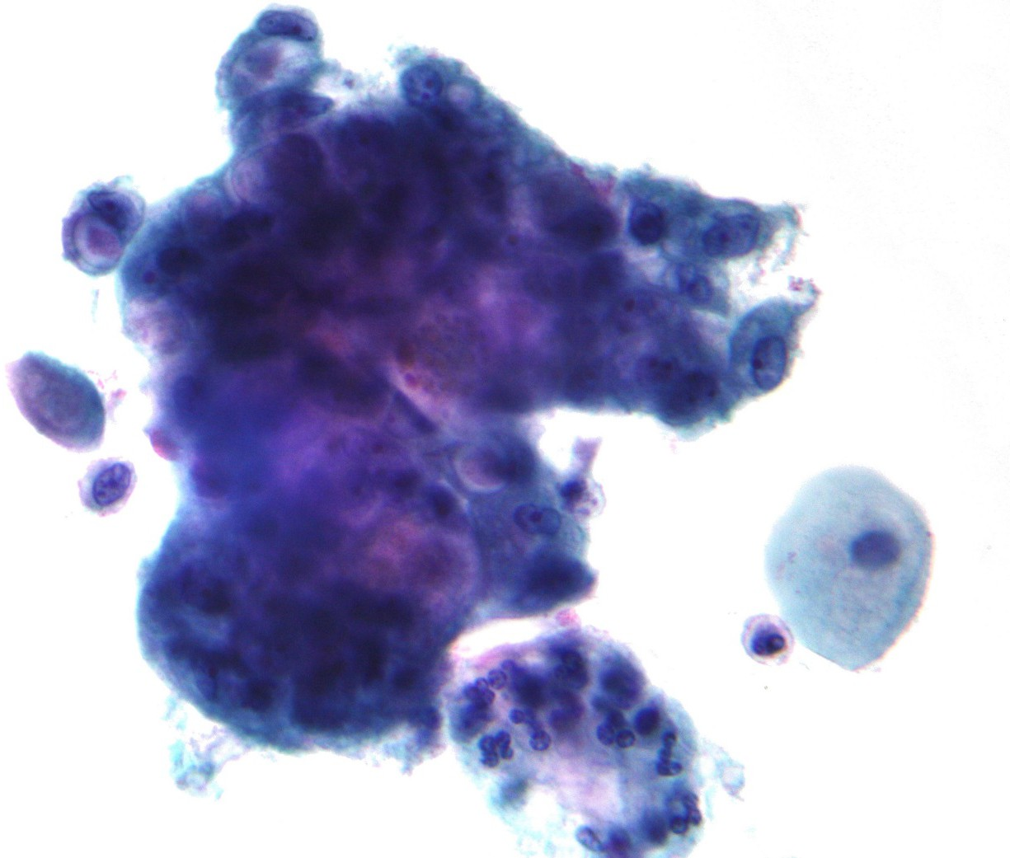
Endocervical adenocarcinoma on a pap test

Slide 18
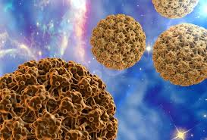
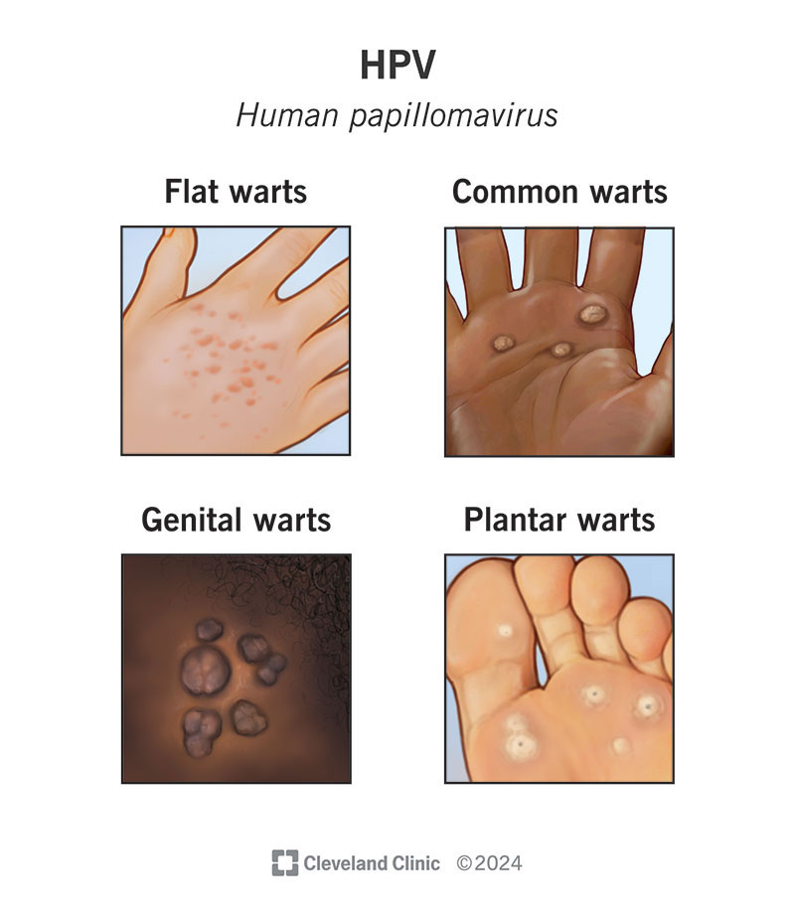
Human papilloma virus (HPV)
HPV viruses can affect:
cervix, anus, mouth and throat
More than 100 types of HPV
Around 30 types of HPV can affect the genital area
Genital HPV infections are common and highly contagious
High-risk HPV (HR-HPV) mainly genotypes 16 & 18
Low-risk HPV (LR-HPV) mainly genotypes 6 & 11
About 10% of women with cervix HPV infection will develop long-lasting HPV infections that put them at risk for cervical cancer.
National Foundation for Infectious Diseases
HPV (Human Papillomavirus) – NFID

Slide 19
Which other cancers can be detected using microscopy-based techniques
(cytology or histopathology)
Microscopy is commonly used for both screening and diagnostic confirmation.
Cervical cancer - pap smear (cervical cytology) and hpv testing for screening; abnormal cytology confirmed by colposcopy-directed biopsy and histopathology.
Skin cancer (suspicious lesions) - clinical/ dermoscopic exam followed by punch/shave/excisional biopsy and histopathology to detect melanoma, basal cell carcinoma, squamous cell carcinoma.
Oral cavity and oropharyngeal cancers - visual/oral exam plus exfoliative cytology or biopsy with histology for early lesions.
Bladder cancer - urine cytology can detect some high‑grade tumors; cystoscopy with biopsy and histopathology is diagnostic.
Colorectal cancer - colonoscopy visualizes lesions and biopsy specimens are examined by microscopy for early cancer or precancerous polyps. Gastric cancer - endoscopic inspection with forceps biopsy and histopathology.
Note: cytology (pap, urine, sputum, fnac) is often used for screening or triage; definitive diagnosis requires histology (tissue biopsy) and may need adjunct tests (immunohistochemistry, molecular tests). Sensitivity and specificity variety by cancer type and method.

Slide 20
(Contd) Which cancers can be detected using microscopy-based techniques (cytology or histopathology)
Endometrial cancer - endometrial sampling/curettage or cytology with histologic examination.
Lung cancer (selected cases) - sputum cytology has limited sensitivity; bronchoscopy with brushings/biopsy and histology is used for early detection in high‑risk patients.
Thyroid cancer - fine‑needle aspiration cytology (fnac) of nodules with cytologic assessment; surgical pathology gives definitive diagnosis.
Breast cancer - imaging-based screening (mammography) followed by core-needle biopsy or surgical excision with histopathology for microscopic diagnosis.
Lymphoma/leukemia - peripheral blood smear, bone marrow aspirate/biopsy, lymph node biopsy with microscopic and immuno-phenotypic studies.

Slide 21
Stains used for cytology/histology and adjunct methods)
Papanicolaou (Pap) stain — standard for cervical and many exfoliative cytology smears.
Hematoxylin & Eosin (H&E) — routine histology stain for tissue biopsies.
Romanowsky-type stains (Wright, Giemsa, Diff‑Quik) — commonly used for blood, bone marrow, FNAC smears, and rapid on‑site evaluation.
Fixed‑smear cytologic variants (Alcohol fixation vs air‑dry) — determines choice between Pap and Romanowsky stains.
Special stains for specific substances:
Periodic acid–Schiff (PAS) — glycogen, mucopolysaccharides, fungal elements.
Alcian blue / Mucicarmine — mucin detection (e.g., adenocarcinomas).
Choice of stain depends on specimen type, fixation, and diagnostic question.

Slide 22
Imaging techniques
(microscopy, digital imaging, and non-invasive optics)
Brightfield light microscopy — standard for H&E, pap, and romanowsky stains (routine work).
Phase‑contrast and darkfield microscopy — enhance contrast for unstained/poorly stained specimens.
Fluorescence microscopy — used with fluorescent ihc, fish, and fluorescent probes.
Confocal laser scanning microscopy — high‑resolution optical sectioning for fluorescence and reflectance imaging.
Digital whole‑slide imaging / whole‑slide scanners — create high‑resolution digitized slides for remote review and ai analysis.
Automated cytology screening systems / image analysis platforms — e.G., Thinprep imager, focalpoint, ai-based slide triage that scan slides and highlight suspicious fields.
Image cytometry / quantitative digital image analysis — nuclear morphometry, dna ploidy analysis, automated feature extraction.
Note: digital/automated imaging enables high‑throughput screening and ai‑assisted triage but still relies on appropriate staining and quality specimen preparation.

Slide 23
(Cont) Imaging techniques
(microscopy, digital imaging, and non-invasive optics)
Flow cytometry — for hematologic malignancies (immunophenotyping), not slide‑based but complementary.
Multispectral and hyperspectral imaging — spectral unmixing for multiple fluorophores or label‑free contrast (research/advanced labs).
Reflectance confocal microscopy and optical coherence tomography (oct) — in vivo, noninvasive imaging for some skin/oral lesions (adjuncts to biopsy).
Narrow‑band imaging / video endoscopy and probe‑based confocal endomicroscopy — enhanced endoscopic visualization to guide biopsy.

Slide 24
Can we Detect pre-cancerous or cancerous cells by automated cytology analysis
Yes, mostly using it for cervical cancer screening !
Automated screening systems (e.G., Thinprep imaging system, focalpoint, various AI slide scanners) are widely used to scan pap smears and flag any abnormal fields on the slide for the cytotechnologist to review.
This is the primary, validated clinical use of automated cytology for precancerous/cancerous cell detection.
Well established! Cervical cytology is the only broadly validated, widely implemented automated cytology screening program.

Slide 25
Can we Detect of pre-cancerous or cancerous cells by automated cytology analysis
Which other Cancers?
Emerging Use
      anal cancer, urinary bladder cancer, oral cancer
For these specimen types, automated/AI cytology is largely adjunctive, pilot-stage, or combined with molecular tests
Anal cancer cytology for high‑risk populations is sometimes processed with automated/ai-assisted slide evaluation to improve sensitivity. Follow-up high‑resolution anoscopy/biopsy
Bladder ca: digital image analysis and ai-assisted cytology platforms are being used in some labs to screen urine cytology to flag atypical/high‑grade lesions; with molecular tests
Oral ca: commercial (computer-assisted/AI systems) oral cytology are adjunctive and exist to screen exfoliative samples, but they are not universally adopted and generally used as adjuncts to clinical exam/biopsy.

Slide 26
Can we Detect of pre-cancerous or cancerous cells by automated cytology analysis
Which other Cancers?
STILL IN RESEARCH
Limited use so for : respiratory/ sputum cytology , thyroid FNAC
Respiratory/sputum cytology (research/limited use): automated image analysis and ai prototypes have been tested for sputum cytology but are not widely implemented for routine population screening.
Thyroid fnac and other cytology specimens (research/implementation in some labs): digital slide scanners and ai models are increasingly applied, but histopathology/molecular testing remain central for indeterminate cases.
Opportunities exist !

Slide 27
End

Slide 28
More specificity
Immunocytochemistry / Immunohistochemistry (IHC) —
                For cell lineage and tumor‑specific markers
                (e.g., TTF‑1, PAX8, thyroglobulin, CK7/CK20, p16, Ki‑67, S100, HMB‑45).
  Molecular cytogenetics/ In situ hybridization :
  FISH (fluorescence in situ hybridization) — chromosomal rearrangements, HER2, ALK, etc.
  Chromogenic ish (cish) — colorimetric alternative to fish.
  Rna/dna ish assays for viruses or gene expression.
  Molecular assays on cytology material — pcr, ngs panels, mutation/fusion testing (e.G., Genes BRAF, RAS, RET, EGFR) used adjunctively.
  Note: ihc, fish, and molecular tests are increasingly performed on cytology material (cell blocks or liquid‑based preparations)

