Slide 1
Challenges and Opportunities:
Cancer cell heterogeneity
Resistance to Therapy
Colorectal Cancer

Slide 2
First :
A clinical look at a cancer-
Colorectal Cancer

Slide 3
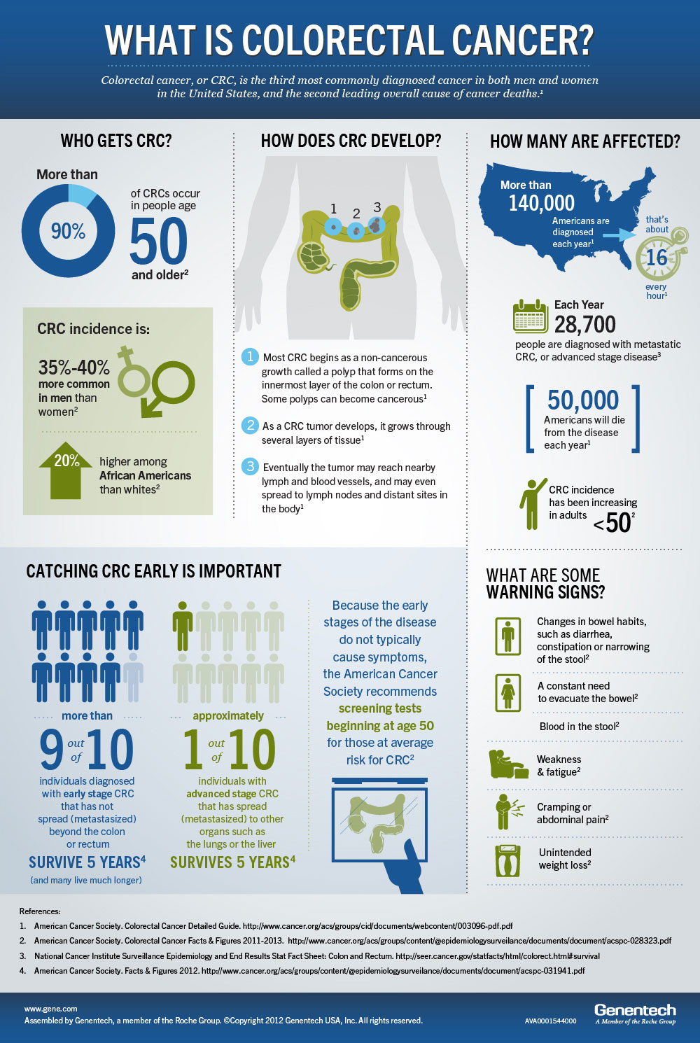
A clinical look at Colorectal Cancer

Slide 4
Epidemiology and Risk Factors
Insights
Prevalence Surge
1
01
Colorectal cancer cases increase by 20% yearly.
2
Age Risk
75% of cases found in individuals aged 50+.
3
Diet Impact
High-fat diets increase cancer risk significantly.

Slide 5
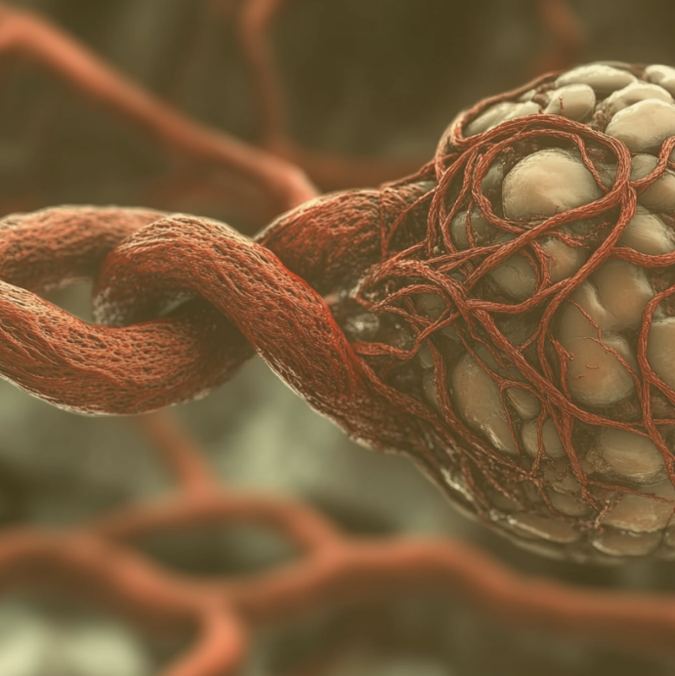
Pathophysiology of Colorectal Cancer
01
Genetic Mutations
04
Metastasis Mechanisms
Critical mutations drive the initiation of colorectal cancer progression.
Understanding metastasis pathways aids in targeted therapy development.
02
Tumor Microenvironment
05
Immune Evasion
Alterations in the microenvironment promote tumor growth and invasion.
Tumors develop strategies to evade immune system detection and response.
03
Inflammation Role
06
Clinical Biomarkers
07
Screening Strategies
Chronic inflammation contributes to increased cancer risk and progression.
Identifying biomarkers enhances diagnosis and treatment decisions.
Regular screenings are vital for early detection and improved outcomes.

Slide 6
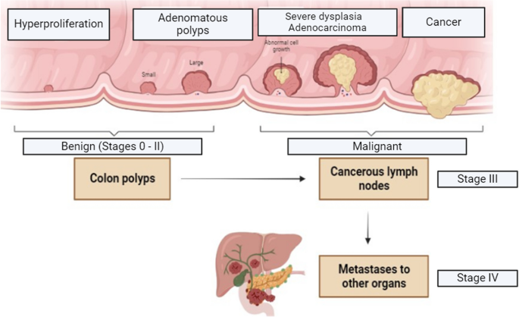

Slide 7

01
02
03
KRAS
NRAS
04
TP53
Mutations lead to uncontrolled cell proliferation and survival.
Altered signaling pathways contribute to tumor progression.
Loss of function increases genomic instability and malignancy.
PIK3CA
05
Activating mutations involved in growth and metabolism deregulation.
BRAF
06
V600E mutation associates with poor prognosis in colorectal cancer.
Mismatch Repair
Deficiency results in microsatellite instability and targeted therapies.
Genetic Mutations in Colorectal Cancer

Slide 8



Tumor Microenvironment and Immunology
Cellular
Vascular
Cells in the tumor create an environment.
Blood vessels supply nutrients to the tumor.
01
02
Ecosystem
Immune
The entire system influences tumor behavior.
06
03
Immune cells interact with tumor cells.
05
04
Signaling
Metabolic
Metabolic processes fuel tumor development.
Signals guide tumor growth and progression.

Slide 9
Pathological Classification of Colorectal Cancer
Colorectal Cancer Types
Adenocarcinoma
Carcinoid
Lymphoma
Most common type of colorectal cancer.
Neuroendocrine tumors of the gastrointestinal tract.
Cancer originating in the lymphatic system.

Slide 10




Clinical Manifestations and Symptoms
Abdominal Pain
Change in Bowel
Often intermittent, this pain can vary in intensity and location.
This may include diarrhea, constipation, or change in stool caliber.
Rectal Bleeding
Weight Loss
Blood may be visible in stool or on toilet paper during bowel movements.
Unexplained weight loss without any noticeable diet or exercise changes.
Fatigue
Nausea
Bloating
Patients often report a persistent feeling of tiredness or lack of energy.
This may be accompanied by vomiting and reduced appetite in some cases.
Patients frequently experience feelings of fullness or abdominal distension.

Slide 11

Diagnostic Imaging Techniques in Colorectal Cancer
MRI
Ultrasound
Useful in evaluating tumor invasion in peritoneal and pelvic regions.
Helpful in detecting liver lesions and guiding biopsies for diagnosis.
02
03
CT Scan
PET Scan
Effective for staging and identifying metastases in colorectal cancer.
Assists in assessing cancer recurrence and metabolic activity of tumors.
01
04

Slide 12

Biomarkers for Screening and Prognosis
 | Type | Specimen | Sensitivity | Specificity | Usage | Clinical Benefit
CEA | Tumor Marker | Blood | 70% | 80% | Monitoring | Recurrence indication
KRAS | Genetic Mutation | Tumor | 45% | 90% | Targeted therapy | Predicts response
MSI | Molecular Signature | Tissue | 50% | 85% | Prognostic tool | Survival insight
NCCN | Guideline Criteria | Clinical | Variable | Variable | Risk assessment | Treatment decisions
01
02
03
Summary Points
CEA Levels
KRAS Mutation
MSI Status
Elevated CEA signifies advanced disease progression.
Presence indicates resistance to specific therapies.
High MSI correlates with better immunotherapy response.

Slide 13
Treatment Options by Stage:
Stage 0: Removal of the polyp during colonoscopy.
Stage I-II: Surgery (colectomy) with or without chemotherapy.
Stage III: Surgery, chemotherapy, and possibly immunotherapy.
Stage IV: Chemotherapy, immunotherapy, and possibly targeted therapy.

Slide 14

Staging and Grading of Colorectal Cancer
Snapshot
Stage IV Prevalence
01
20% of patients are diagnosed at advanced stage.
Grading Impact
02
15% have poorly differentiated tumors, affecting prognosis.
Stage II Diagnosis
03
25% diagnosed at this moderate stage requirement.

Slide 15

01
02
Surgical Options
03
Various surgical techniques available for colorectal cancer treatment.
Preoperative Assessment
Thorough evaluation of patient health before surgical intervention.
Minimally Invasive
04
Laparoscopic surgeries offer reduced recovery times and scarring.
Postoperative Care
Monitoring and support are crucial for optimal recovery post-surgery.
05
Long-term Follow-up
Regular assessments needed to monitor for recurrence of cancer.
Treatment Modalities: Surgery Overview

Slide 16
Chemotherapy Regimens for Colorectal Cancer
 | FOLFOX | XELOX | FOLFIRI | CAPOX | Single Agent
Regimen | Oxaliplatin + 5-FU | IV | 30-50% response | Neutropenia, diarrhea | Text Here
Administration | Capecitabine + Oxaliplatin | Oral/IV | 40-60% response | Fatigue, neuropathy | Text Here
Efficacy | Irinotecan + 5-FU | IV | 30-50% response | Nausea, vomiting | Text Here
Side Effects | Oxaliplatin + Capecitabine | IV/Oral | 35-55% response | Diarrhea, hand-foot syndrome | Text Here
01
02
03
Highlights
Efficacy
Side Effects
Administration
FOLFOX shows a 30-50% response rate.
Neutropenia prevalent in FOLFOX regimens.
XELOX can be given orally for convenience.

Slide 17

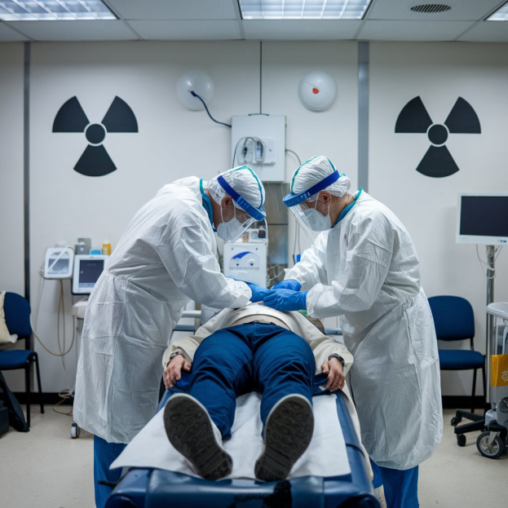
Radiation Therapy in Colorectal Cancer
Treatment
Effective for localized advanced colorectal tumors before surgery.
01
Combination
02
Often used alongside chemotherapy for enhanced effectiveness.
Precision
03
Utilizes targeted techniques to minimize damage to surrounding tissues.
Side Effects
04
Potential adverse effects include skin irritation and fatigue during treatment.
05
Follow-Up
Regular monitoring required post-treatment for early detection of recurrence.

Slide 18
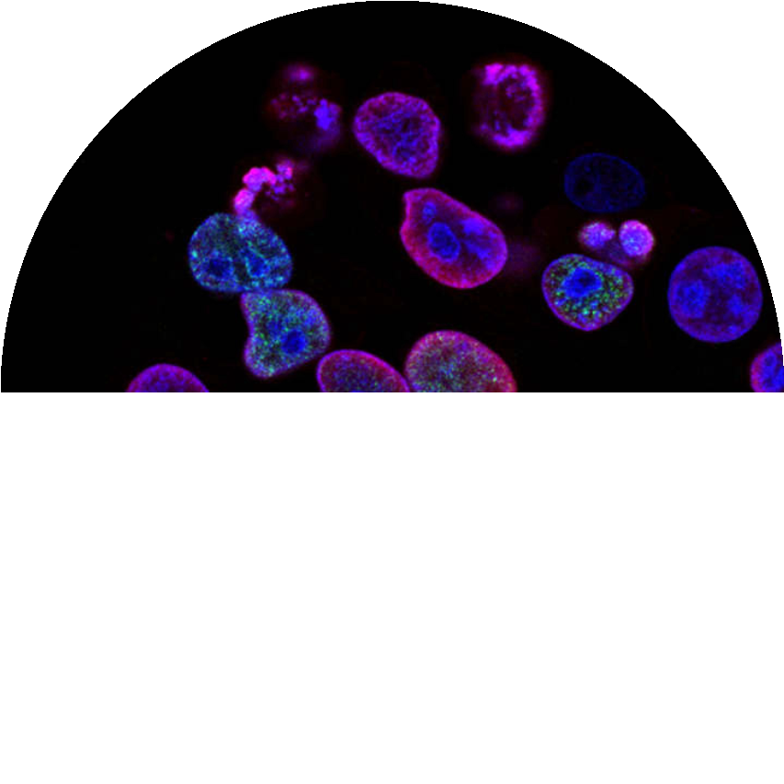
Targeted Therapies and Novel Agents
Immunotherapy
Utilizes the immune system to identify and destroy cancer cells effectively.
TKIs
Combination Therapy
Tyrosine kinase inhibitors reduce tumor growth and spread efficiently.
03
Combines therapies to enhance effectiveness and minimize resistance.
02
04
MABs
Clinical Trials
Monoclonal antibodies targeting specific cancer cell markers effectively.
Ongoing research evaluating new agents and treatment strategies actively.
01
05

Slide 19
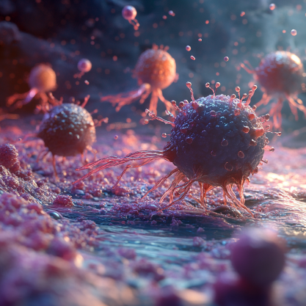

Immunotherapy Approaches in Colorectal Cancer
Checkpoint Inhibitors
01
Enhances T-cell response against tumor cells effectively.
Microsatellite Instability
02
Identifies patients likely to respond to specific therapies.
CAR T-Cell Therapy
03
Customized T-cells target and eliminate colorectal cancer.
04
Combination Treatments
Utilizes synergy of immunotherapy with traditional chemotherapy.

Slide 20

Palliative Care and Supportive Measures
Pain
Implement effective pain management strategies for improved comfort.
01
Nutrition
02
Tailor dietary plans to enhance nutrition and maintain strength.
Psychosocial
03
Provide emotional support to alleviate anxiety and depression.
Mobility
04
Encourage physical activity as tolerated to improve quality of life.
Communication
05
Foster open dialogue about treatment goals and end-of-life planning.
06
Support
Connect patients with support groups for shared experiences and resources.

Slide 21


Survivorship and Long-Term Outcomes
01
Monitoring
04
Follow-Up Care
Regular assessments to detect recurrences are crucial for management.
Structured follow-up care plans improve long-term health outcomes significantly.
02
Nutrition
05
Exercise Regimen
A balanced diet to support recovery and prevent complications is essential.
Incorporating physical activity aids in regaining strength and improving quality of life.
03
Psychological Support
06
Patient Education
Counseling services can help address mental health challenges faced by survivors.
Providing information empowers survivors in managing post-treatment care effectively.

Slide 22


Quality of Life Considerations
01
Emotional
04
Social
Support networks can improve mental health and reduce anxiety levels.
Maintaining social interactions helps combat feelings of isolation.
02
Dietary
05
Symptom
Balanced diets promote better recovery and overall well-being.
Effective symptom management can greatly enhance daily life.
03
Physical
06
Financial
07
Psychosocial
08
Follow-up
Regular exercise can enhance physical strength and stamina.
Understanding financial resources can reduce stress for patients.
Counseling services can assist in coping with chronic illness effects.
Regular follow-ups ensure timely intervention and promote health monitoring.

Slide 23

Future Directions in Research and Therapy
01
Genetic Biomarkers
Identification of specific genetic markers can lead to personalized therapy approaches, improving patient response and survival rates in colorectal cancer treatments.
02
Innovative Therapies
Development and clinical validation of novel drug combinations and immunotherapies that target colorectal cancer more effectively based on tumor biology and progression.
03
Preventive Strategies
Implementing population-based screening programs and lifestyle intervention strategies can significantly reduce risk factors associated with colorectal cancer onset and progression.

Slide 24
01
02
Informed Consent
Patient Autonomy
03
Ensure patients understand treatment options and risks involved.
Respect patient's choices even if they differ from recommendations.
Equitable Access
Strive for equal treatment opportunities regardless of background.
04
End-of-Life Options
Discuss palliative care options to improve quality of life.
Ethical Considerations in Treatment

Slide 25




Case Studies: Success Stories
Problem Faced
Patients struggle with late-stage colorectal cancer diagnosis.
Solution Offered
Implementation of routine screening programs nationwide.
Benefits
Earlier detection leads to improved patient outcomes.

Slide 26






Patient Education and Engagement Strategies
John
Sara
Nurse Educator
Patient Advocate
Mike
Emma
Oncology Specialist
Research Assistant
Liam
Olivia
Health Coach
Social Worker

Slide 27

Conclusion and Key Takeaways
Understand Risk Factors
Screening Importance
Identifying risk factors can aid in early intervention for colorectal cancer.
Regular screenings are crucial for early detection and better treatment outcomes.
Genetic Mutations
Treatment Options
Certain genetic mutations significantly increase the risk of colorectal cancer.
A variety of treatment modalities exist, including surgery, chemotherapy, and radiotherapy.
Symptom Awareness
Lifestyle Modifications
Being aware of symptoms helps in prompt medical attention and improved prognosis.
Adopting healthy lifestyle changes can reduce the risk of developing colorectal cancer.

Slide 28
A preclinical story :
NOSH-Aspirin Inhibits the Growth of MIA PaCa2 Human Pancreatic Cancer Cells in a Mouse Xenograft

Slide 29
NOSH-Aspirin Inhibits the Growth of MIA PaCa2 Human Pancreatic Cancer Cells in a Mouse Xenograft
Protocol
Inoculation
NOSH-ASA
1st Volume Recorded
Sacrifice
10 days
3 days
30 days

Slide 30
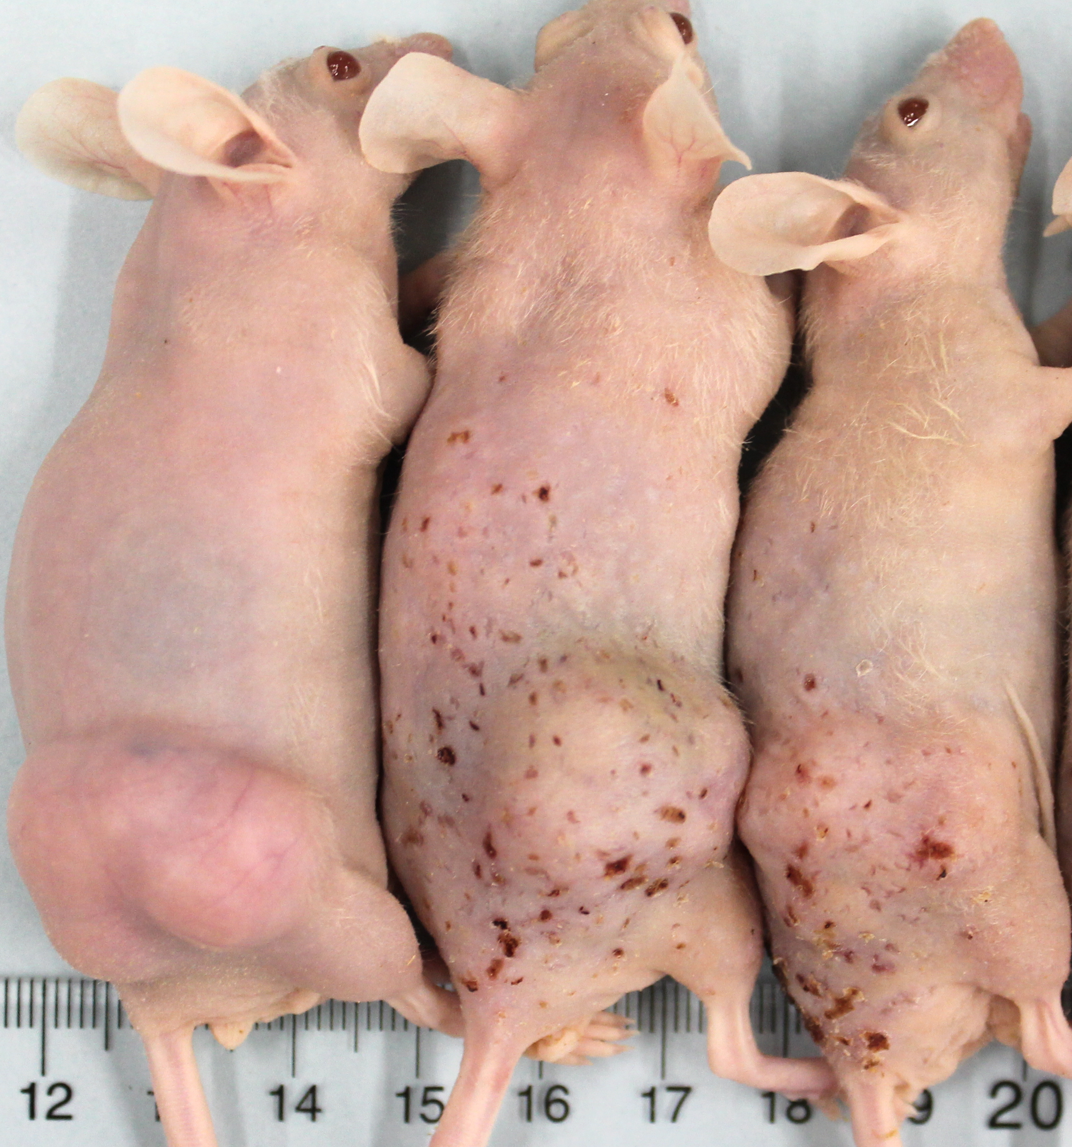
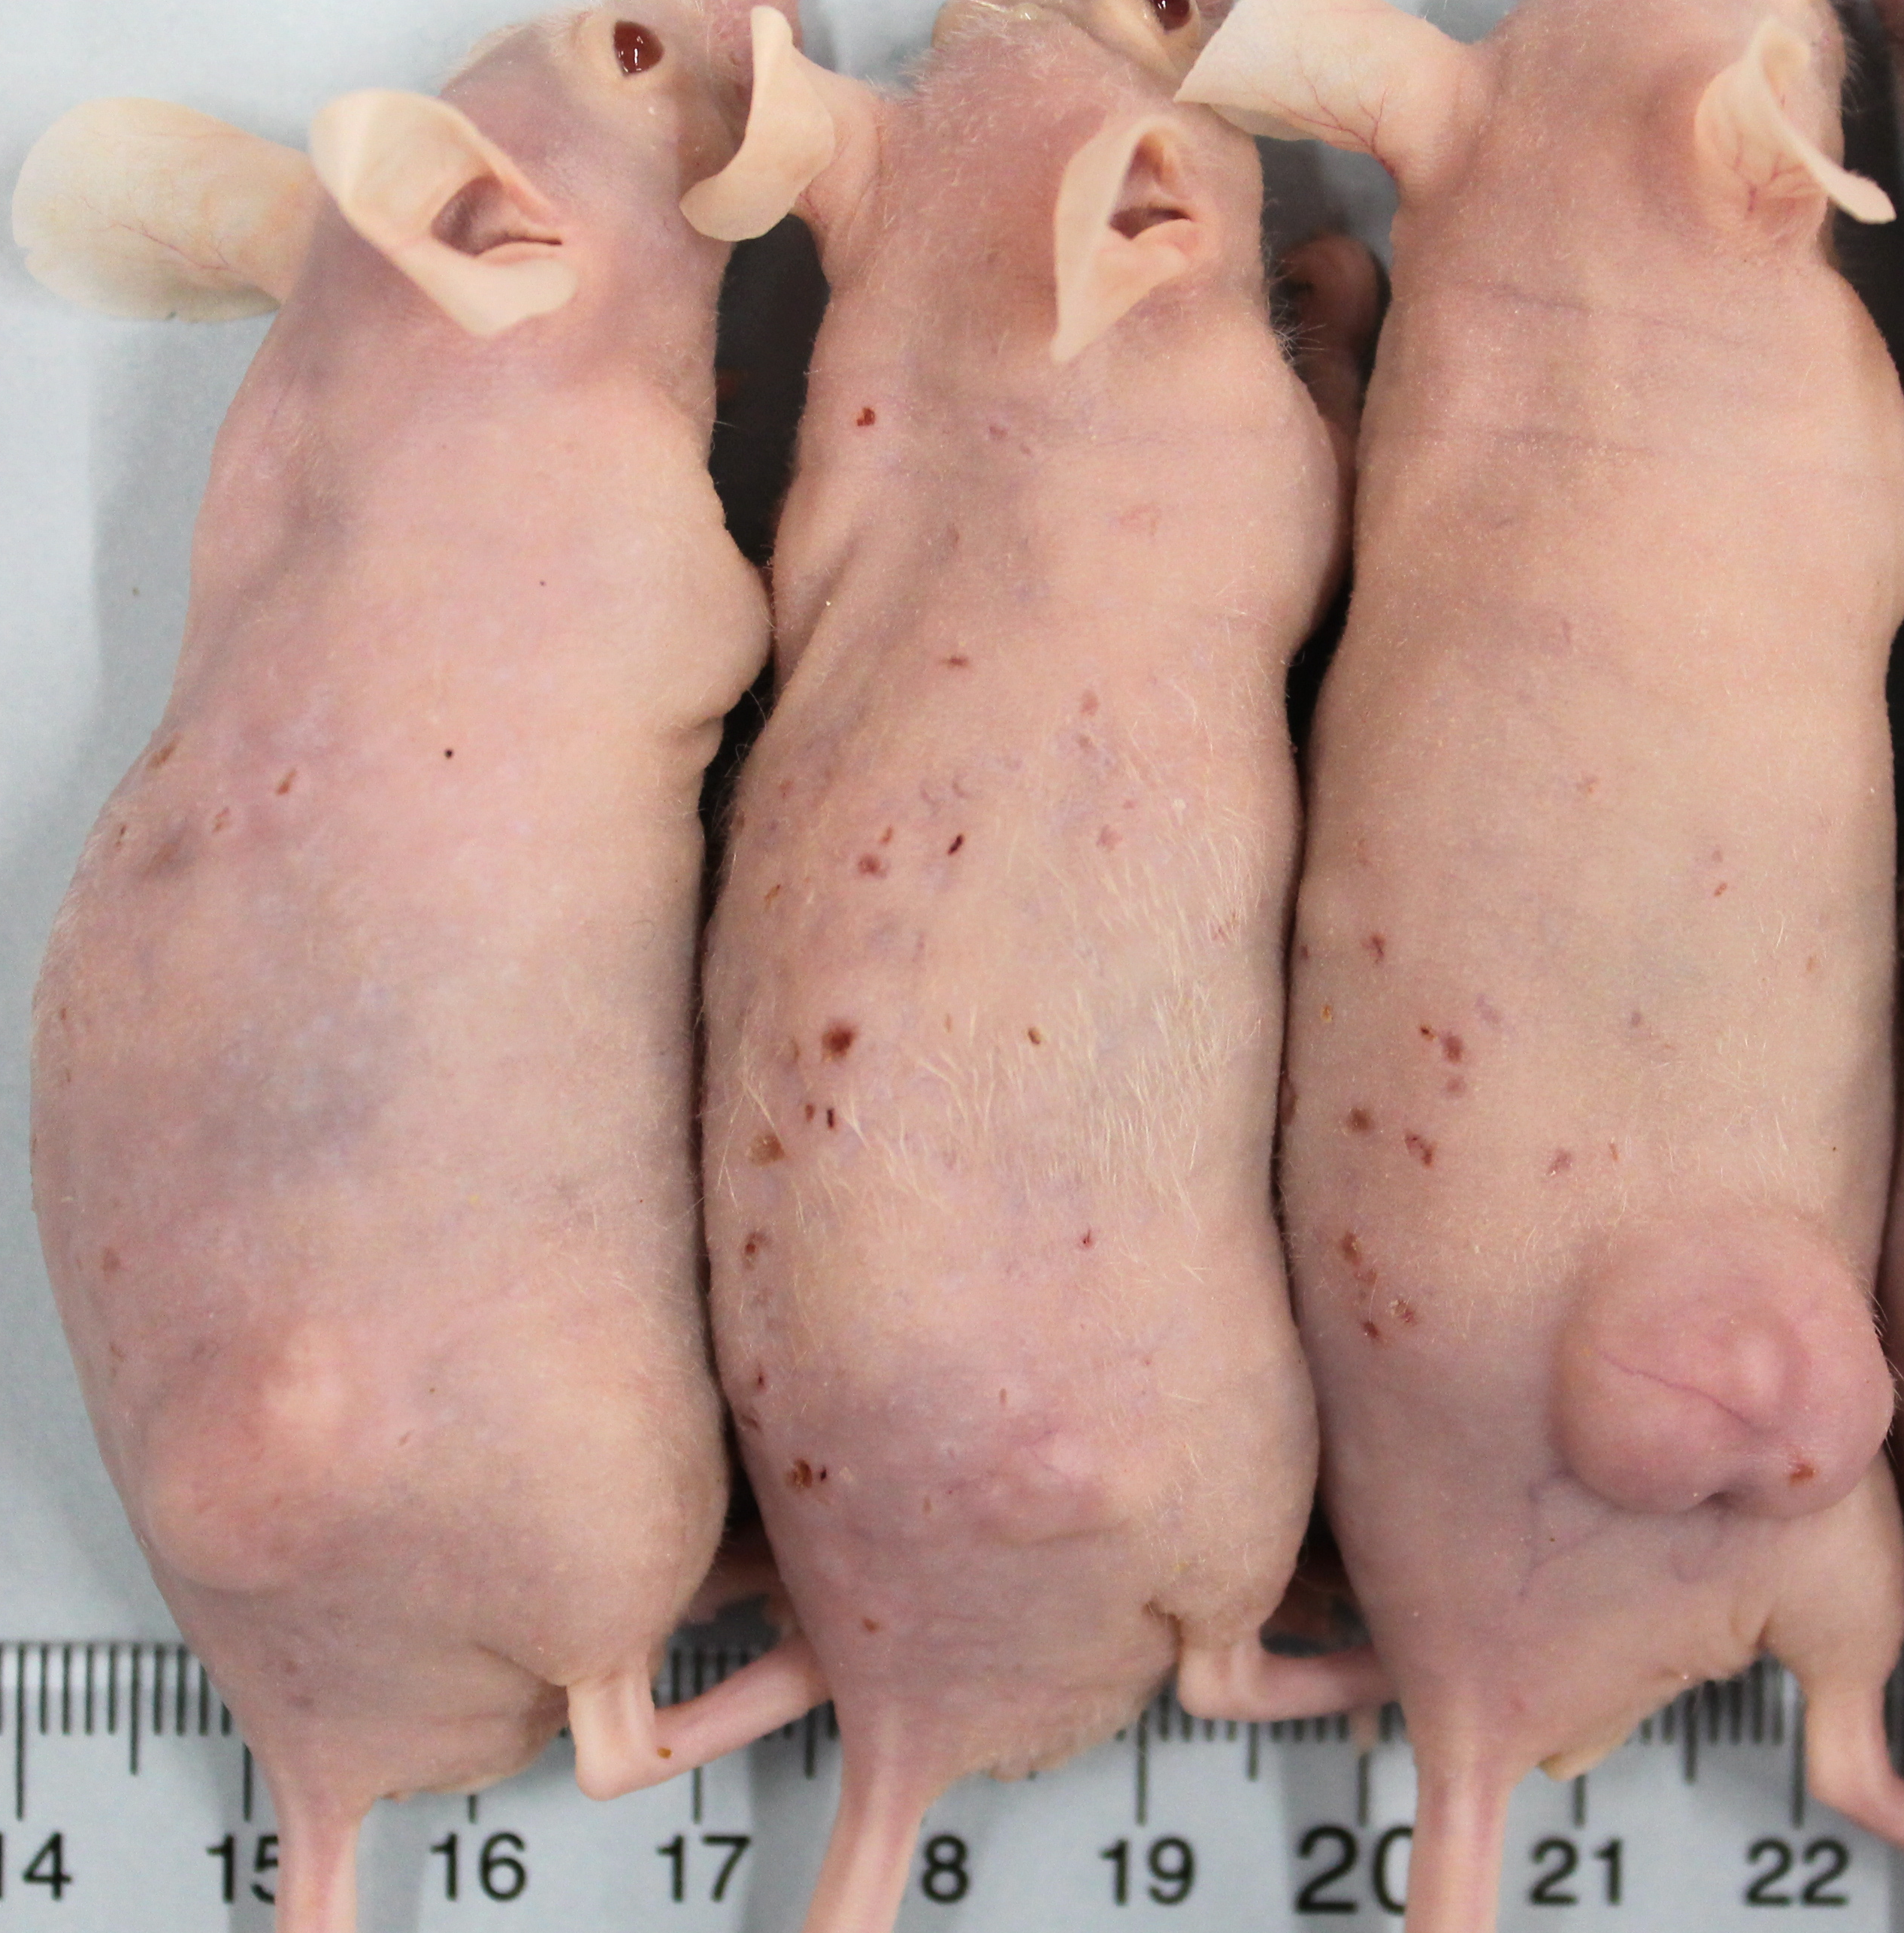
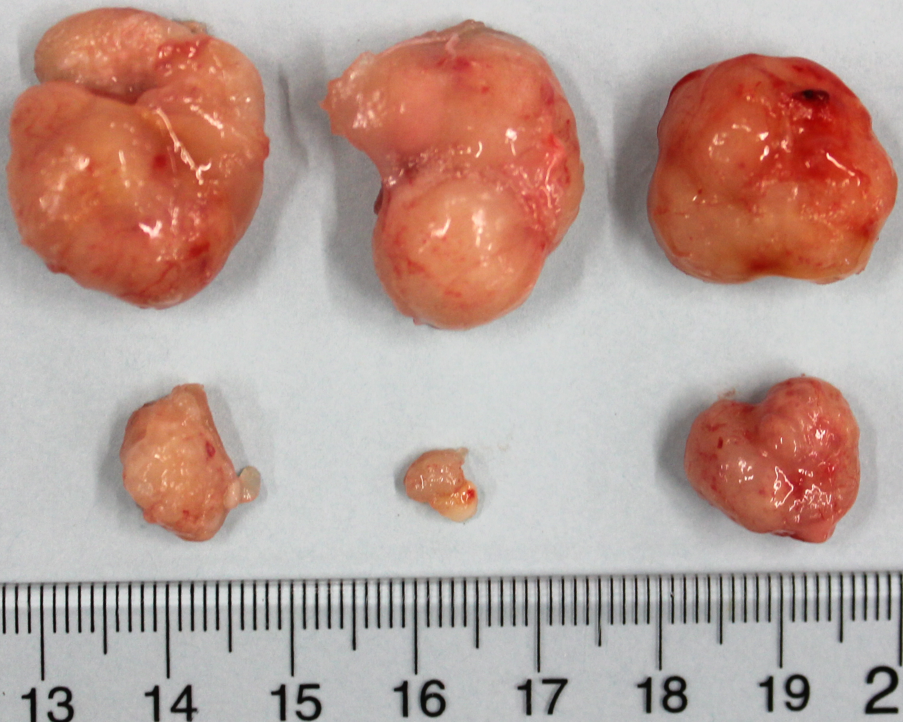
4000
400
3500
300
3.0
P = 0.003
Volume, mm³
200
3000
100
2.5
0
2500
0
3
6
9
12
15
18
21
24
27
30
2.0
Average Tumor Volume, mm³
Days of Treatment
75%
2000
Tumor Mass, g
Vehicle
1.5
1500
NOSH-aspirin
1.0
1000
500
0.5
*
0
0.0
0
3
6
9
12
15
18
21
24
27
30
Control
NOSH-ASA
Days of Treatment
Treatment

Slide 31
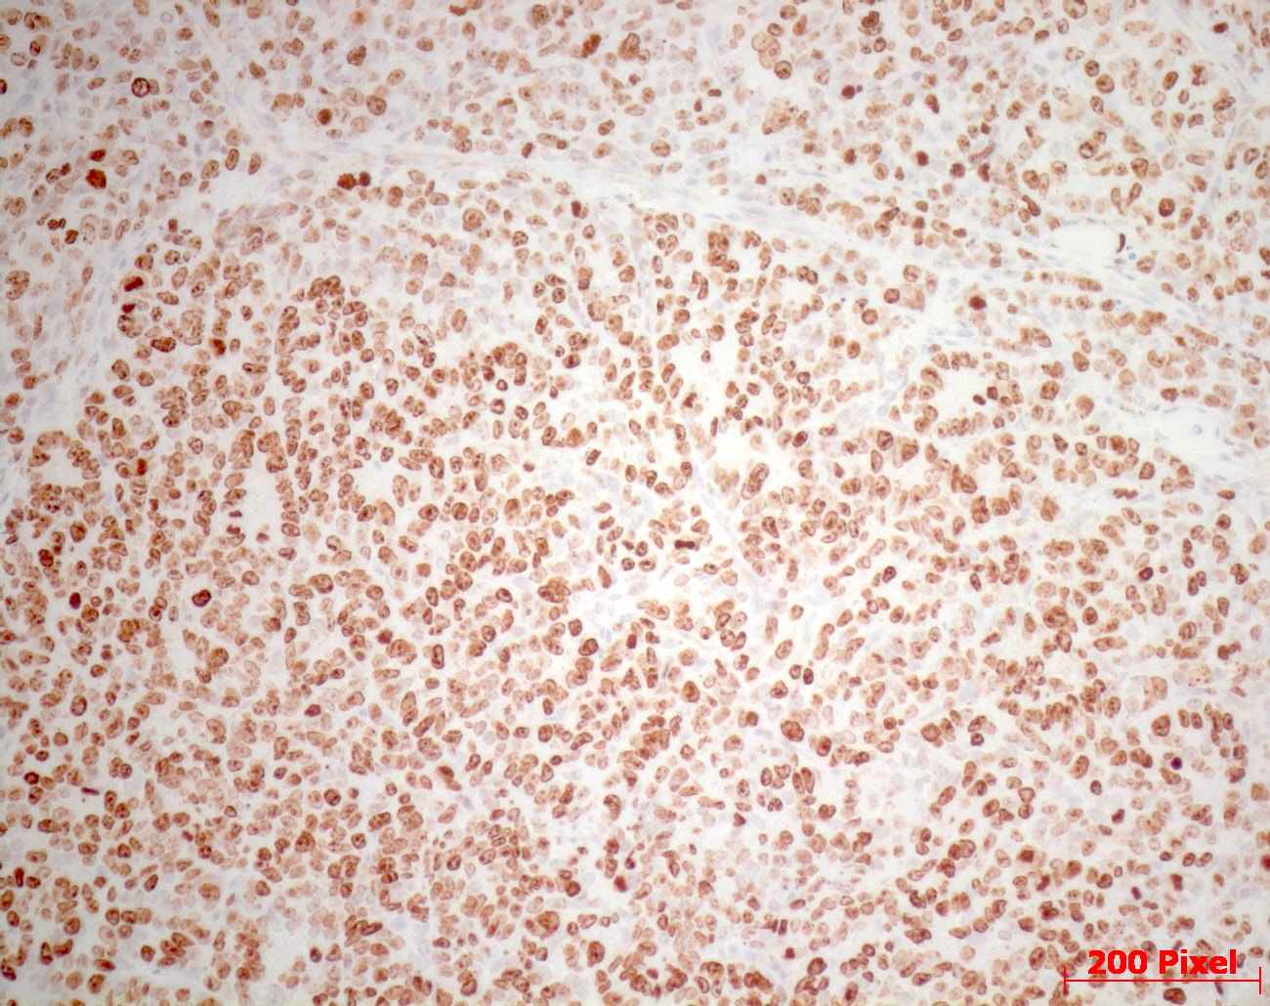
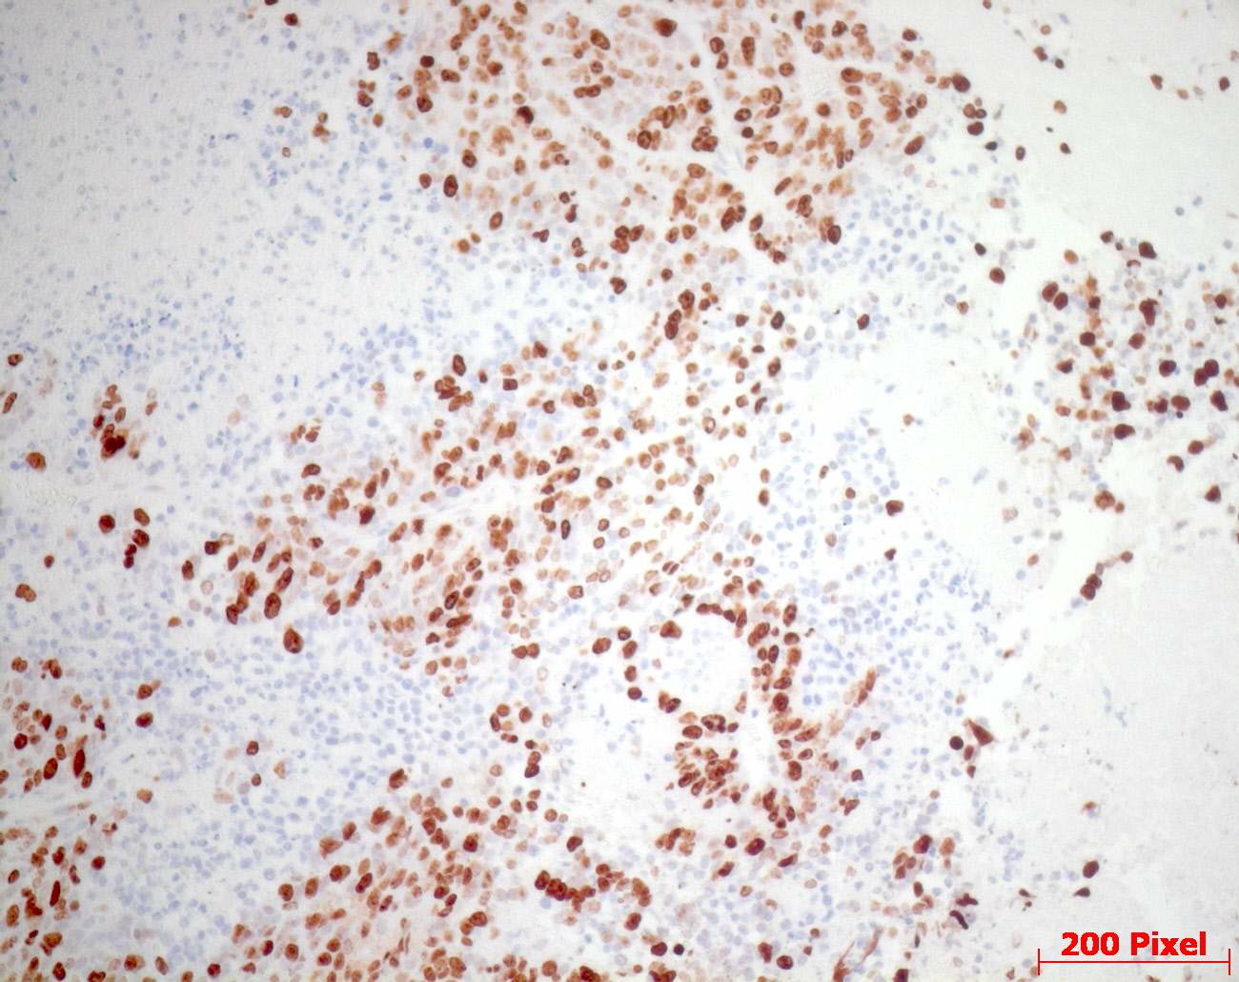
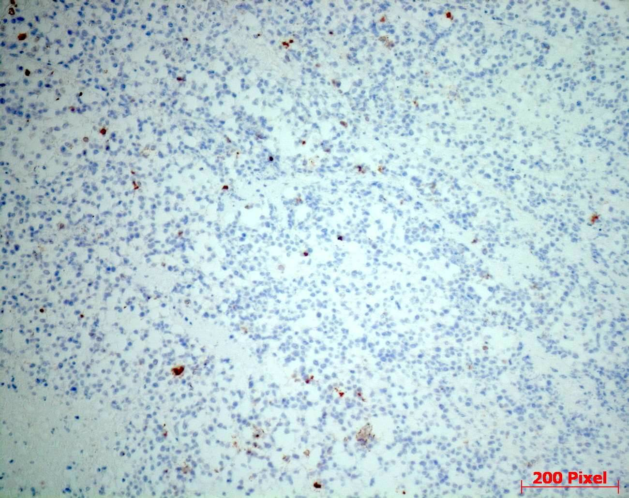
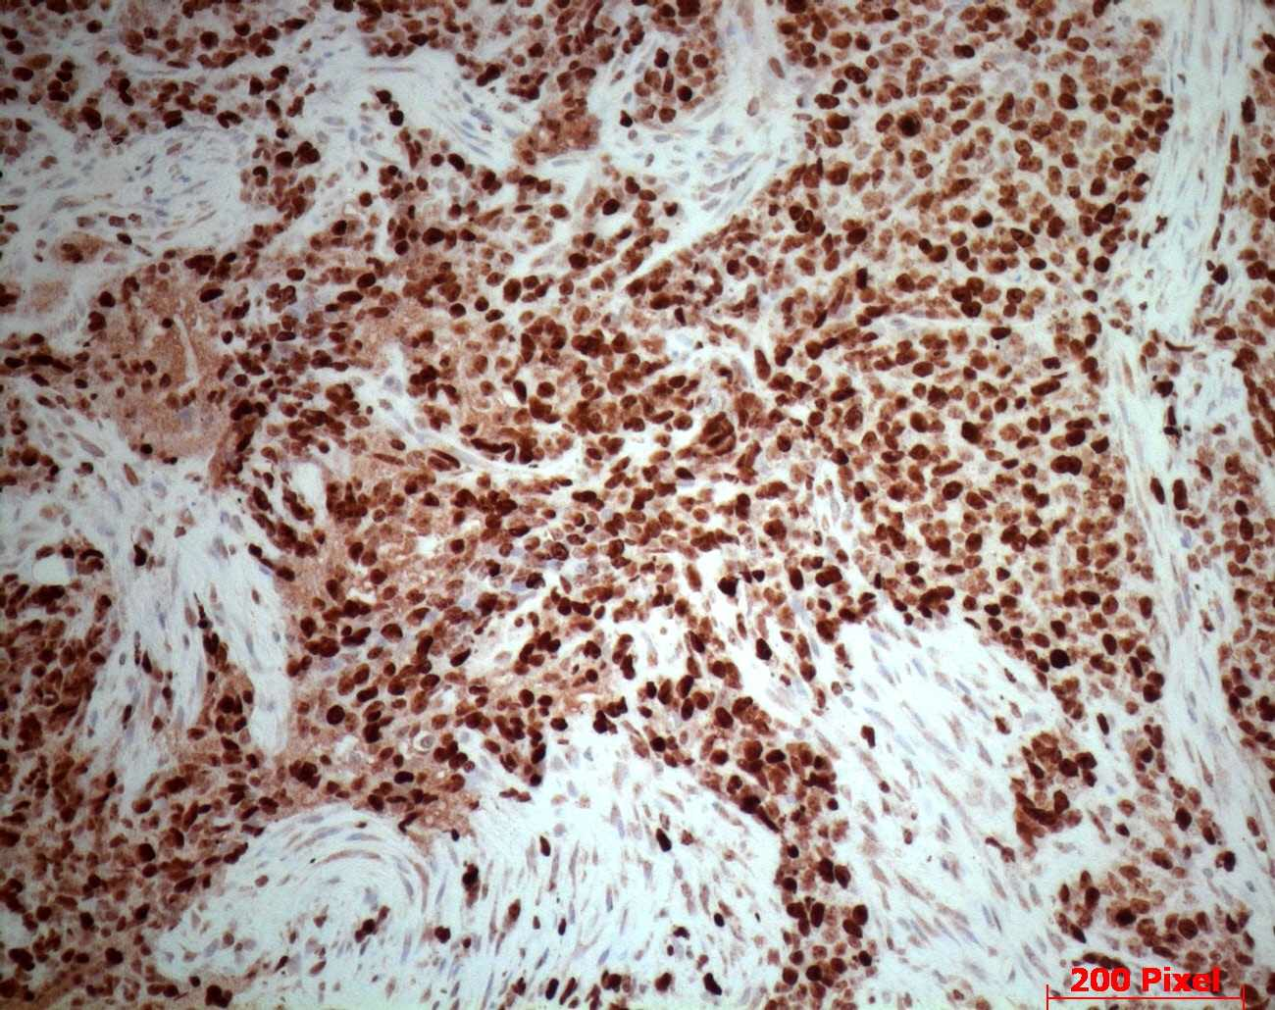
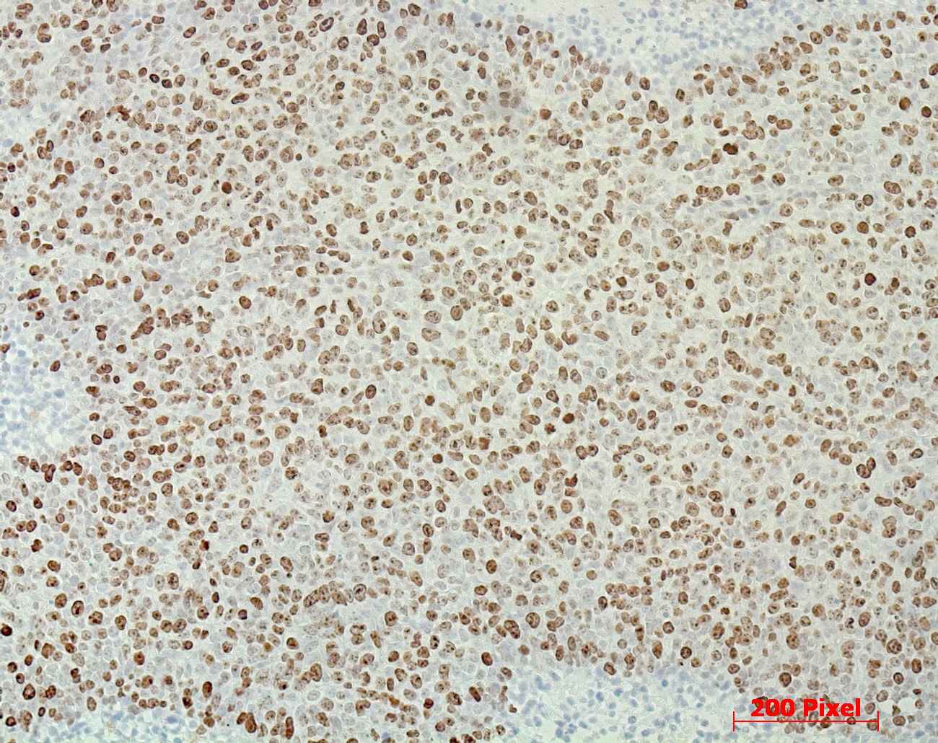
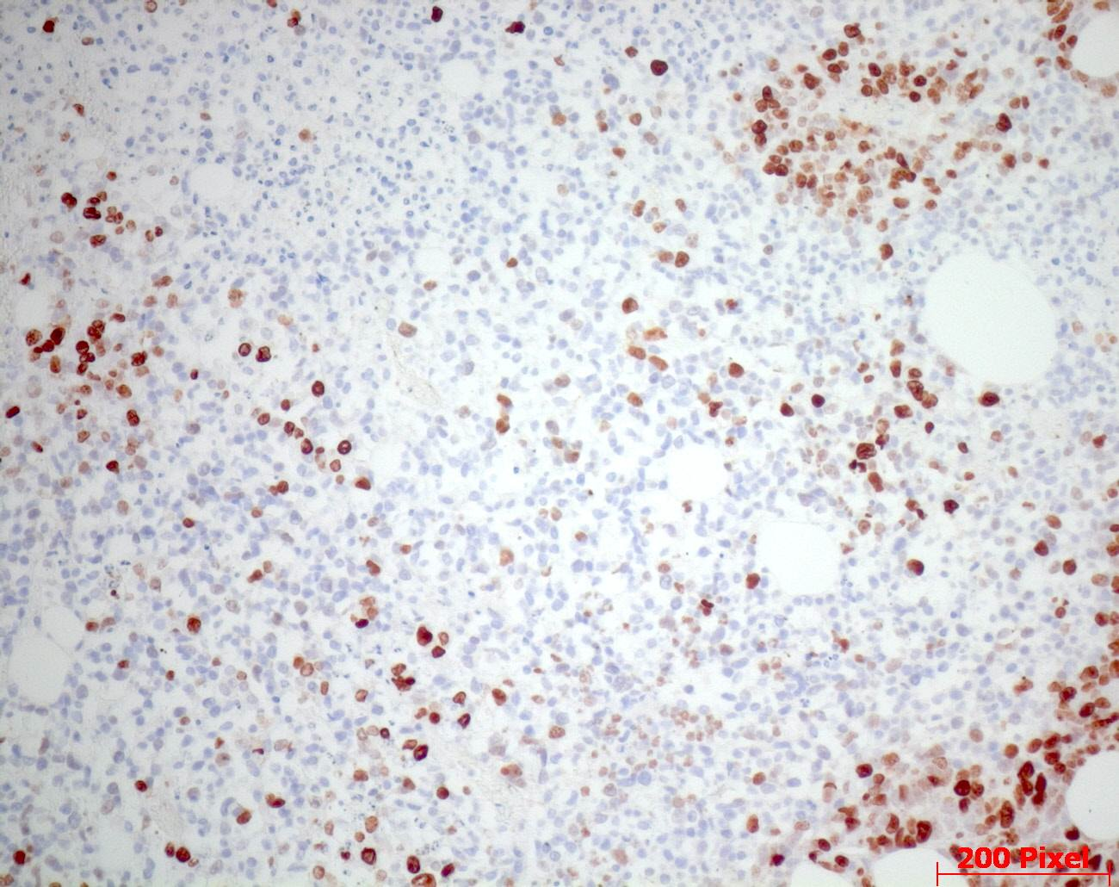
Vehicle
NOSH-ASA
78.4 ± 8%
25.2 ± 3%
Proliferation
3.4 ± 0.3%
83.9 ± 3%
Apoptosis
63.6 ± 7%
14.7 ± 3%
NF-κB

Slide 32
Cancer cell Heterogeneity
Resistance to Therapy
Colorectal cancer
exhibits significant cancer cell heterogeneity
and shows resistance to therapy.
Intra-tumoral heterogeneity arises from genetic and epigenetic differences among cancer cell subpopulations, including cancer stem-like cells (CSCs). These diverse populations differ in proliferation, invasion, and drug sensitivity.

Slide 33
Heterogeneity by cancer stem-like cells
Cellular-state heterogeneity by cancer stem–like cells, with metabolic variability.
They are small subpopulations with stemness or altered metabolism that survive therapy and seed recurrence - important in glioblastoma, colorectal, and pancreatic cancers.

Slide 34
Tumors of CRC have HETROGENEOUS population of cancer cells.
Two models of cancer cell heterogeneity
Asymmetric cell division of colorectal cancer stem-like cells generates heterogeneous subtypes, which contribute to tumor progression and metastasis .
The tumor microenvironment also interacts with these heterogeneous cells, influencing clonal evolution and selective pressures that shape tumor diversity over
A CSC divides both asymmetrically and symmetrically giving rise to nontumorigenic /nonmetastatic

Slide 35
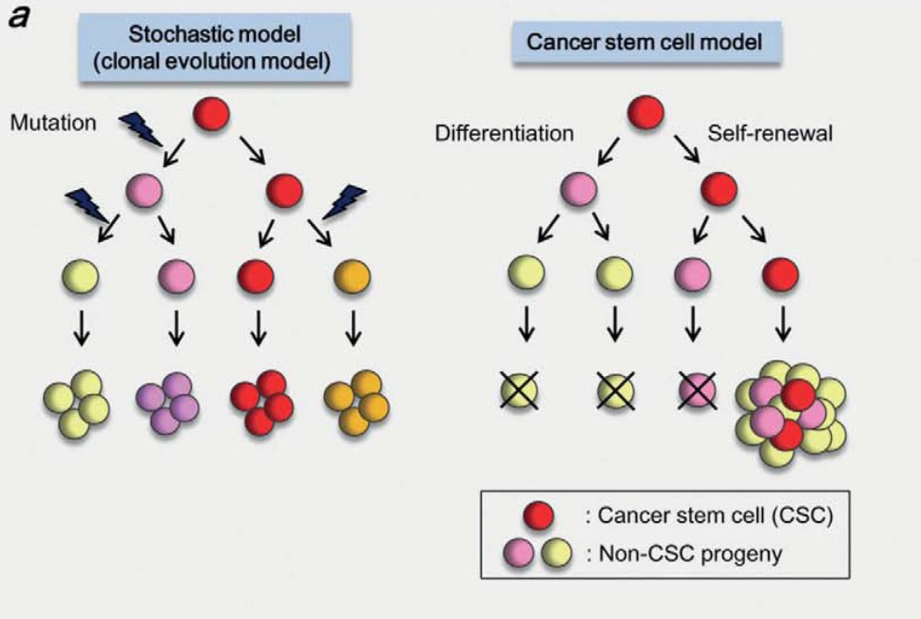
CSCS
CSCs have been identified as rare cell populations in many cancers, including leukemia and solid tumors.
CSCs are capable of self-renewal and differentiation into various types of cancer cells.
CSC show aberrant regulation of gene expression and some signaling pathways
and they are thought to be responsible for cancer initiation, progression, metastasis, recurrence and drug resistance.
CSC-related therapies with the identification of key molecules involved in controlling the unique properties of CSC populations have been examined.

Slide 36
Cancer stem cell
Properties
A small population of tumor cells with ‘stem cell’ characteristics and the capacity for self-renewal.
These cancer stem cells make up as few as 1% of the cells in a tumor, making them difficult to detect and study.
Like normal stem cells, cancer stem cells have a number of properties
permitting them to survive traditional cancer chemotherapy and radiation therapy.
These cells express high levels of ATP-binding cassette (ABC), drug transporters, providing for a level of resistance; are relatively quiescent; have higher levels of DNA repair and a lowered ability to enter apoptosis.

Slide 37
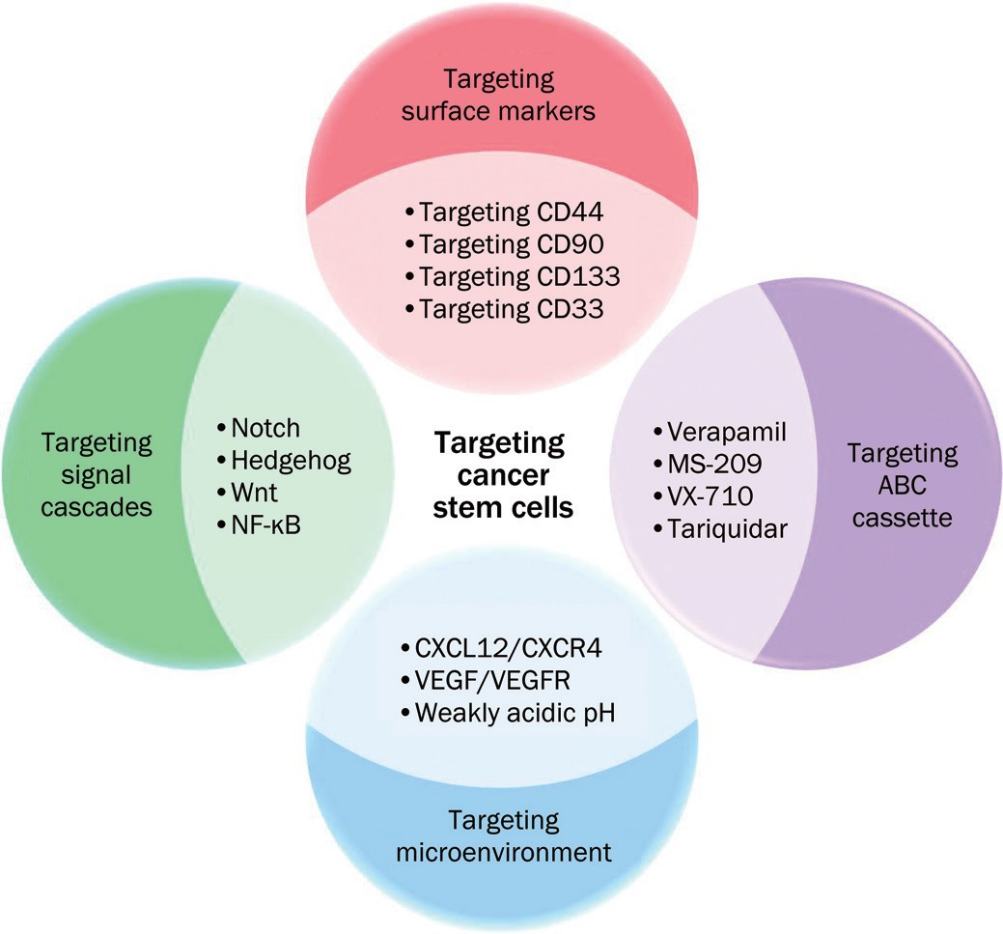
Therapies targeting cancer stem cells as Opportunities

Slide 39
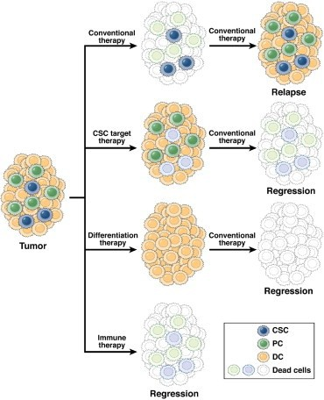
Strategies for CSC senzitization
CSCs are believed to be spared from most anticancer therapies, such as chemotherapy.
Inhibitors of survival pathways, along with differentiation-inducing agents, immune cells, and cytotoxic chemotherapeutics, might be used to destroy
CSCs and induce complete tumor regression.
Strategies for increased sensitization of cancer cells to drug and chemotherapy are widely different.

Slide 40
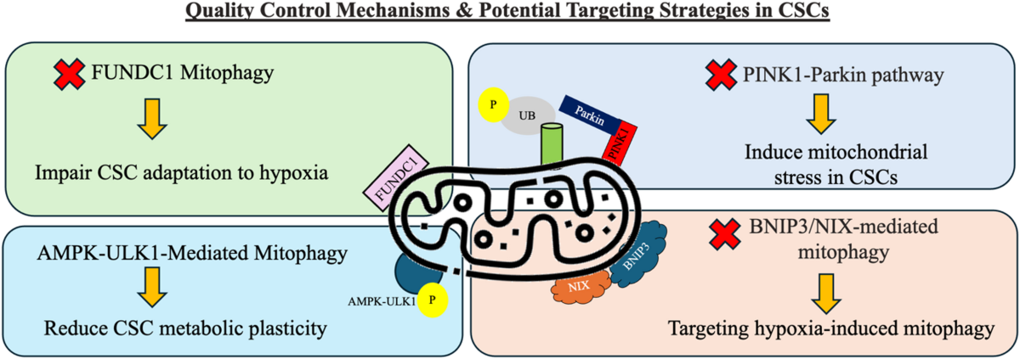
Targeting the mitocondria

Slide 41
Opportunities still exist for CSC therapy
Advantages of Cancer Stem Cell Therapy
Specificity
      Possibility of enabling Targeted Therapy and eradication of each individual type of cancer
  Decreased Toxicity
  Drug delivery systems with highly-specific CSC targeting that minimizes damage to patient’s host cells
Disadvantages
  Difficult to perform due to small population of CSCs
  Need greater determination of CSC markers upon mutation, and hence, tolerance to therapy

Slide 42
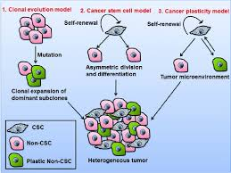
Heterogenity due to clonal evolution
Clonal evolution:
A single-cell origin: A tumor typically starts from a single cell that undergoes a genetic modification, or lesion.
Clone formation: This initial cell produces a clone of genetically identical descendants that have an increased rate of cell division and/or decreased cell death (apoptosis).
Subclone development: One cell in this clone may then acquire a new mutation, creating a new, distinct subclove with its own advantages

Slide 43
Resistance to therapy in CRC
Heterogeneity provides the fuel for resistance
Resistance mechanisms include genetic alterations in key signaling pathways,
  e.g., mutations in KRAS, NRAS, BRAF, and alterations in EGFR,
  activation of alternative receptors (HER2, IGF-1R), and modulation of downstream pathways (PI3K/Akt, MAPK) that blunt the efficacy of targeted therapies like anti-EGFR antibodies (cetuximab, panitumumab). Problem!
Moreover, epithelial-to-mesenchymal transition (EMT), tumor microenvironment-mediated immune evasion, and metabolic reprogramming contribute to resistance .
A major problem therefore is anti-EGFR therapy resistance in CRC

Slide 44
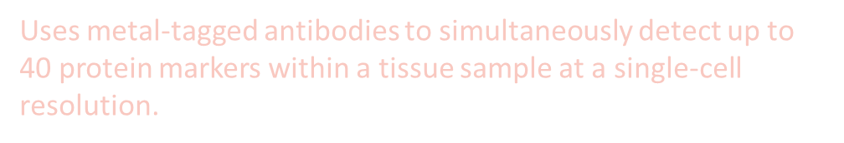
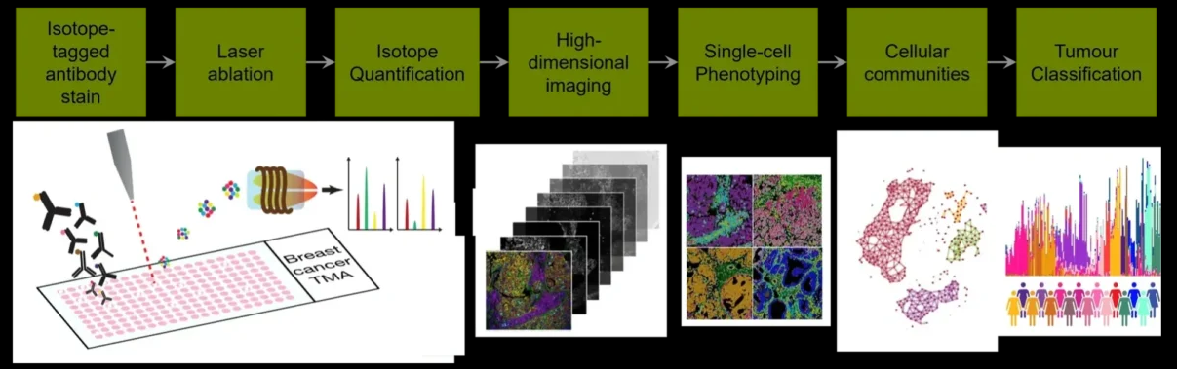
Imaging can help resolve heterogeneity and therapy resistance issues in CRC
1. Multiplexed spatial proteomic imaging
e.g., imaging mass cytometry, MIBI, CODEX, multiplex IF)
Can map many protein markers (about 40) at single‑cell resolution in intact tissue to define co‑existing cell phenotypes (tumor, immune, stromal) and their spatial relationships that drive resistance.
Identifies microenvironmental niches (immune deserts, suppressive macrophage zones, stromal barriers) that correlate with poor drug delivery or immune escape and suggest combination strategies.

Slide 45
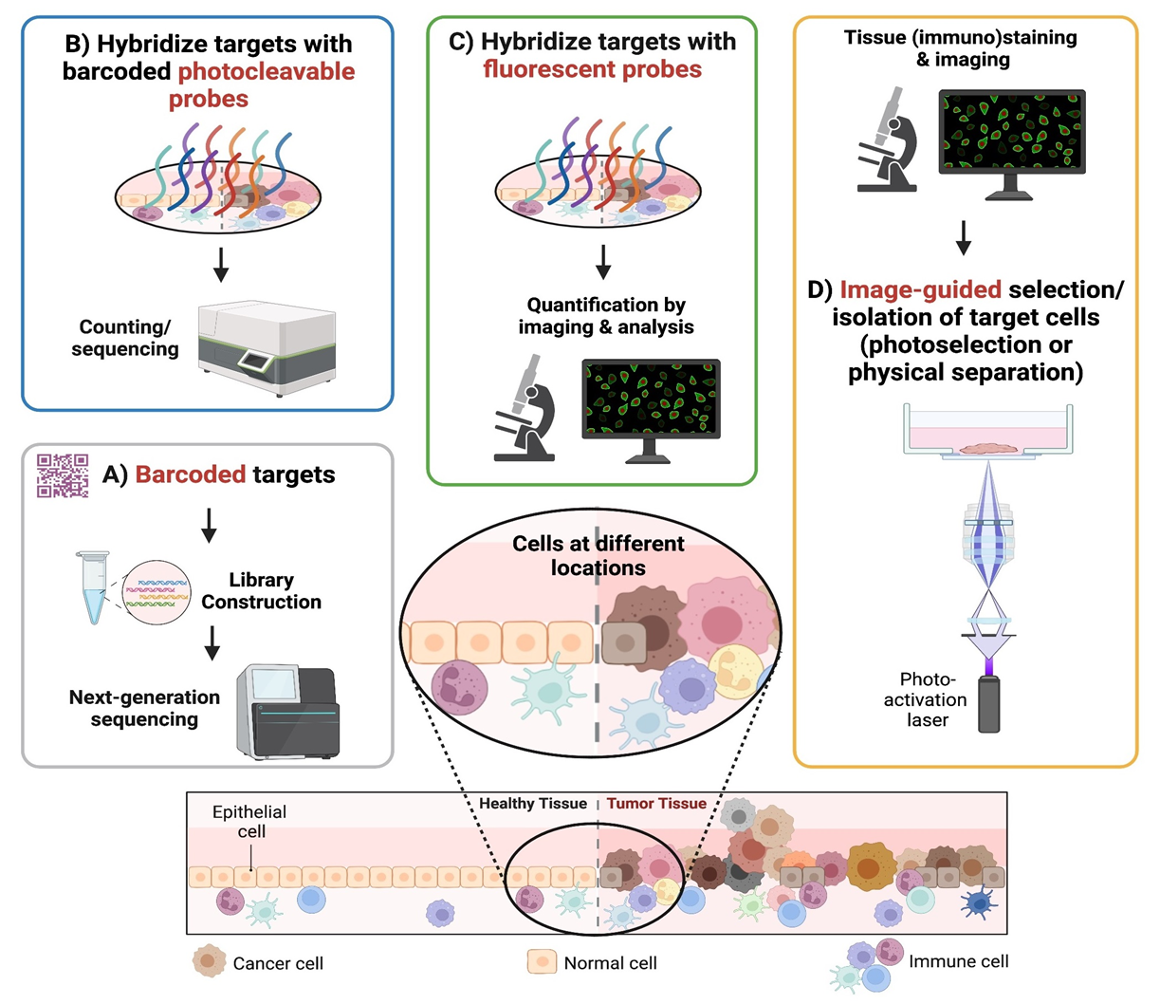
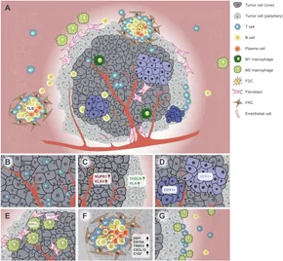
2. Clinical molecular & functional imaging (advanced PET tracers, PET/MRI, functional MRI) including endoscopic cellular imaging (confocal laser endomicroscopy)
  Systemically detects heterogeneous biology across lesions (metabolic uptake, hypoxia, fibroblast activation) to reveal differential treatment sensitivity.
3. Spatial transcriptomics / in situ RNA imaging to map gene expression within a tissue's physical structure, providing crucial insights into cancer by showing how cells are organized and interact in the tumor microenvironment. These methods reveal spatial heterogeneity

Slide 46
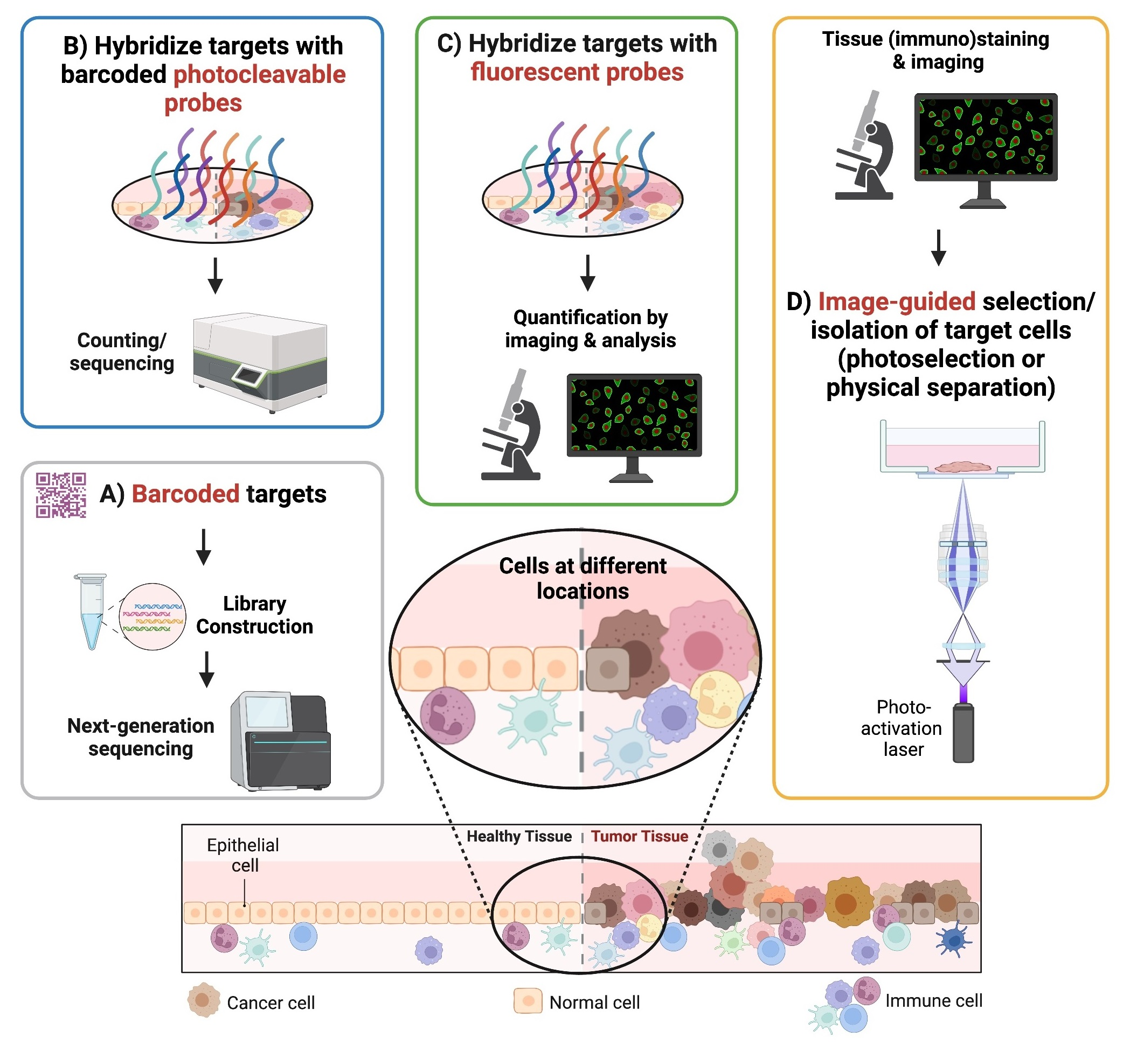

Slide 47
Thank you

Slide 49
