Slide 1
Molecular Biology of Carcinogenesis and Metastasis
GIAN WORKSHOP
Oct 29, 2025
N Nath

Slide 2
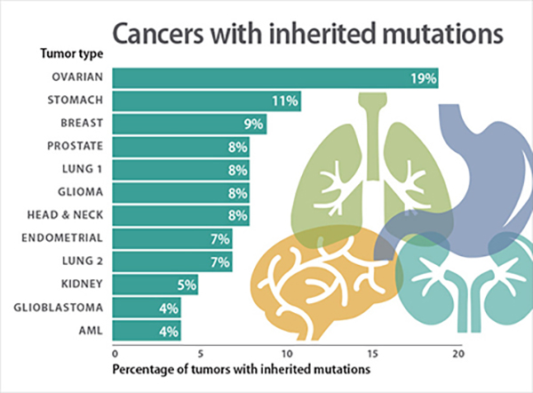

Slide 3
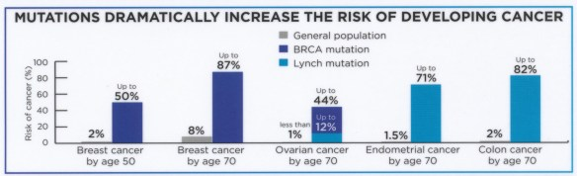
CANCE RISK : MUTATIONS
Lynch syndrome, also known as hereditary non-polyposis colorectal cancer (HNPCC), is a genetic predisposition to certain types of cancer. It is caused by mutations in DNA mismatch repair (MMR) genes

Slide 4
Hallmarks of Cancer
Cancer: uncontrolled cell growth and division

Slide 5
Cancer: uncontrolled cell growth and division
Hallmarks of Cancer
1) Disregard External and Internal Cues
7) Induce help from nearby cells (angiogenesis).
2) Altered responses to apoptosis and stress-signals
6) Metastasize
3) Circumvent Replicative Senescence
5) Escape from home tissue
4) Genetically Unstable

Slide 6
Molecular alterations that drive tumor initiation, progression, and metastasis
• Oncogene activation: Gain-of-function mutations, amplifications, translocations, or viral insertion drive constitutive growth-factor signaling (e.g., RAS, MYC, EGFR, BCR-ABL).
• Tumor-suppressor gene inactivation: Loss-of-function mutations, deletions, or epigenetic silencing disable negative regulators of the cell cycle, DNA repair, and apoptosis (e.g., TP53, RB1, PTEN, BRCA1/2).
• Genome instability and mutation: Defects in DNA-repair pathways (mismatch, nucleotide-excision, homologous-recombination) accelerate mutation rates, generating heterogeneity and selectable variants.
• Epigenetic reprogramming: Aberrant DNA methylation, histone-modifying enzymes, and chromatin remodelers alter gene expression without changing DNA sequence, enabling plastic phenotypes.
• Telomere maintenance: Reactivation of telomerase (hTERT) or ALT pathways prevents telomere shortening, supporting replicative immortality.
• Deregulated cell-death pathways: Suppression of intrinsic or extrinsic apoptosis (BCL-2 family shifts, CASP8 loss), necroptosis, and ferroptosis enables survival under stress.

Slide 7
Contd-Molecular alterations that drive tumor initiation, progression, and metastasis
• Reprogrammed metabolism: Warburg effect (aerobic glycolysis), glutamine addiction, fatty-acid synthesis, and altered redox balance fuel rapid growth and biosynthesis.
• Angiogenic signaling: VEGF, FGF, and HIF-1α–driven programs build new vasculature, supplying oxygen and nutrients to expanding tumors.
• EMT and cytoskeletal remodeling: Transcription factors (SNAIL, TWIST, ZEB) down-regulate E-cadherin, enhance motility, and facilitate invasion and metastasis.
• Immune evasion: Up-regulation of immune checkpoints (PD-L1), secretion of immunosuppressive cytokines (TGF-β, IL-10), and loss of antigen presentation (β2-microglobulin mutations).
• Tumor-promoting inflammation: NF-κB, STAT3, and inflammasome activation create a cytokine milieu (IL-6, TNF-α) that fosters proliferation, survival, and genome damage.
• Microenvironmental crosstalk: Cancer-associated fibroblasts, endothelial cells, and infiltrating immune cells exchange growth factors, extracellular-matrix proteins, and exosomes that reinforce malignancy.
• Noncoding RNA regulation: Oncogenic microRNAs and long noncoding RNAs modulate gene networks controlling proliferation, apoptosis, and metastasis.
• Chromothripsis and structural rearrangements: Catastrophic one-off genomic shattering events or extrachromosomal DNA (ecDNA) amplify oncogenes and drive rapid evolution.
These interconnected molecular mechanisms collectively endow cancer cells with uncontrolled growth, survival, adaptability, and metastatic potential.

Slide 8

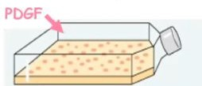

Hallmark 1: Disregard External and Internal Cues
Normal Cells : Basic Growth Media | Basic Growth Media w/ PDGF
Cancer Cells: Basic Growth Media
Experiment 1:
Description: Normal cells are placed in 2 different types of basic growth media (one without PDGF and one with PDGF) Cancer cells are placed in only a basic growth media.
What are the results?
What can you conclude from this experiment?

Slide 9
Hallmark 1: Disregard External and Internal Cues
Normal Cells : Basic Growth Media | Basic Growth Media w/ PDGF
Cancer Cells: Basic Growth Media
Experiment 1:
Description: Normal cells are placed in 2 different types of basic growth media (one without PDGF and one with PDGF) Cancer cells are placed in only a basic growth media.
Results:
  Most Normal cells divide in the basic growth media w/ PDGF. Many cancer cells divide in only a basic growth media.
Conclusion:
  Normal cells require mitogens for cell division however, cancer cells usually don’t require mitogens/ external signals for cell division because the pathway downstream of that signaling molecule is already activated.

Slide 10
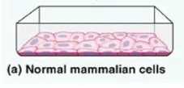
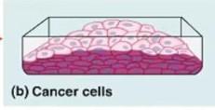
Hallmark 1: Disregard External and Internal Cues
Experiment 2:
Description: Normal mammalian cells are placed in a petri dish and allowed to divide. Cancer cells are placed in a petri dish and allowed to divide.
What are the results?
What can you conclude from this experiment.

Slide 11
Hallmark 1: Disregard External and Internal Cues
Experiment 2:
Description: Normal mammalian cells are placed in a petri dish and allowed to divide. Cancer cells are placed in a petri dish and allowed to divide.
Results:
Normal mammalian cells anchor themselves to the surface of the petri dish and divide until they form a monolayer (single-cell thick).
Cancer cells don’t anchor themselves to the surface of the petri dish. They divide and pile up on each other.
Confluence Stage: # of cells is constant
Conclusion:
  Normal cells exhibit
density-dependent contact inhibition (the cells stop dividing when their receptors are engaged and they sense cells around them) however, cancer cells don’t.

Slide 12

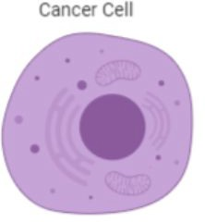
Hallmark 2: Altered Responses to Apoptotic Signals
Cancer cells don’t respond to apoptosis signals (ex: loss of engagement in membrane receptors). They divide anyways.
Cancer cells die if there is extensive damage and mitotic failure (cell falls apart).
Mitotic Failure

Slide 13
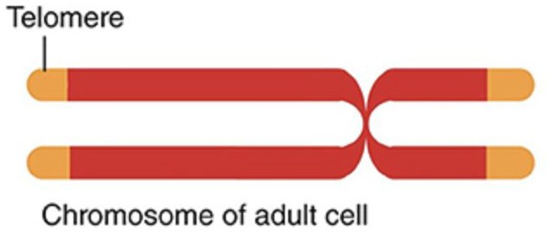
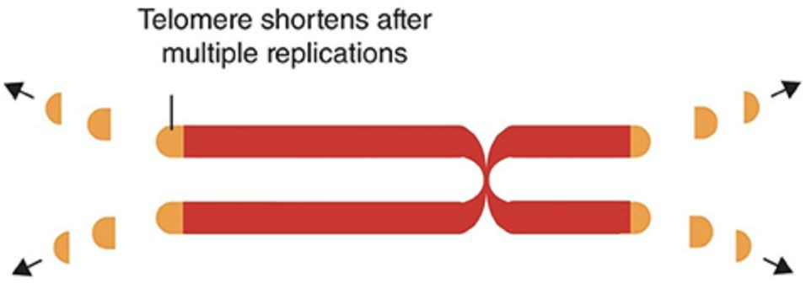
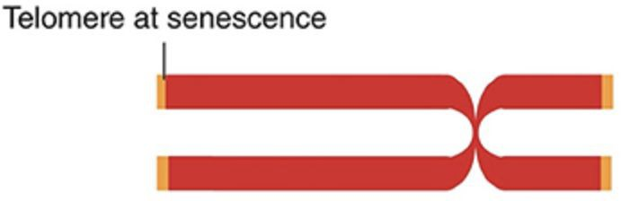
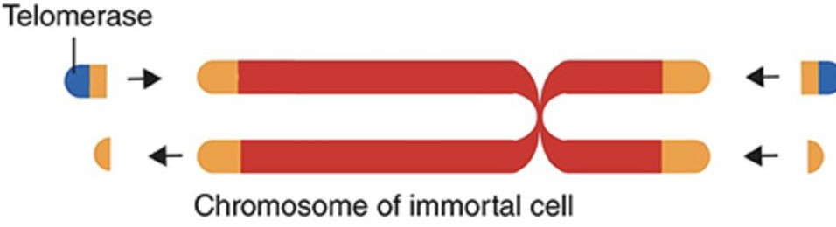
Hallmark 3: Circumventing Limitations on Proliferation and Replicative Senescence.
How do cancer cells circumvent limitations on proliferation?
Normal Cells:
Cancer Cells:

Slide 14
Hallmark 3: Circumventing Limitations on Proliferation and Replicative Senescence.
Many cancer cells activate telomerase which extends their telomere sequences and prevents them from reaching replicative senescence.
Normal Cells:
Cancer Cells:

Slide 15
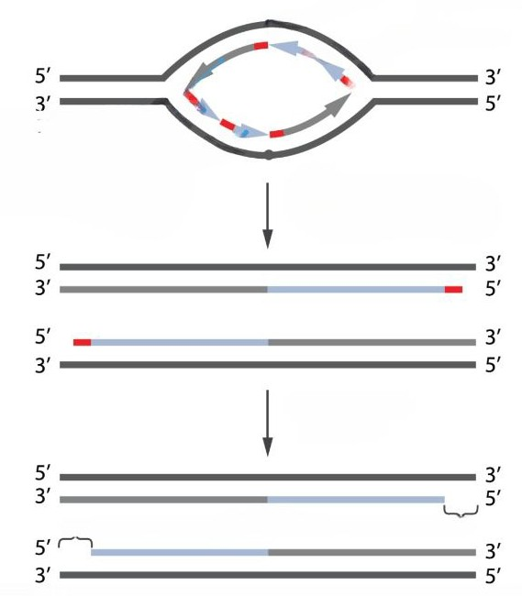
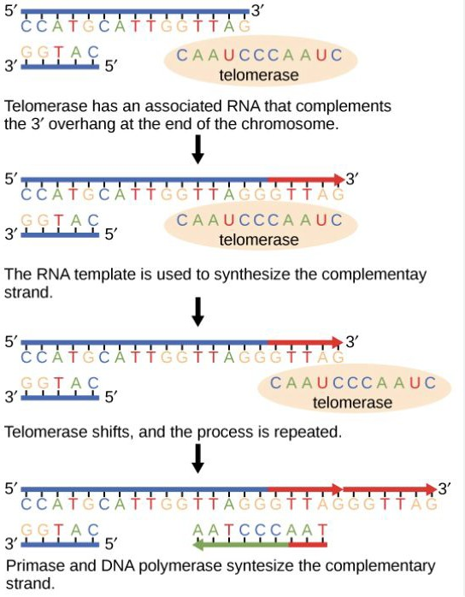
Telomere Sequences
During DNA duplication:
Telomerase activation:
RNA primers are removed.
Overhangs

Slide 16
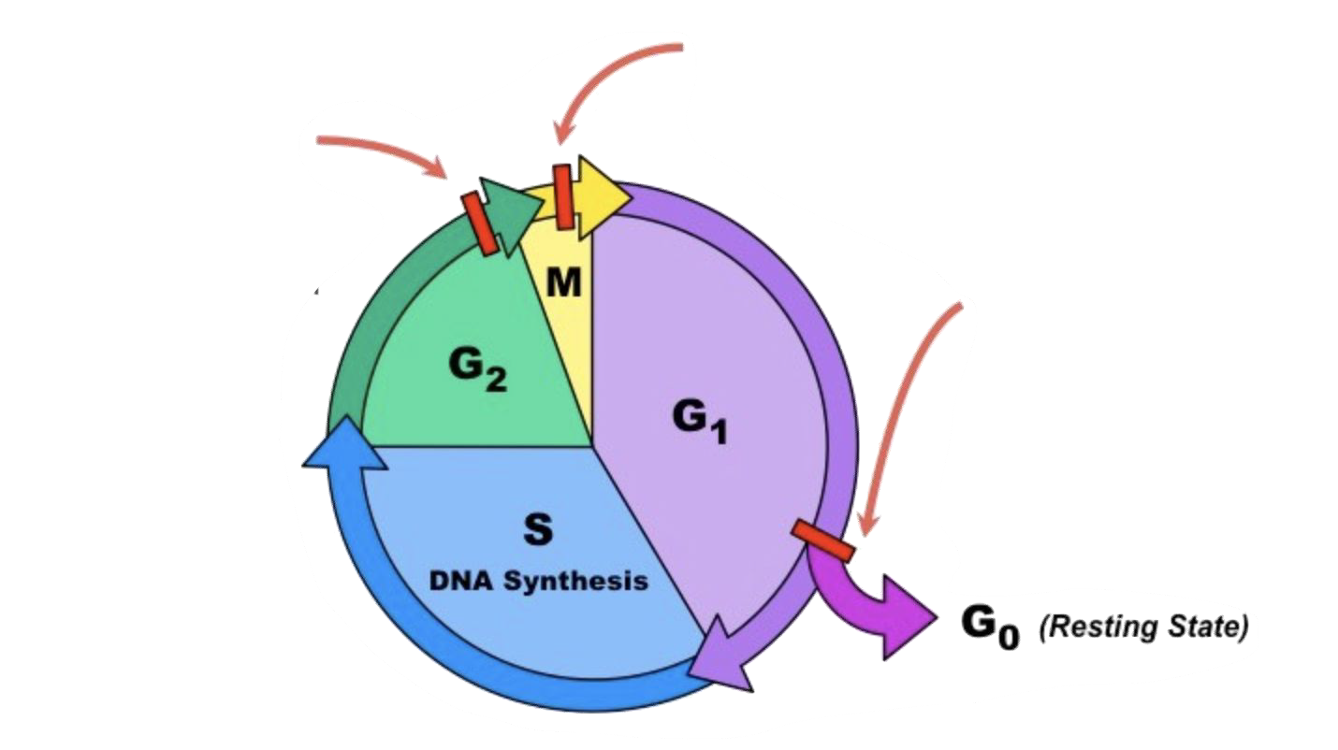
Hallmark 4: Genetic Instability
Metaphase checkpoint
Cancer-critical genes regulate the cell cycle.
Mutations in
cancer-critical genes can turn a normal cell into a cancerous cells.
G2 Checkpoint
G1 Checkpoint
What phases make up the cell cycle?
What are the checkpoints of the cell cycle? What is their criteria?

Slide 17
Hallmark 4: Genetic Instability
 |  | Metaphase checkpoint All chromosomes are attached to the mitotic spindle.
G2 Checkpoint DNA has replicated successfully. Adequate cell size.
 |  |  | G1 Checkpoint Damage DNA (repair/ apoptosis) Adequate cell size. Sufficient Nutrients (insufficient can mean Go) Cytokines/ Growth Factors/ Mitogens
Cancer-critical genes regulate the cell cycle.
Mutations in
cancer-critical genes can turn a normal cell into a cancerous cells.
1) G1 (Cell growth) → S (DNA duplication) → G2 (Cell growth) → Mitosis (Division)
2)

Slide 18
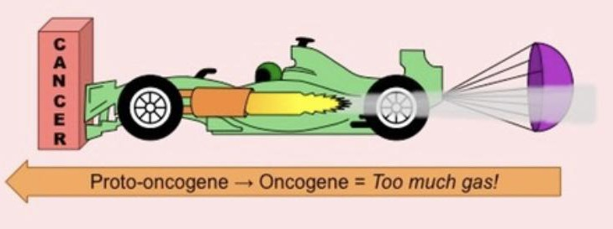
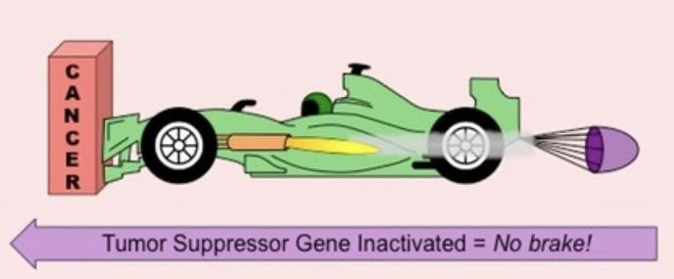
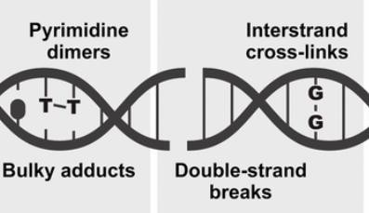
Hallmark 4: Genetic Instability
What are the 3 types of cancer-critical genes?

Slide 19
Hallmark 4: Genetic Instability
What are the 3 types of cancer-critical genes?
Proto-oncogenes:
Tumor Suppressor Genes:
Genes that stop the cell cycle
DNA Repair Genes:
Genes that promote the progression of the cell cycle.
“Gain of Function”
Oncogenes result in hyperactivity of a protein(s) which accelerate the progression of the cell cycle.
Genes that maintain genomic stability
from proceeding forward.
“Loss of Function”
The loss of tumor suppressor genes (usually both copies) results in the inability to inhibit the progression of the cell cycle.

Slide 20

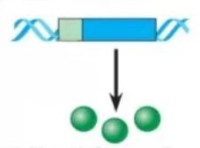
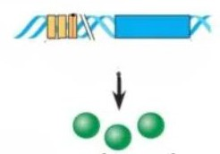
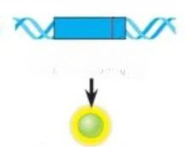
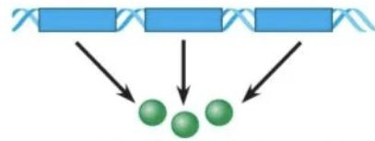
Proto-Oncogenes → Oncogenes
What are the different ways that proto-oncogenes become oncogenes?
Normal Proto-Oncogene:

Slide 21
Proto-Oncogenes → Oncogenes
What are the different ways that proto-oncogenes become oncogenes?
Normal Proto-Oncogene:
The gene is translocated and placed under a new promoter that expresses the gene with greater frequency, resulting in the production of excess proteins. | The gene is duplicated on the same chromosome. The expression of multiple copies of the same gene results in the production of excess proteins. | There is a point mutation in the control elements/ promoter. The gene is expressed with a greater frequency, resulting in the production of excess proteins. | There is a point mutation in the gene itself. The expression of the gene results in a protein that is always active/ resistant to degradation.

Slide 22
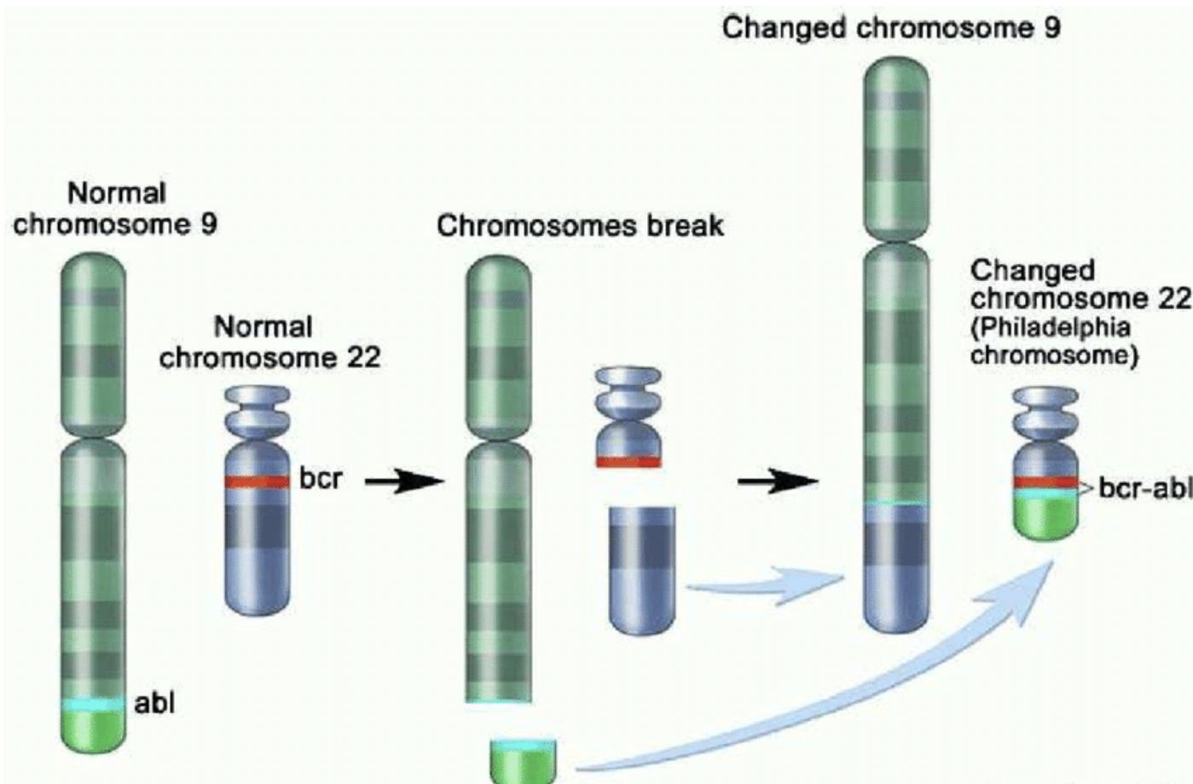
Oncogene Example: BCR-ABl Gene
What does bcr gene on chromosome 22 encode for? What does the abl gene on chromosome 9 code for?
How is the philadelphia chromosome (specifically the bcr-abl gene) formed?

Slide 23
Oncogene Example: BCR-ABl Gene
The bcr gene codes for a receptor tyrosine kinase. The abl gene codes for a
non-receptor tyrosine kinase
There is a reciprocal translocation between chromosome 9 and 22 (they swap DNA segments). The translocation forms the philadelphia chromosome (changed chromosome 22). .

Slide 24
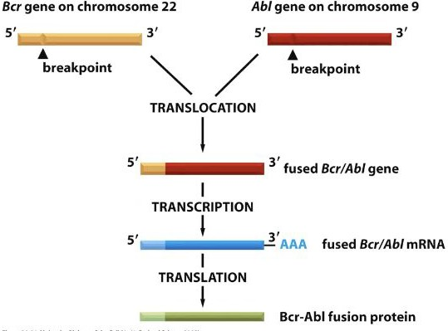
Oncogene Example: BCR-ABl Gene
The Bcr/Abl gene is located on the philadelphia chromosome.
The 5’ of the gene comes from the bcr gene and the 3’ of the gene comes from the abl gene.

Slide 25
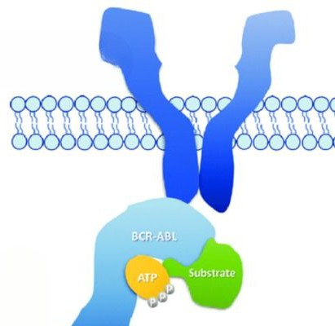
Oncogene Example: BCR-ABl Gene
1) What does the bcr/abl gene code for?

Slide 26
Oncogene Example: BCR-ABl Gene
Receptor Tyrosine Kinase
1) The bcr/abl gene codes for an overactive receptor tyrosine kinase that participates in signal transduction pathways that progress the cell cycle forward. This overactive receptor tyrosine kinase cannot be allosterically regulated and turned off.
Note: The overactive RTK confers growth factor independence to the signaling pathway (pathway doesn’t need a signaling molecule to be active).

Slide 27
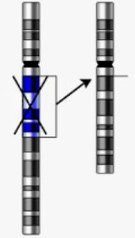
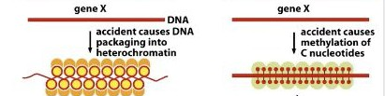
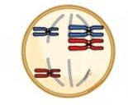
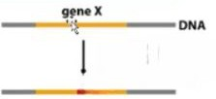
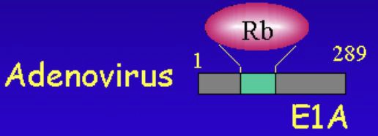
Tumor Suppressor Genes
What are the different ways that tumor suppressor genes lose function?

Slide 28
Tumor Suppressor Genes
What are the different ways that tumor suppressor genes lose function?
A point mutation inactivates the allele. The expression of the tumor suppressor gene codes for a nonfunctional protein. | Epigenetic silencing: The gene is tightly packaged (heterochromatin) and can’t be expressed. The gene is extensively methylated and can’t be expressed. | A nondisjunction event during division results in a chromosome (and the tumor suppressor gene on it) being lost. | The tumor suppressor gene is deleted during duplication. | The tumor suppressor genes express proteins normally however, viral proteins bind to the tumor suppressor proteins, rendering them nonfunctional.

Slide 29

Tumor Suppressor Gene Example: P53
The gene for P53 is on chromosome 17.
1) P53 is a transcription factor.
2) What signals activate the p53 protein?
Stable, Activated P53
3) What kind of cellular responses are generated by p53?

Slide 30
Tumor Suppressor Gene Example: P53
The gene for P53 is on chromosome 17.
1) P53 is a transcription factor.
Hyperproliferative Signals
DNA Damage
Telomere Shortening
Hypoxia (low O2)
2)
Stable, Activated P53
3)
Cell Cycle Arrest
Senescence
Apoptosis

Slide 31
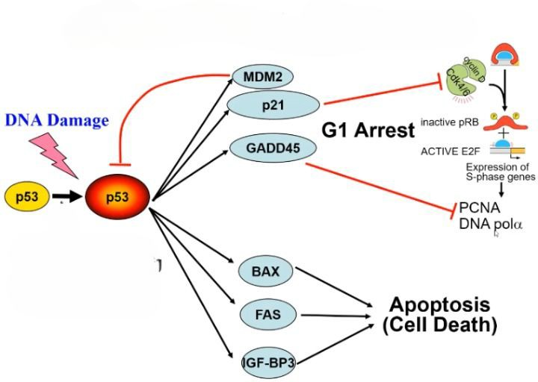
Tumor Suppressor Gene Example: P53
P53 Transcriptional Targets:
Scenario: There is DNA damage in the cell.
How is the p53 protein activated/ stabilized?
How does the p53 arrest the cell cycle? What happens if the DNA damage is fixed? What is the function of MDM2?
What happens if the DNA damage can’t be fixed?

Slide 32
Tumor Suppressor Gene Example: P53
P53 Transcriptional Targets:
Scenario: There is DNA damage in the cell.
The enzymes detect DNA damage in the cell and phosphorylate p53 which stabilizes the protein.
P53 helps transcribe/ express genes that would lead to G1 arrest (notably p21). If DNA damage is repaired, the cell cycle resumes. MDM2 binds to p53 and takes it to the “trash” / proteosome.
If the DNA damage isn’t repaired, p53 helps transcribe/ express genes that would lead to apoptosis.

Slide 33
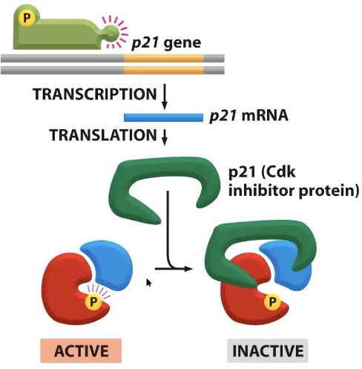
Tumor Suppressor Gene Example: p21
The gene for P21 is on chromosome 6.
1) What is the function of the p21 protein? How does p21 help arrest the cell cycle?

Slide 34
Tumor Suppressor Gene Example: p21
The gene for P21 is on chromosome 6.
1) P21 is a CDK inhibitor. P21 binds to the G1/S CDK (CDK that moves the cell cycle from the G1 to the S phase) and the S CDK (CDK that moves the cell through the S phase). When P21 binds to the CDK, they prevent the formation of the CDK-cyclin complexes which phosphorylate proteins that will move the cell forward in the cell cycle.
G1/S CDK or S CDK

Slide 35
What is the effect on cell cycle regulation if both p53 alleles were rendered nonfunctional.

Slide 36
Response: If both p53 alleles for the cell were rendered nonfunctional,
the cell can not transcribe p21 (cdk inhibitor) and arrest the cell cycle (ex: when DNA damage is detected in G1)
  or stimulate DNA repair genes.
the cell also can not transcribe genes for apoptosis in the event that the cell fails to meet the criteria of a checkpoint in the cell cycle (ex: DNA damage can’t be repaired in G1)
……..which means the cell will divide indefinitely

Slide 37

Tumor Suppressor Gene Example: Rb
The Rb gene is on chromosome 13
Retinoblastoma protein (Rb)
1) What is the function of Rb proteins? How does Rb regulate the cell cycle?
DNA

Slide 38
Tumor Suppressor Gene Example: Rb
The Rb gene is on chromosome 13
Retinoblastoma protein (Rb)
1) Rb proteins bind to proliferation factors (gene regulatory proteins) and prevent the transcription/ expression of cyclin genes.
Cyclin
Proliferation Factor
Gene

Slide 39
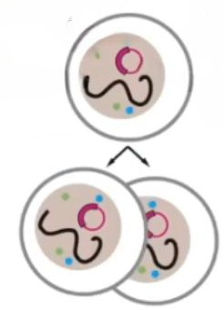
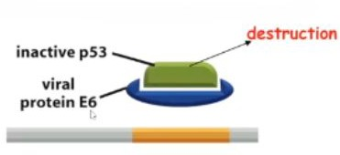
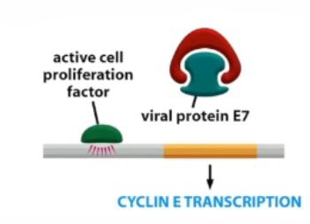
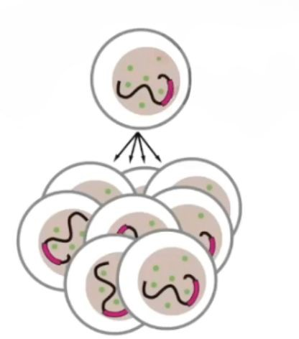
Human Papillomavirus (HPV)
Benign wart:
- Viral genome is distinct from host genome.
-Low levels of transcription.
1) How does HPV increase cell division and proliferation?
Malignant tumor:
- Viral genome is integrated into the host genome.
-High levels of transcription.

Slide 40
Human Papillomavirus (HPV)
Benign wart:
- Viral genome is distinct from host genome
-Low levels of transcription.
1) Viral protein E6 binds to P53 and destroys it.
Viral Protein E7 binds to Rb and prevents it from binding to the proliferation factor. The progression of the cell cycle is accelerated.
Malignant tumor:
- Viral genome is integrated into the host genome.
-High levels of transcription.

Slide 41
A point mutation that leads to over-production of a function tumor suppressor protein would be roughly equivalent (in terms of how susceptible it makes the cell to losing division control) to:
A mutation converting one allele of a proto-oncogene into an oncogene.
A mutation that knocked out the function of one allele of a proto-oncogene.
A mutation that knocked out the function of one allele of a tumor suppressor gene.
A mutation that reactivated the telomerase gene.
A mutation that knocked out both alleles of a gene involved in apoptosis.

Slide 42
A point mutation that leads to over-production of a function tumor suppressor protein would be roughly equivalent (in terms of how susceptible it makes the cell to losing division control) to:
A mutation converting one allele of a proto-oncogene into an oncogene.
A mutation that knocked out the function of one allele of a proto-oncogene.
A mutation that knocked out the function of one allele of a tumor suppressor gene.
A mutation that reactivated the telomerase gene.
A mutation that knocked out both alleles of a gene involved in apoptosis.

Slide 43
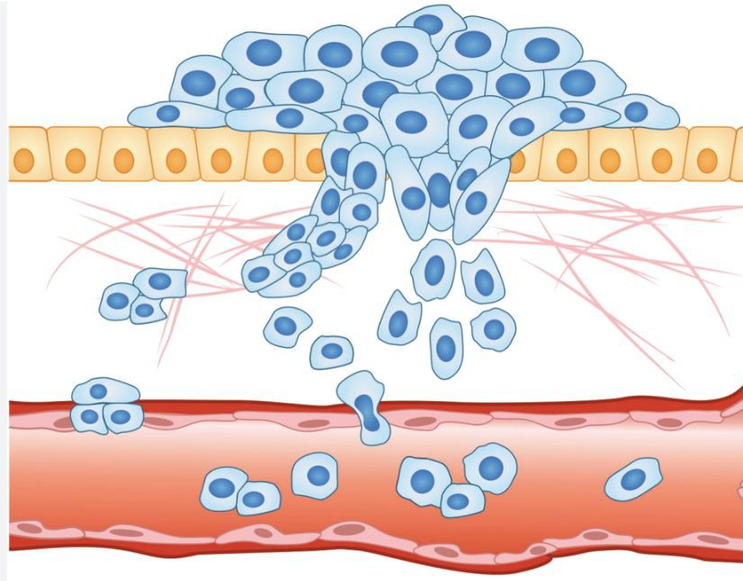
Hallmark 5 & 6: Invasive Tissue/ Metastasis
How do cancerous cells metastasize?
Is it easy for cancer cells to metastasize? Why or why not?

Slide 44
Hallmark 5 & 6: Invasive Tissue/ Metastasis
The lineage of a single cell accumulates mutations (usually 10-12) in their cancer critical genes and proliferates uncontrollably. The cancerous cells express scissor-like proteins that cut the basal lamina. The cells also stop expressing the adhesion proteins which anchor them to their original location. The cancerous cells migrate to a secondary site in the body via lymph/blood vessels.
No. The cancer cells manipulated the normal cells for their own survival and proliferation at the primary site, however, there is no guarantee they can do that at a secondary site.

Slide 45
Two cancer cells are taken from different areas within an advanced aggressive solid tumor and analyzed. Which of the following statements is most likely false?
It is possible that the two cancer cells contain identical numbers of mutations in cancer critical genes.
It is possible that the two cancer cells do not share any of the same mutations in cancer critical genes.
It is possible that the two cancer cells do not have the same number of chromosomes.
It is possible that the two cancer cells have a different rate of division.
None of the above.

Slide 46
Two cancer cells are taken from different areas within an advanced aggressive solid tumor and analyzed. Which of the following statements is most likely false?
It is possible that the two cancer cells contain identical numbers of mutations in cancer critical genes.
It is possible that the two cancer cells do not share any of the same mutations in cancer critical genes.
It is possible that the two cancer cells do not have the same number of chromosomes.
It is possible that the two cancer cells have a different rate of division.
None of the above.

Slide 47
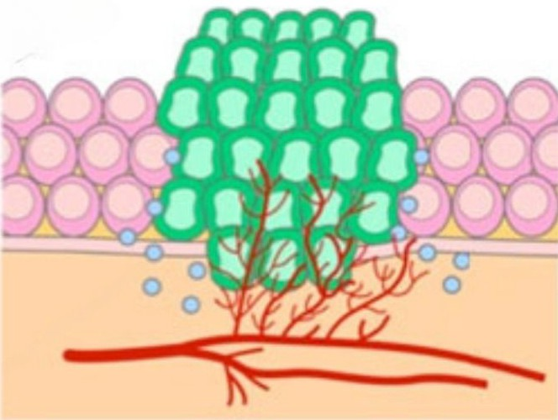
Hallmark 7: Induce Help from Nearby Cells
Example 1: Angiogenesis
What is angiogenesis?
How do cancerous cells induce angiogenesis?

Slide 48
Hallmark 7: Induce Help from Nearby Cells
Example 1: Angiogenesis
Angiogenesis is the development of new blood vessels from pre-existing blood vessels.
Cancerous cells secrete VEGF or they manipulate nearby normal cells to secrete VEGF (cytokine) which binds to endothelial cells and promotes synthesis/ branching of blood vessels towards the tumor cells.

Slide 49
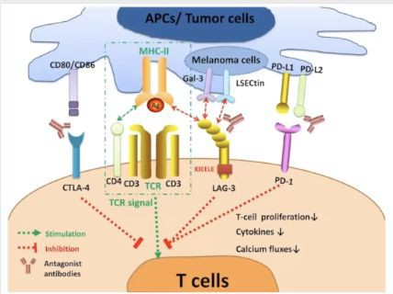
Hallmark 7: Induce Help from Nearby Cells
Example 2: Immune Cells
What is the function of CTLA-4 and PD-1 on helper T cells?
How do cancer cells inactivate immune cells?

Slide 50
Hallmark 7: Induce Help from Nearby Cells
Example 2: Immune Cells
When APCs activate helper T cells and they undergo clonal selection and differentiation, they express CTLA-1 and PD-1 on their surfaces. The CD80/86 on APCs binds to the CTLA-4 on differentiating T cells. The PDL1/2 on APCs binds to the
PD-1 on differentiating T cells. Both interactions inhibit further division and differentiation.
Some cancer cells express CD80/86 and PD-L1/L2 on their surfaces and inactivate T cells.

Slide 51
Thank you

