Slide 1
Tumor Microenvironment- What cells play roles

Slide 2
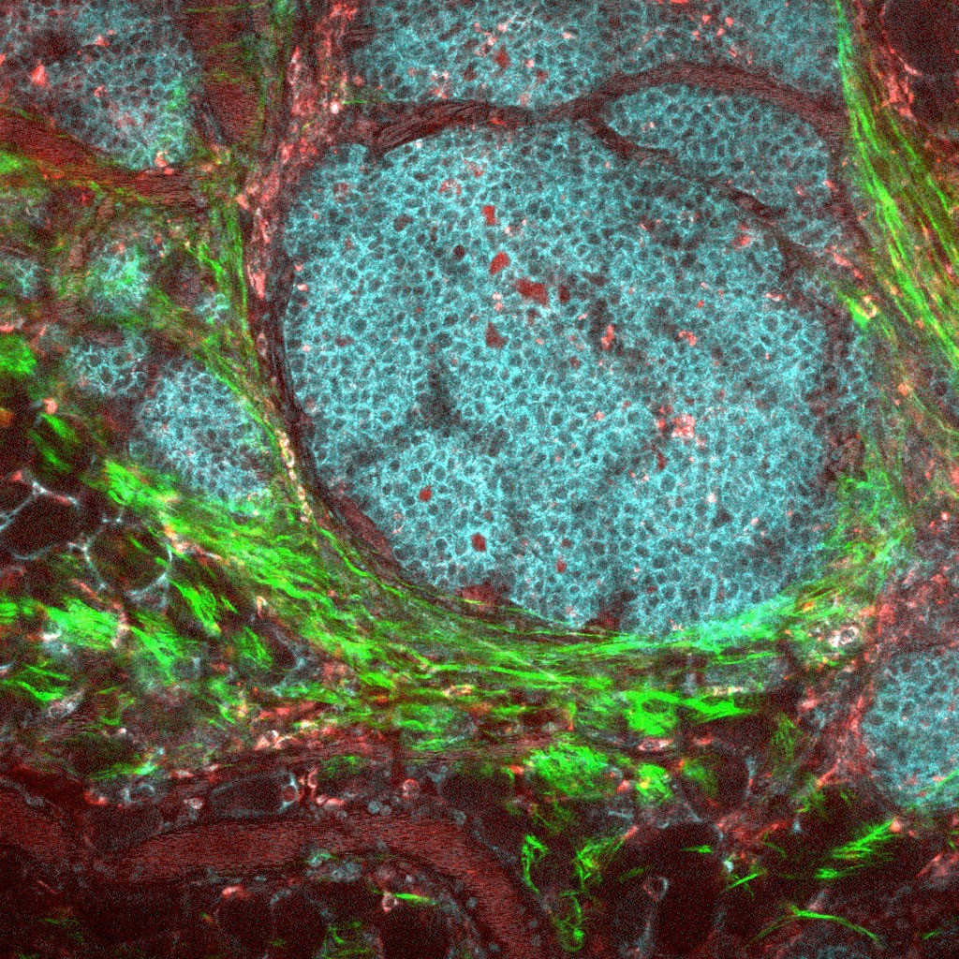
Tumor microenvironment (TME)
The normal cells, molecules, signaling factors, and blood vessels that surround and feed a malignant tumor cell. A tumor can change its microenvironment, and the microenvironment can affect how a tumor grows and spreads.
www.youtube.com/watch?v=bdWRZd19swg www.youtube.com/watch?v=eSwG5O_kiOQ

Slide 3
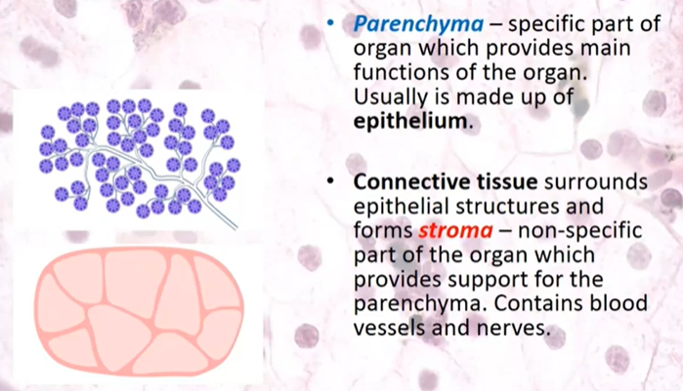
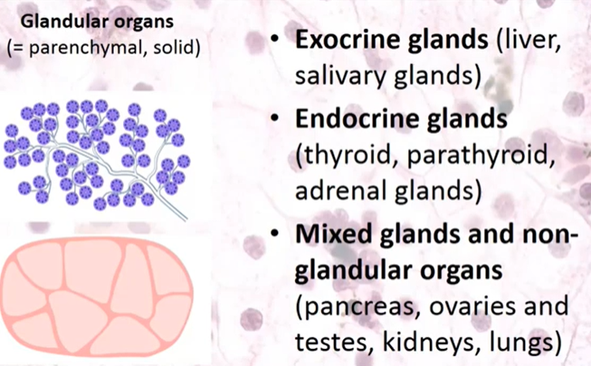
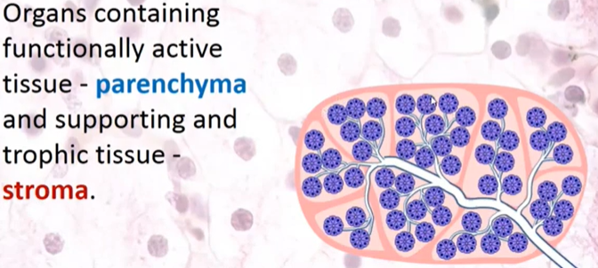
Basic terminology first

Slide 4


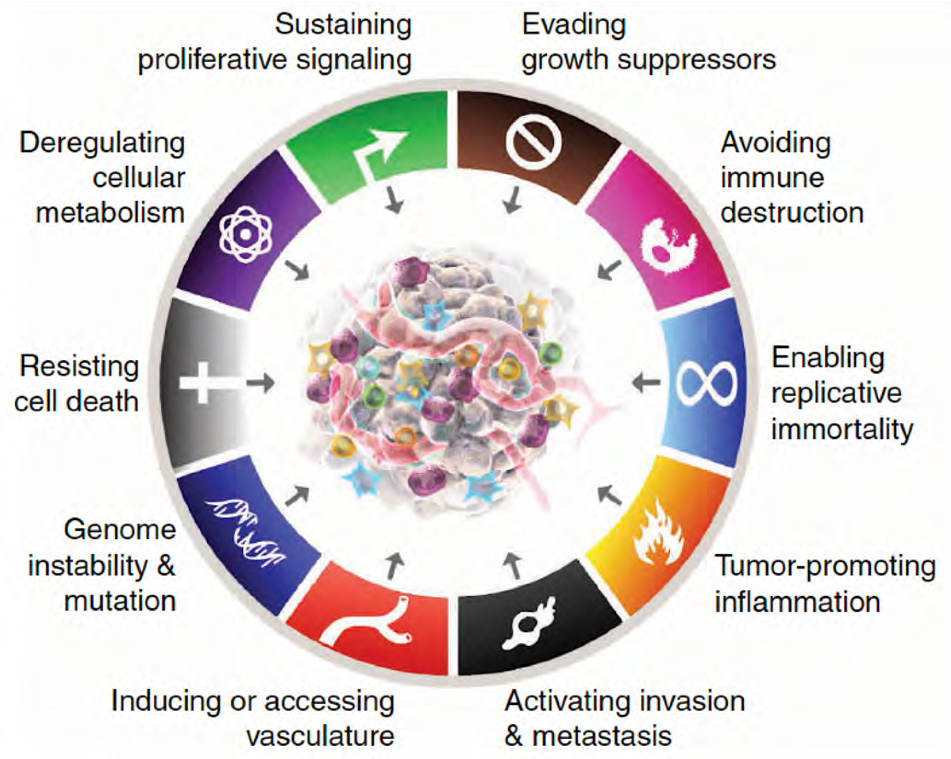








Recall also The Hallmarks of Cancer
1
3
10
4
2
5
9
6
8
7
Sources: Hanahan D Cancer Discovery (12) 2022; Hanahan D and Weinberg RA Cell (144) 2011; Hanahan D and Weinberg RA Cell
(100) 2000; Lee RJ, Abramson JS and Goldsby RA Case Studies in Cancer 2019.

Slide 5
The tumor microenvironment (TME) is the complex, dynamic ecosystem:
surrounding and infiltrating tumor tissue,
comprising not only cancer cells
also supporting cells, extracellular matrix,
and signaling factors
Together they govern tumor behavior, progression, and response to therapy

Slide 6
Important components of the TME
Tumor cells:
Bulk cancer cells, cancer stem cells, tumor cells with diverse phenotypes
Infiltrating cells:
Resident cells:
Lymphocytes, macrophages
Fibroblasts, pericytes, adipocytes, endothelial cells
Secreted soluble factors: cytokines, chemokines, matrix metalloproteinases, growth factors (TGF-�, PDGF, VEGF)
Hypoxia: Low oxygen, angiogenesis
Dying tumor cells: apoptosis, necrosis, pyroptosis of immune cells
Honestly… its complex.

Slide 7
Composition of the Tumor Microenvironment is complex and is an ecosystem
Cancer cells: The primary malignant population, often showing significant heterogeneity within and between tumors
Stromal cells: Including cancer-associated fibroblasts (CAFs), mesenchymal stem cells, and adipocytes, which remodel the local environment and support tumor growth
Immune cells: Both tumor-promoting (e.g., immunosuppressive myeloid-derived suppressor cells and regulatory T cells) and tumor-infiltrating lymphocytes that can mount anti-tumor responses
Extracellular matrix (ECM): A dense network of proteins (collagen, fibronectin, elastin, laminin), glycoproteins, and enzymes that provide structural support and regulate cell adhesion, migration, and signaling
Vasculature: Blood and lymphatic vessels, both existing and newly formed, which supply nutrients, oxygen, and facilitate metastasis
Acellular components: Growth factors, cytokines, chemokines, and extracellular vesicles that coordinate communication between different cell types

Slide 8
Key Functions of TME and Interactions
Biomechanical support and cell signaling: The ECM influences cancer cell behavior through physical cues (stiffness, topography) and biochemical signaling (integrin binding, growth factor sequestration)
Immune modulation: Immune cells in the TME can suppress or promote tumor growth, and the TME often evolves mechanisms to evade immune surveillance (immune checkpoint ligands, cytokine secretion)
Remodeling and invasion: Cancer cells and stromal cells remodel the ECM to promote invasion, migration, and metastasis
Angiogenesis and vasculogenesis: Tumors induce new blood vessel formation (angiogenesis) through factors like VEGF, facilitating nutrient supply and metastatic spread
Metabolic reprogramming: The TME adapts its metabolic environment to support rapid cancer cell proliferation.
Therapeutic resistance: The TME can protect tumor cells from drugs and radiation, contributing to treatment failure

Slide 9
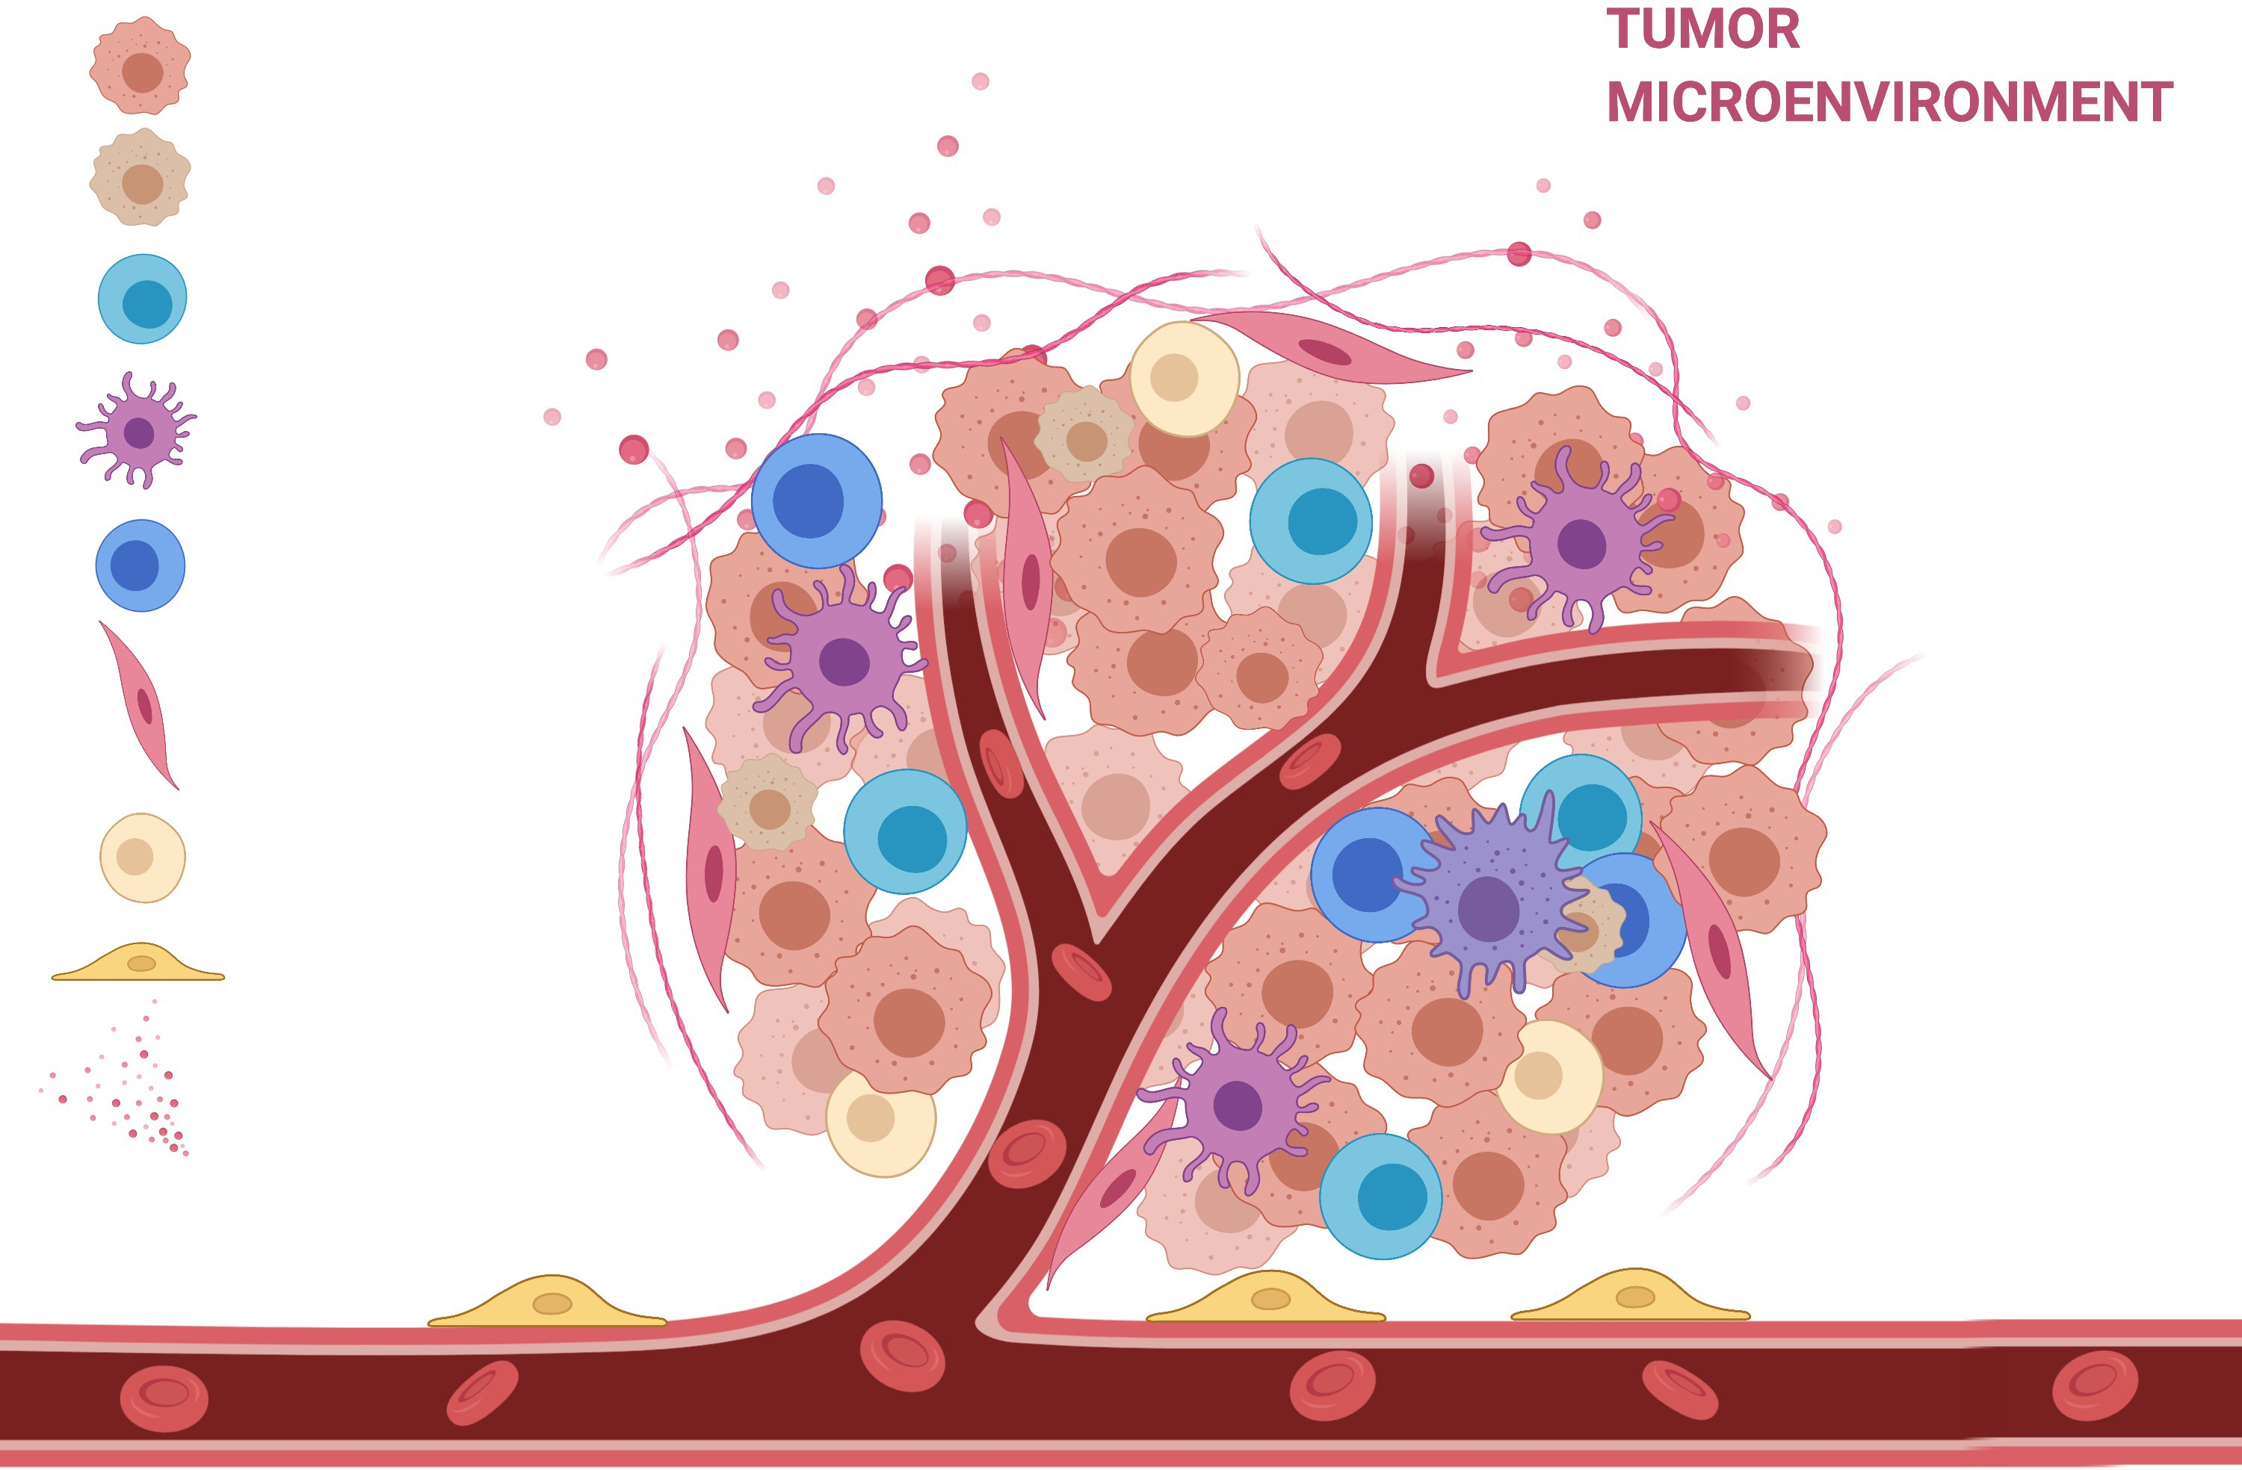
Tumor microenvironment (TME)
Bulk cancer cell
Cancer stem-like cell T lymphocytes
Macrophages
Other immune cells Fibroblasts Adipocytes
Pericytes Cytokines/chemokines

Slide 10

















































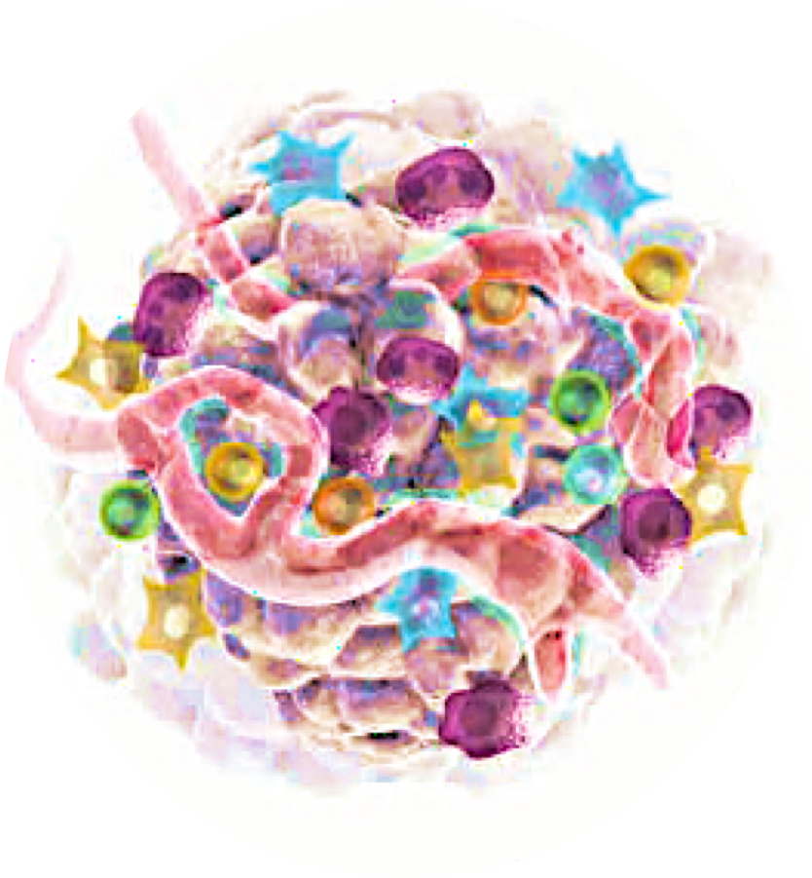
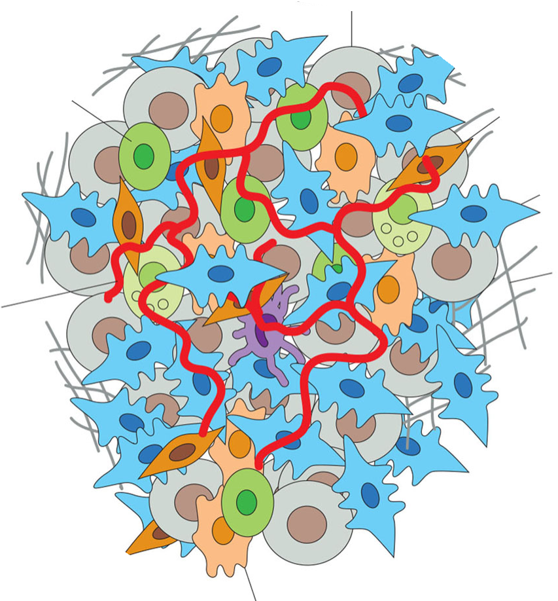


The Tumor Microenvironment (TME)
Neoplasm (tumor)
Neoplasm growth/regression – increased cell proliferation/death
growth regression
Composed of neoplastic parenchyma and non-neoplastic stroma, which provides blood supply for oxygen and nutrients
normal cell cancer cell
cancer-associated fibroblast (CAF)
lymphocyte
extracellular matrix (ECM)
blood vessel
tumor-associated macrophage (TAM)
Tumor growth
CAFs, TAMs,
regulatory T cells, and immature myeloid cells
Tumor growth
Cytotoxic T cells, NK cells, and M1 macrophages
Sources: Hanahan D Cancer Discovery (12) 2022; Lee RJ, Abramson JS and Goldsby RA Case Studies in Cancer 2019.

Slide 11
Important components of the TME
Tumor cells:
Bulk cancer cells, cancer stem cells, tumor cells with diverse phenotypes
Infiltrating cells:
Resident cells:
Lymphocytes, macrophages
Fibroblasts, pericytes, adipocytes, endothelial cells
Secreted soluble factors: cytokines, chemokines, matrix metalloproteinases, growth factors (TGF-�, PDGF, VEGF)
Hypoxia: Low oxygen, angiogenesis
Dying tumor cells: apoptosis, necrosis, pyroptosis of immune cells

Slide 12
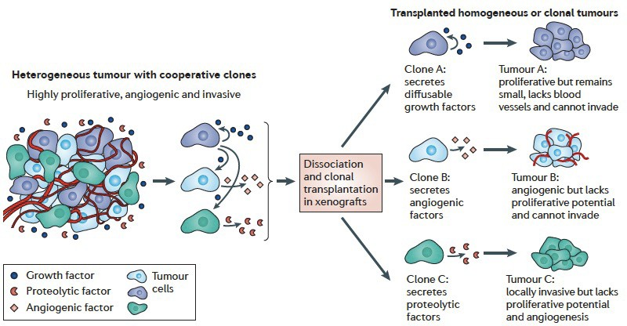
Cooperation of cells within TME support tumorigenesis
Tabassum D and Polyak K. Nat Rev Cancer, 2015

Slide 13
TME: Stem Cell Properties of Tumorigenic Cells
Cancer stem cells (CSCs)
identified in many solid tumors (e.g., colon, breast, pancreas, melanoma)
are a rare subpopulation of tumor cells
exhibit enhanced tumor-initiating potential due to their ability to self-renew and differentiate into multiple cell types
may be responsible for metastatic spread from primary neoplasm/tumor
Epithelial-mesenchymal transition (EMT) TO COVER IN LEC 5
is a reversible transdifferentiation process, in which polarized, immortal epithelial cells acquire a fibroblast-like phenotype characterized by increased motility, invasion, and migration capabilities
Makes carcinoma in situ to become aggressive and invasive

Slide 14

Important components of the TME
Tumor cells: Bulk cancer cells, cancer stem cells, tumor cells with diverse phenotypes
Infiltrating cells: Lymphocytes, macrophages
Resident cells:
Fibroblasts, endothelial cells, adipocytes
Secreted soluble factors: cytokines, chemokines, matrix metalloproteinases, growth factors (TGF-�, PDGF, VEGF)
Hypoxia: Low oxygen, angiogenesis
Dying tumor cells: apoptosis, necrosis, pyroptosis of immune cells

Slide 15
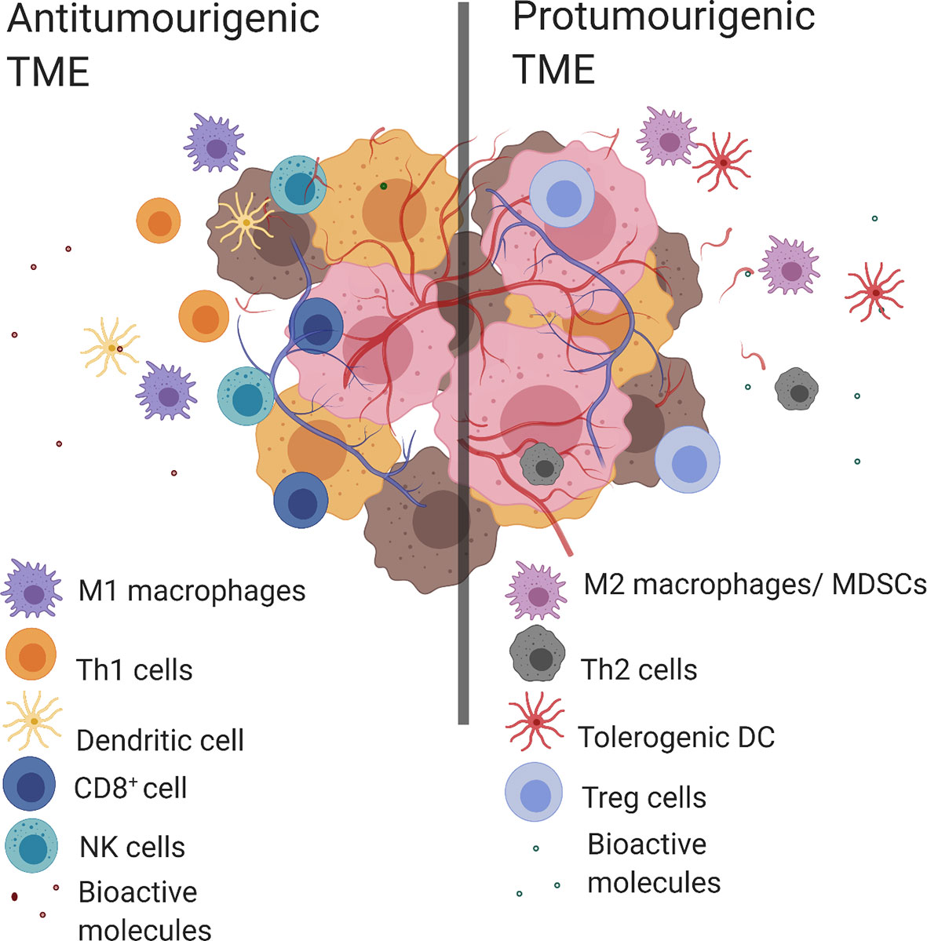
Macrophages : A tale of two roles
Inflammatory tumor microenvironment
VIDEO
TME and cells

Slide 16
Important components of the TME
Tumor cells: Bulk cancer cells, cancer stem cells, tumor cells with diverse phenotypes
Infiltrating cells:
Lymphocytes, macrophages
Resident cells: Fibroblasts, endothelial cells, adipocytes, microbiota
Secreted soluble factors: cytokines, chemokines, matrix metalloproteinases, growth factors (TGF-�, PDGF, VEGF)
Hypoxia: Low oxygen, angiogenesis
Dying tumor cells: apoptosis, necrosis, pyroptosis of immune cells

Slide 17
Cellular Components of the TME
Epigenetic changes and mutations found in cancer cells (p53 and PTEN mutations) were also found in cancer-associated stroma, suggesting that alterations in the stroma may contribute to tumor progression
Cancer-associated fibroblasts (CAFs)
have an “activated” proinflammatory gene expression program
produce collagen and promote tumor cell invasion by releasing factors (proteases) that remodel the ECM
Cancer-associated MSCs
are a functionally distinct subset of fibroblasts because they can differentiate into fibroblasts, endothelial cells, adipocytes, chondrocytes, or osteoblasts (multipotent)
promote progression and metastasis of ovarian, colon, and pancreatic cancers

Slide 18
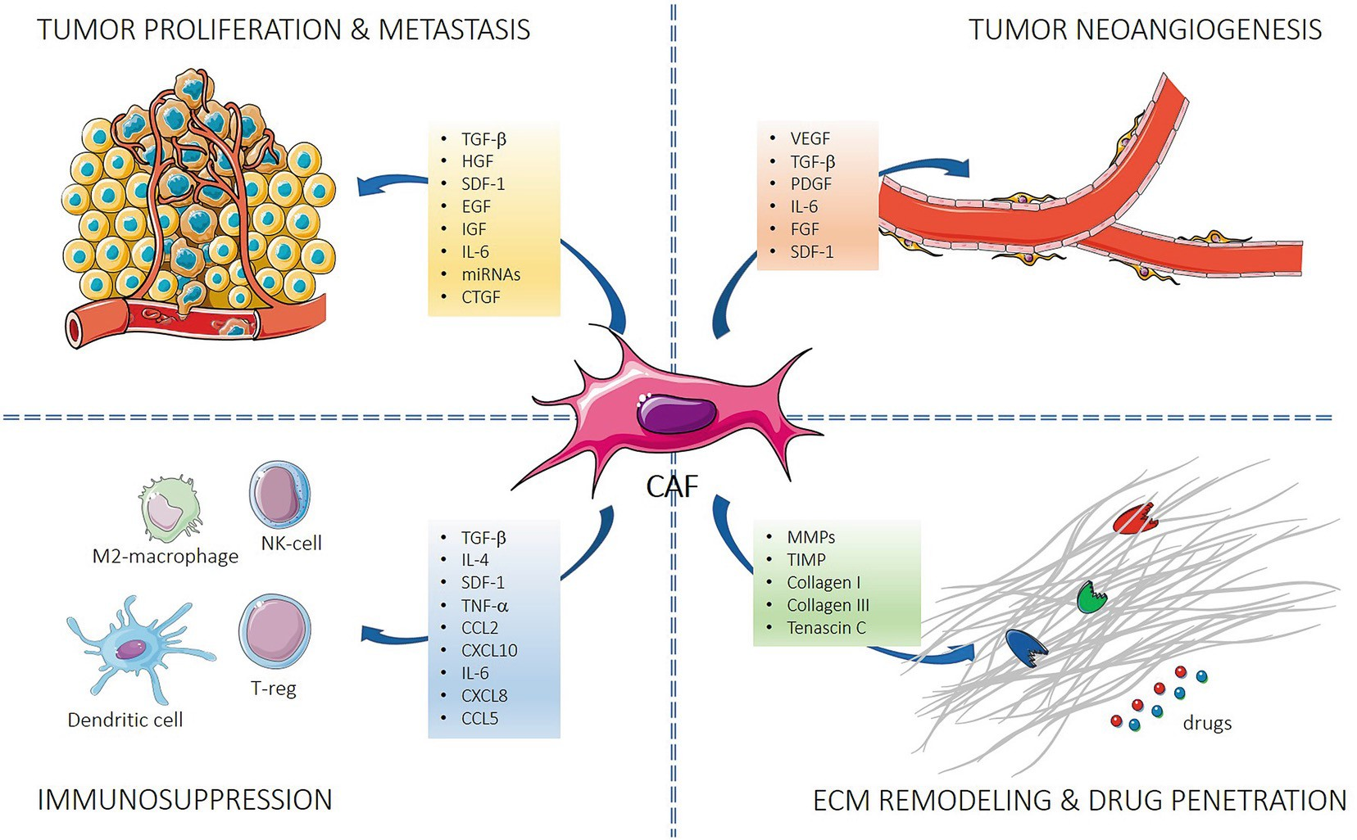
Fibroblasts secrete a variety of factors into the TME that can affect tumor behavior
Truffi M., Sorrentino L., Corsi F. (2020) Fibroblasts in the Tumor Microenvironment. In: Birbrair A. (eds) Tumor Microenvironment. Advances in Experimental Medicine and Biology, vol 1234.

Slide 19
Cells of the TME : Endothelial cells
(To generate blood vessels)
Endothelial cells
They line the blood vessels (inside)
Generate abnormal tumor vasculature
Pericytes
Are smooth muscle-like cells that surround capillaries and promote endothelial cell survival and the stabilize microvasculature (normal and tumor)
stimulate tumorigenesis by supporting blood vessel maturation and function
Sources: Niederhuber JE et al. Abeloff’s Clinical Oncology 2020.

Slide 20
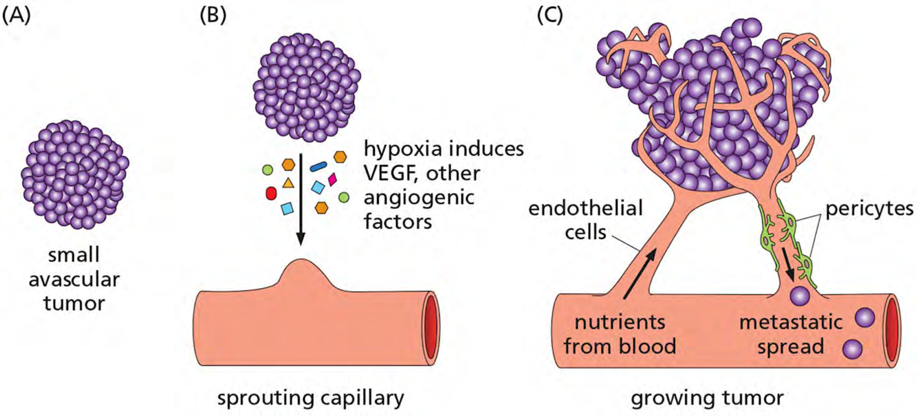
Cells of the TME : Angiogenic vascular cells promote vascularization in Solid Tumors
Sources: Niederhuber JE et al. Abeloff’s Clinical Oncology 2020; Lee RJ, Abramson JS and Goldsby RA Case Studies in Cancer 2019.
Notes:
B) The relative hypoxia of a growing tumor activates hypoxia-inducible transcription factors (HIFs), which induce the expression of vascular endothelial growth factors (VEGFs) and other angiogenic factors, stimulating the sprouting of a capillary.
(C) With vascular branching and elongation of the blood vessel, a lumen forms and the vessel matures, with endothelial cells lining the inside of the vessel and pericytes along its periphery.

Slide 21
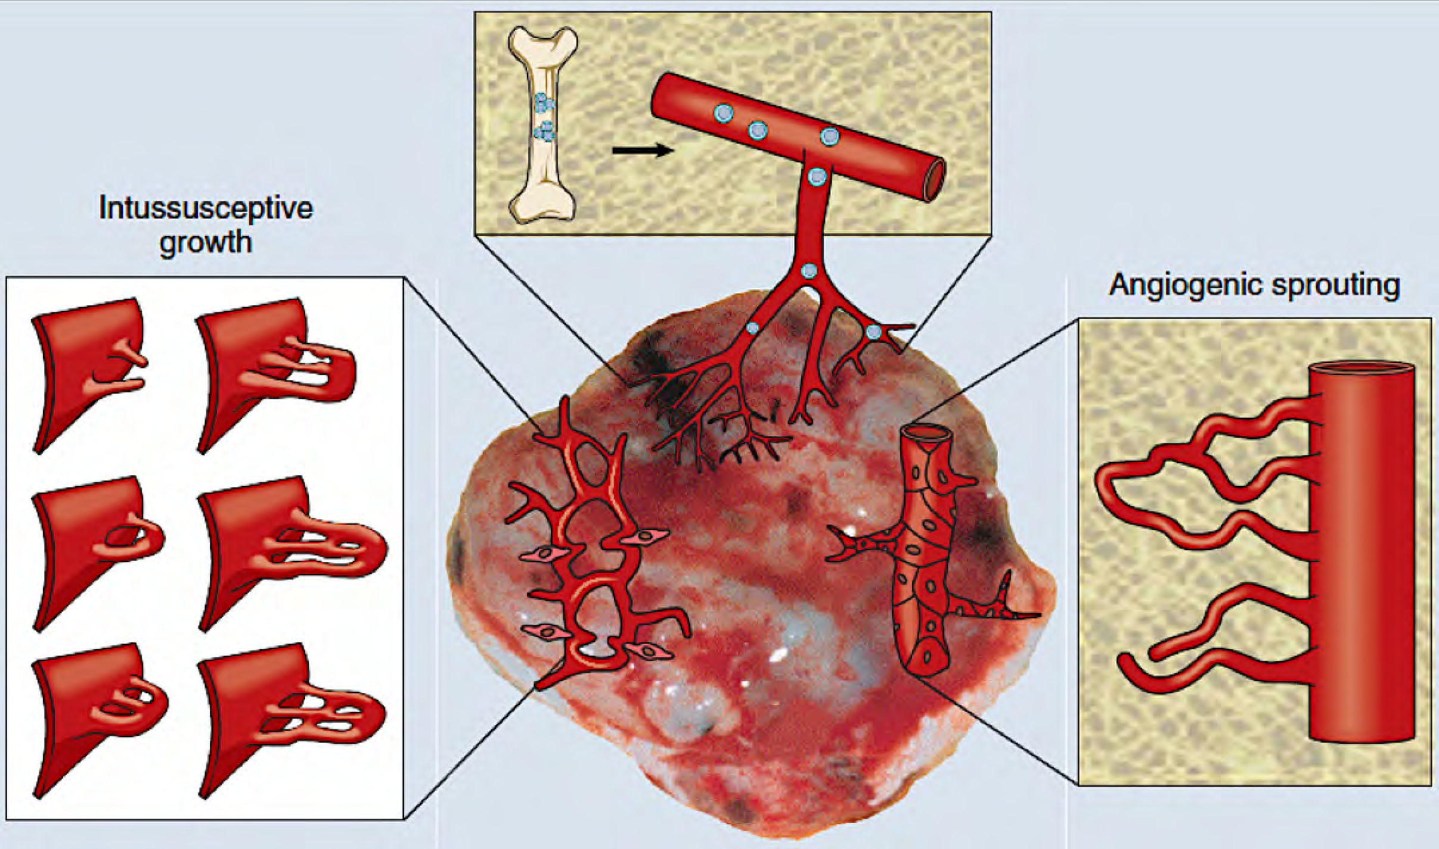
Cellular Mechanisms of Vascularization in Solid Tumors
endothelial precursors
recruited
intussusceptive or
“splitting” angiogenesis
vasculogenesis
“sprouting” angiogenesis
vessel co-option (not shown): tumor cells grow around existing vessels
VIDEO Angiogeneis https://vimeo.com/garlandscience30308032/review/189178292/e65125c3e8

Slide 22
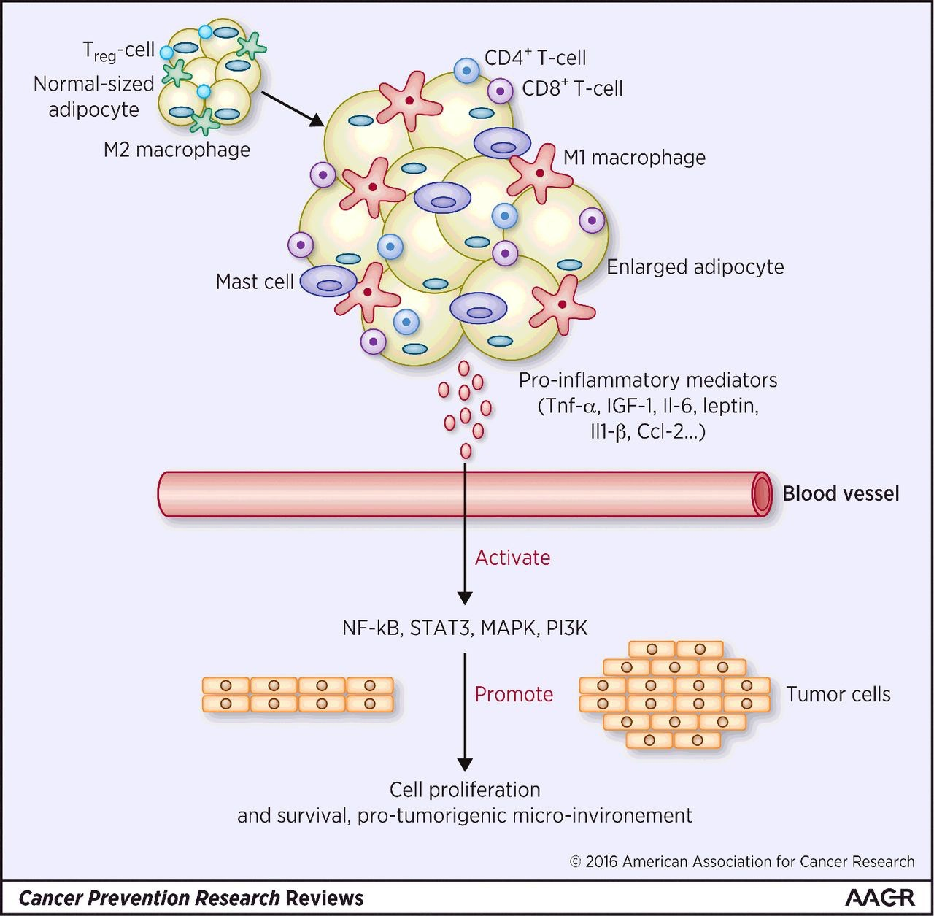


Adipose tissue releases cytokines and fatty acids for cell growth and metabolism
Lean
Obese

Slide 23
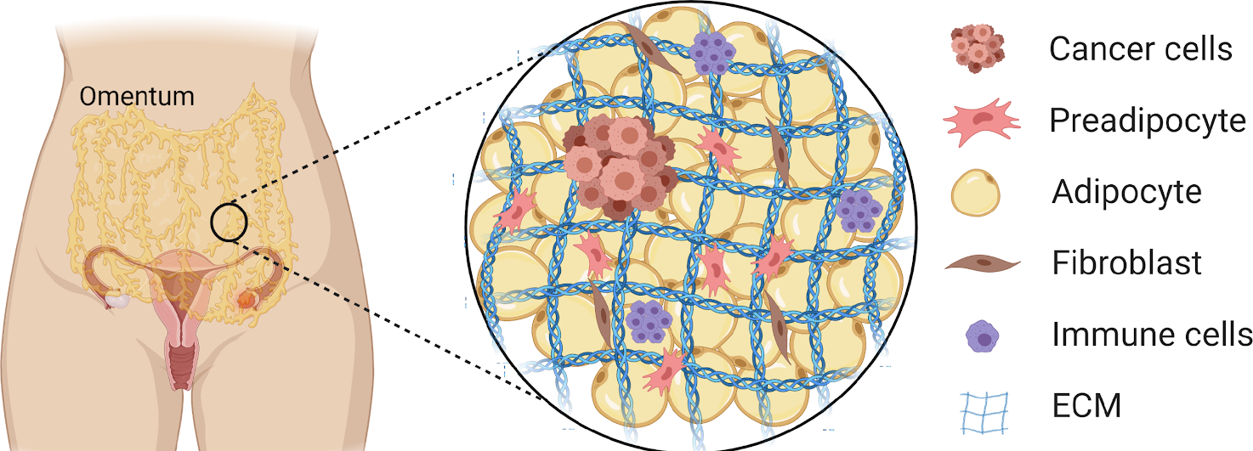
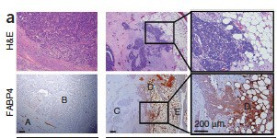

Adipose tissue is a common metastatic site for ovarian cancer cells
Primary tumor Metastatic tumor
FAB4 (adipocyte marker) is high at metastatic sites
Cytokine array using conditioned media from primary omental adipocytes

Slide 24
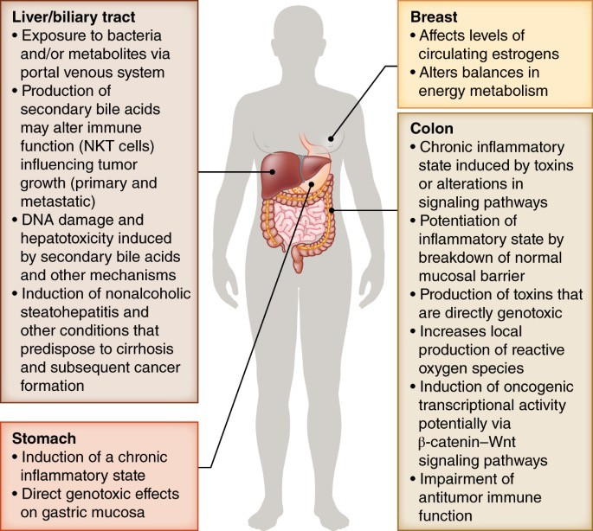
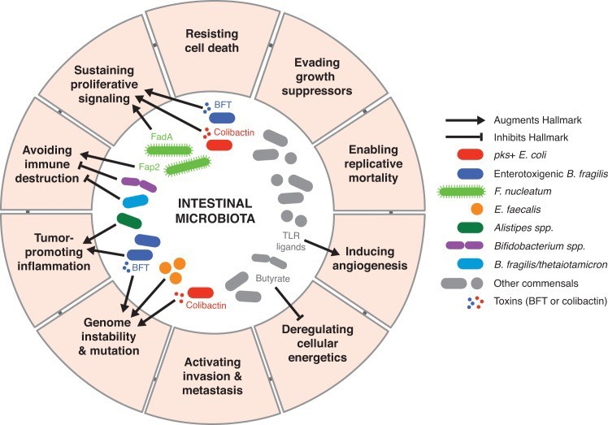
Microbiota modulate TME
Indirect effects through circulating metabolites produced by bacteria

Slide 25
Important components of the TME
Tumor cells: Bulk cancer cells, cancer stem cells, tumor cells with diverse phenotypes
Infiltrating cells:
Resident cells:
Lymphocytes, macrophages
Fibroblasts, endothelial cells, adipocytes
Secreted soluble factors: cytokines, chemokines, matrix metalloproteinases growth factors (TGF-�, PDGF, VEGF)
Hypoxia: Low oxygen, angiogenesis
Dying tumor cells: apoptosis, necrosis, pyroptosis of immune cells

Slide 26
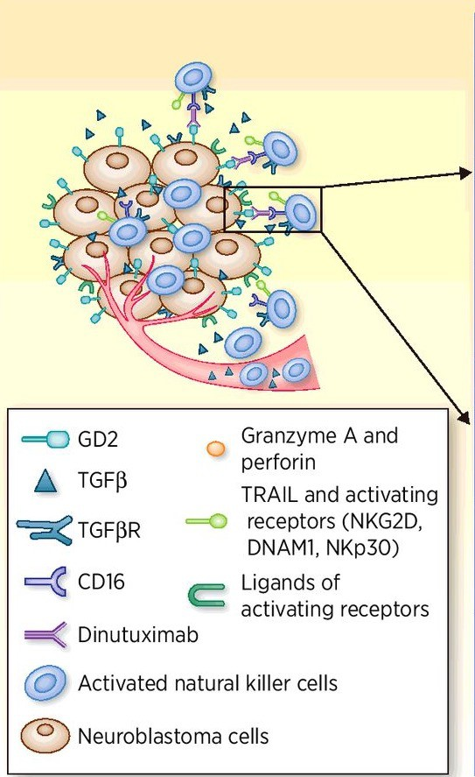
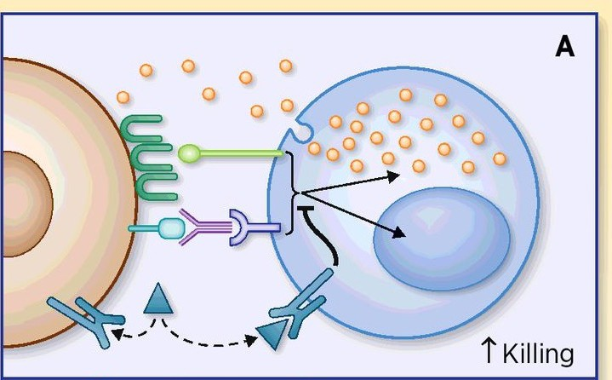
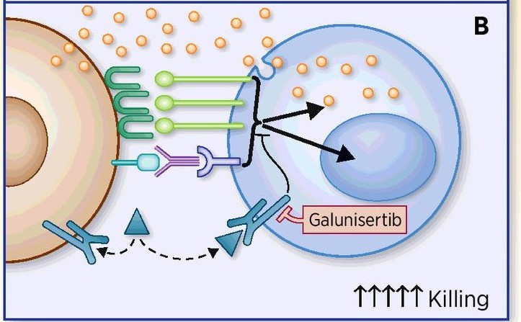
TGF-beta produced in TME suppresses NK activity against tumors
Olatz Zenarruzabeitia et al. Clin Cancer Res 2017;23:615-617

Slide 27
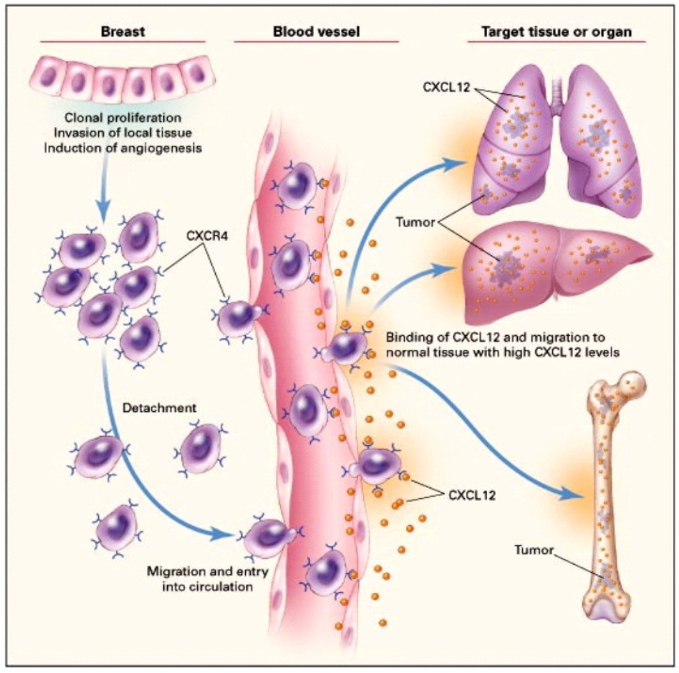
Soluble factors, such as chemokines, in the tumor microenvironment induce EMT and can enable site specific metastasis
Content created by Ramesh K Ganju

Slide 28
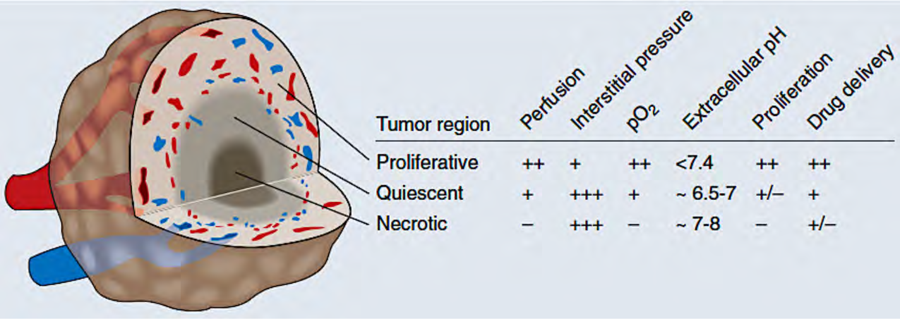
Characteristics of Different Regions of the Heterogeneous TME
Heterogeneity of blood flow contributes to acute and chronic hypoxia in tumors
Several factors contribute to the heterogeneity of blood flow in the TME
Imbalance between proangiogenic and antiangiogenic molecules
Solid stress (vessel compression) generated by proliferating tumor cells and matrix production
Heterogeneity of blood flow contributes to acute and chronic hypoxia in tumors, which is a major cause of resistance to radiation and other therapies.
Hypoxia Drives Tumor Progression/Metastasis !

Slide 29
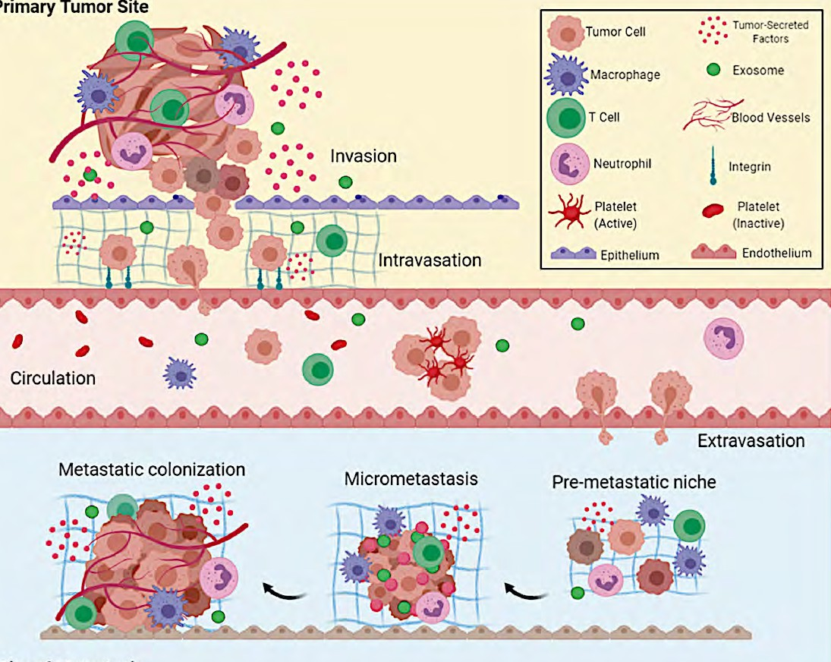
OVERALL- The TME Initiates the Metastatic Cascade
Primary neoplasm/tumor
Local invasion
Dissociation, migration,
and invasion
Intravasation
Metastasis
Sources: Niederhuber JE et al. Abeloff’s Clinical Oncology 2020; Fares J et al. Signal Transduct Target Ther. (5) 2020.

Slide 30
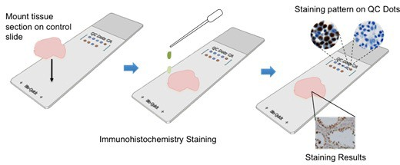
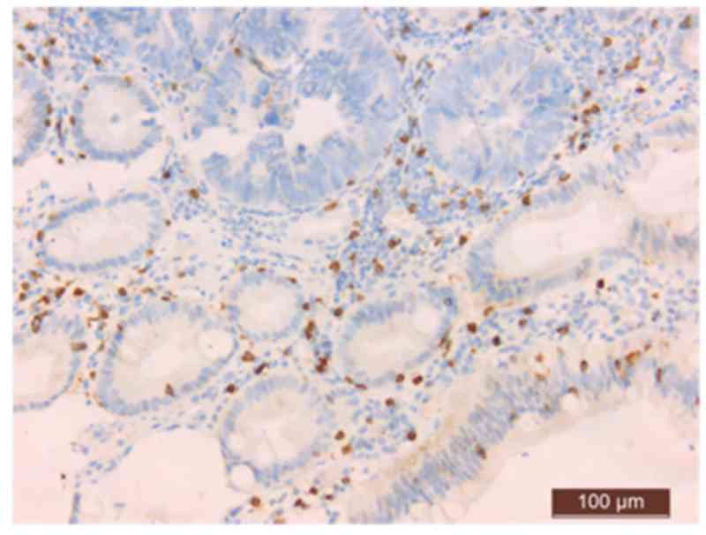
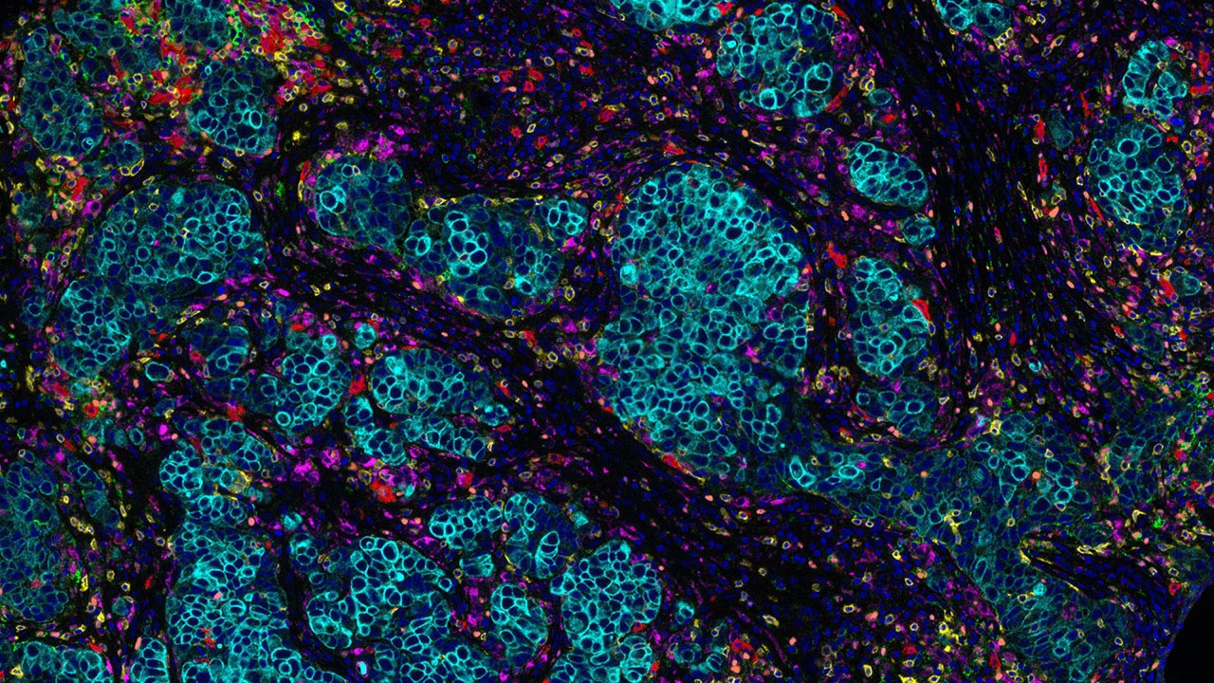
Tools to study tumor microenvironment
Cytokine arrays to quantitate secreted factors
Immunohistochemical staining on resected tumors
Brightfield detection
Fluorescence detection
Add antibody conjugated to fluorophore or enzyme

Slide 31
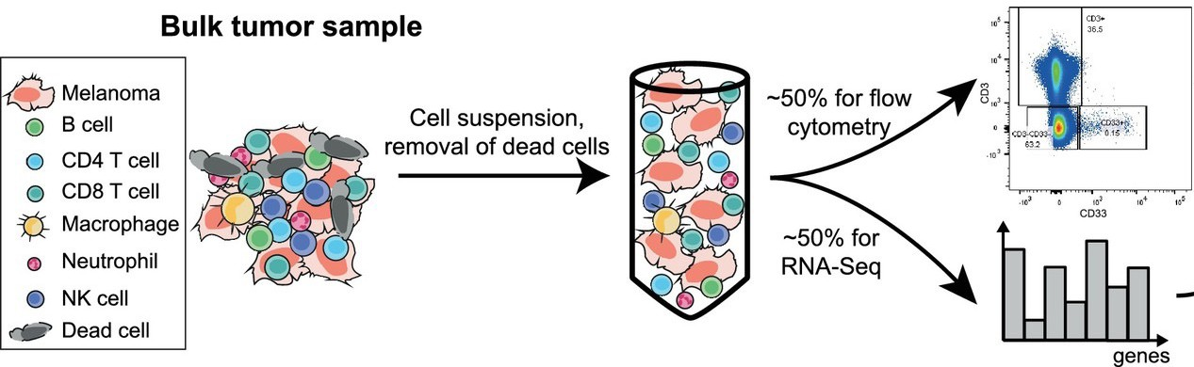

Tools to study tumor microenvironment
Flow cytometry to evaluate and quantitate different cell types
RNA-Seq to evaluate gene expression changes in specific cell types

Slide 32
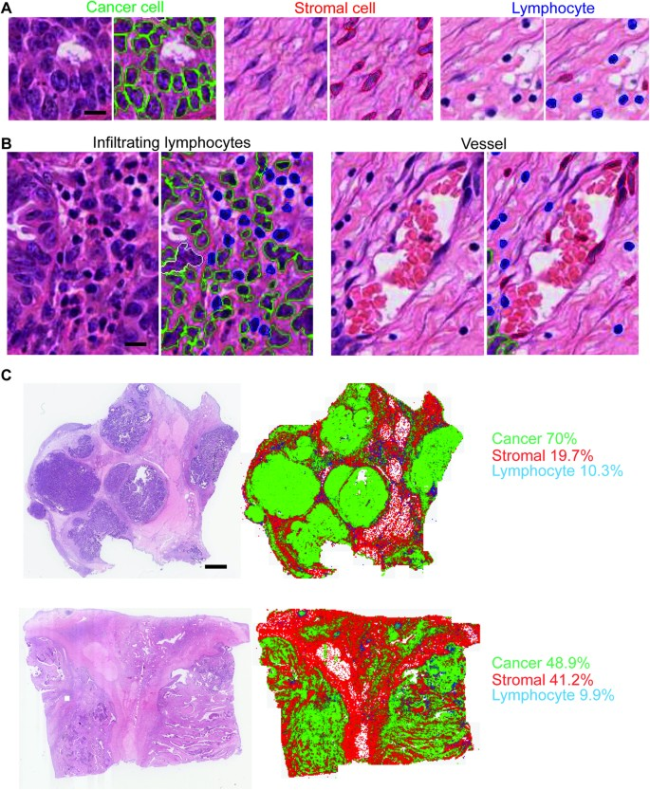
Quantifying TME composition with image analysis of ovarian H&E tumour slides
A cell classifier was trained based on the annotation of 900 cells provided by an expert pathologist, from which 100 morphological features of every cell were quantified. It identifies cancer cells with epithelial morphology, stromal cells with spindle-like morphology which include fibroblasts and endothelial cells and lymphocytes with small, round morphology
(A) Cell nuclei were classified into three cell classes based on morphology: epithelioid-like cancer cells (green), spindle-like stromal cells (red), round lymphocytes (blue) and artefacts (white). Scale bar: 12 μm. (B) Examples of infiltrating lymphocytes and vessel found in the sample. Scale bar: 12 μm.
(C) Illustrative examples of two tumors to show the original H&E section and the spatial distribution and ratios of three cell types obtained from image analysis.
Scientific Reports volume 5, Article number: 16317 (2015)

Slide 33
Tumor microenvironment studies integrating histology and genomics
Integration of quantitative histology with multifaceted clinical and genomic data. Image analysis algorithms can extract features that describe
the histology in digital whole-slide image datasets. This information can be combined with genomic, clinical, and radiology data to identify image
biomarkers of genetic alterations, to build predictive models of clinical outcomes, and to better understand tumor biology
Cooper, Lee. (2015).. Laboratory Investigation. .2014..

Slide 34
Tumor microenvironment studies integrating histology and genomics
(a) TCGA specimens are sections from the top and bottom to produce slides, and the middle portion is submitted for genomic analysis.
(b) Digitized images from top/bottom sections were annotated to calculate the percentage of necrosis and angiogenesis for each tumor.
(c) Tumors from the mesenchymal gene expression class are significantly enriched with necrosis.
(d) CEBPB expression is increased in the hypoxic perinecrotic pseudopalisading cells immediately surrounding necrosis (asterisk).
(e) As the amount of necrosis increases in non-mesenchymal GBMs, gene expression patterns shift towards a mesenchymal expression signature.

Slide 35
TME: The ECM and What is collagen
Collagen is the most common fibrous protein in the ECM
It is important for resisting tensile forces.
It is the most abundant protein in mammals - 25% of total protein mass!

Slide 36
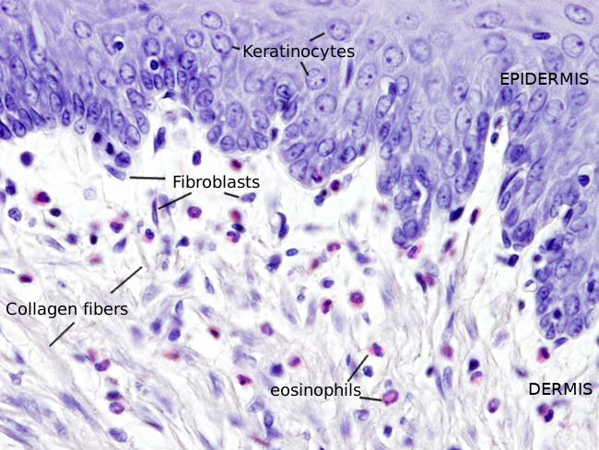
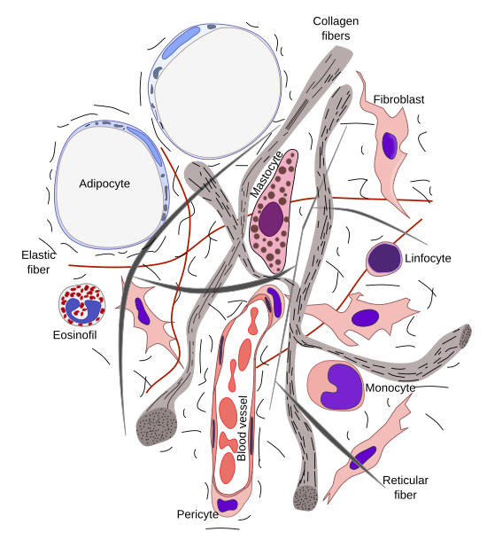
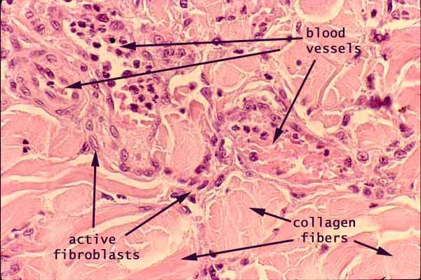
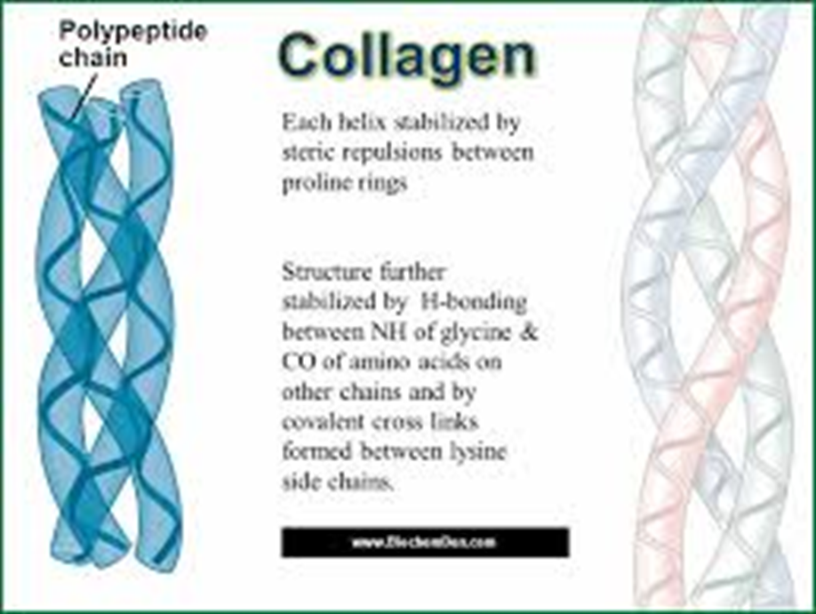
In the normal ECM what is collagen?
Cell types and fibers of the extracellular matrix of the loose connective tissue
Credits: Atlas of Plant and Animal Histology. A site dedicated to Cytology, Histology and Organography

Slide 37
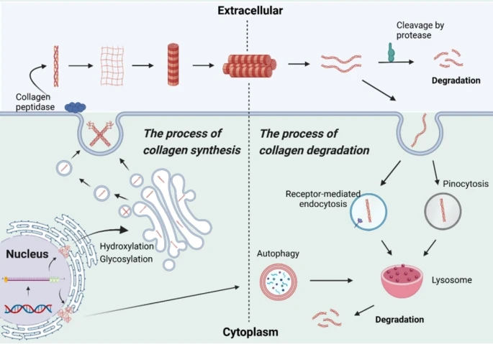
Fibroblasts make Collagen and secrete it OUT into the ECM
Wang, Y., Zhang, F., Qian, Z. et al. Targeting collagen to optimize cancer immunotherapy. Exp Hematol Oncol 14, 101 (2025). https://doi.org/10.1186/s40164-025-00691-y

Slide 38
What is CAF (cancer-associated fibroblasts ?)
Recall: The extracellular matrix (ECM) is component of the TME.
Cancer-associated fibroblasts (CAFs) is a heterogeneous and plastic subset of activated fibroblasts.
ECM materials such as collagen is predominantly secreted by cancer-associated fibroblasts (CAFs)
Do other cells make collagen? YES . So CAFs, keratinocytes, VECs, smooth muscle cells, macrophages, and cancer cells also contribute to collagen

Slide 39
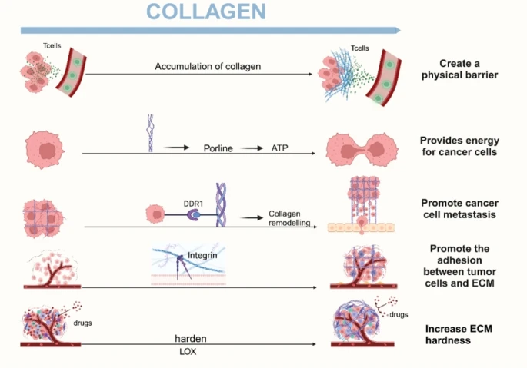
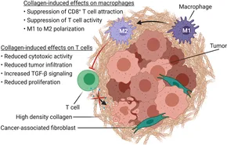
Role of collagen fibers in the TME
Wang, Y., Zhang, F., Qian, Z. et al. Targeting collagen to optimize cancer immunotherapy. Exp Hematol Oncol 14, 101 (2025). https://doi.org/10.1186/s40164-025-00691-y
Restricts tumor
spread
Collagen as a energy source
Promotes tumor
Promotes
Promotes
Promotes resistance

Slide 40
The dual role of collagen in breast cancer
Collagen can inhibit tumor growth or promote it.
The effects vary depending on the type, structure, and stage of the cancer.
How collagen can promote cancer
Creating "highways" for metastasis: Collagen fibers make "invasion highways," along which breast cancer cells can migrate
Shielding tumors from the immune system: Dense and misaligned collagen fibers can physically block immune cells, such as T cells, from entering the tumor core; reduces the effectiveness of immunotherapies.
Causes drug resistance: A highly dense and stiff collagen matrix can act as a physical barrier that prevents chemotherapy drugs from penetrating the tumor effectively.
Influencing tumor growth: Certain types of collagen, like type I and type XII, can create a stiff scaffolding that supports tumor growth and progression.
How collagen can suppress cancer
Restricting tumor growth: In some breast cancer cases, a high level of type III collagen has been found to restrict tumor growth and metastasis.
Serving as a barrier: In certain contexts, dense collagen tissue can form a physical barrier that helps contain the tumor and prevents metastasis.
Breast cancer treatments targeting collagen :
Because of collagen's influence on tumor development, researchers are investigating new strategies to target it.
Collagenase treatment: Administering enzymes like collagenase to break down the dense collagen matrix can improve the penetration of therapeutic drugs into solid tumors.
The goal is to make tumors less stiff and more accessible to therapies.

Slide 41
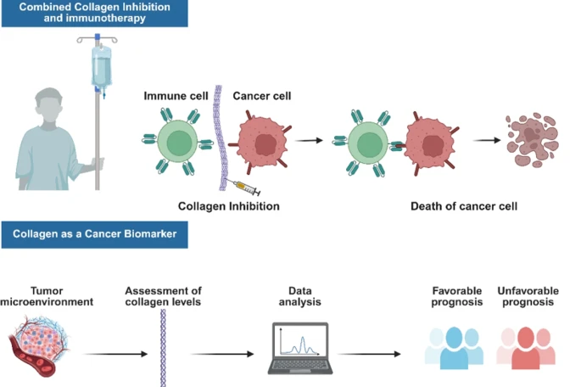
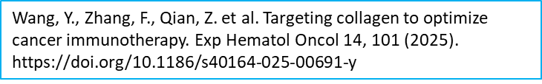
Collagenase treatment: breaks down collagen
ASESS COLLAGEN BY HISTOLOGY??

Slide 42

Collagen and breast cancer: Use of Optical Histology technique
2414
IEEE TRANSACTIONS ON BIOMEDICAL ENGINEERING, VOL. 71, NO. 8, AUGUST 2024
SHG Fiberscopy Assessment of Collagen Morphology and Its Potential for Breast Cancer Optical Histology
Gunnsteinn Hall , Wenxuan Liang , Zaver M. Bhujwalla , and Xingde Li
SHG Fiberscopy System used. Also termed fiber-optic nonlinear endomicroscopy
Image Metrics - The collagen content was determined for each SHG image by calculating the total area fraction of collagen-containing foreground pixels.
They assessed the feasibility of distinguishing cancerous versus normal tissue based on the area fraction of collagen fibers in the fiberscopy SHG images.
Abstract—Objective: This study is to investigate the fea- sibility of our recently developed nonlinear fiberscope for label-free in situ breast tumor detection and lymph node status assessment based on second harmonic genera- tion (SHG) imaging of fibrillar collagen matrix with histo- logical details. The long-term goal is to improve the cur- rent biopsy-based cancer paradigm with reduced sampling errors. Methods: In this pilot study we undertook retro- spective SHG imaging study of ex vivo invasive ductal carcinoma human biopsy tissue samples, and carried out quantitative image analysis to search for collagen struc- tural signatures that are associated with the malignance of breast cancer. Results: SHG fiberscopy image-based quantitative assessment of collagen fiber morphology re- veals that: 1) cancerous tissues contain generally less ex- tracellular collagen fibers compared with tumor-adjacent normal tissues, and 2) collagen fibers in lymph node pos- itive biopsies are more aligned than lymph node negative counterparts. Conclusion/Significance: The results demon- strate the promising potential of our SHG fiberscope for in situ breast tumor detection and lymph node involvement assessment and for offering real-time guidance during on- going tissue biopsy.
Index Terms—Biomedical imaging, breast cancer, optical imaging, nonlinear fiberscope, second-harmonic genera- tion microscopy.
VIDEO- SHG Fiberoscopy

Slide 43
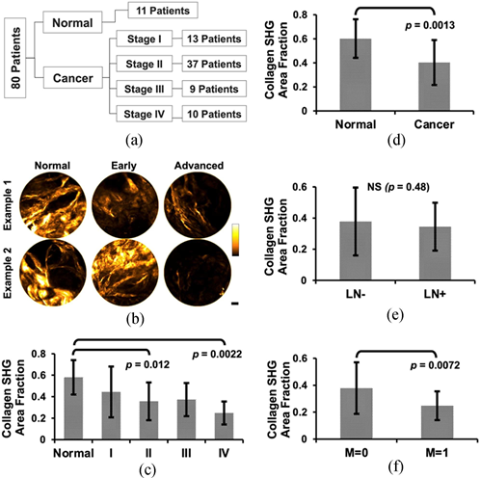
Collagen density imaging in breast cancer
Reduced Collagen Density found in Cancerous Tissue
Overall collagen density of all cancerous tissues
(stages I to IV all together) is significantly lower than the normal group (p = 0.0013, Welch’s t-test; Fig. 1(d)).
Breast Cancer Optical Histology– not regular histology- for collagen.
SHG Fiberscopy Assessment of Collagen Morphology and Its Potential for Breast Cancer Optical Histology. IEEE TRANSACTIONS ON BIOMEDICAL ENGINEERING, VOL. 71, NO. 8, AUGUST 2024

Slide 44
Thank you.

