Slide 1
Recent trends in cancer studies and opportunities

Slide 2
Overview
Preclinical Cancer Research Trends 2025
What are the recent trends in research phases, supporting scientific and clinical translation advances in cancer therapy
  Do these show us opportunities ?
Emphasis on precision preclinical models:
  genetically engineered models
  patient-derived xenografts (PDX) models
  Organoids
  Why? - to better mimic tumor biology and microenvironment

Slide 3
Not so recent: just one example ……

Slide 4
A preclinical story :
NOSH-Aspirin Inhibits the Growth of MIA PaCa2 Human Pancreatic Cancer Cells in a Mouse Xenograft

Slide 5
NOSH-Aspirin Inhibits the Growth of MIA PaCa2 Human Pancreatic Cancer Cells in a Mouse Xenograft
Protocol
Inoculation
NOSH-ASA
1st Volume Recorded
Sacrifice
10 days
3 days
30 days

Slide 6
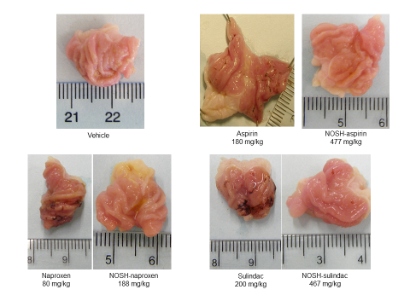
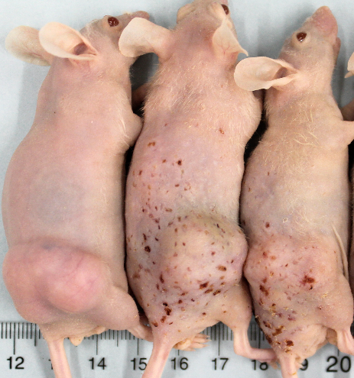
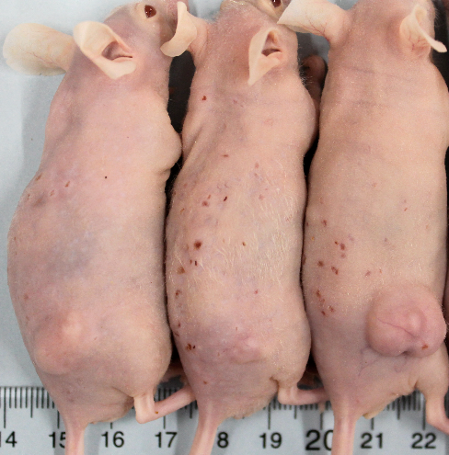
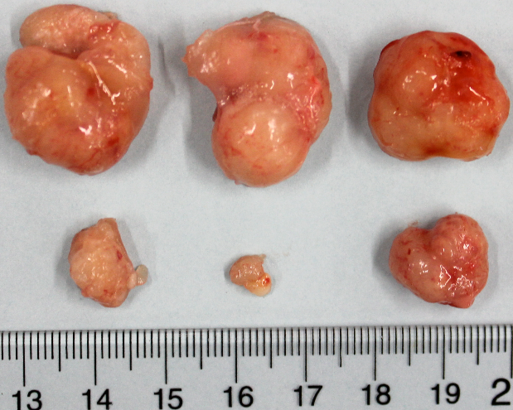
4000
400
3500
300
3.0
P = 0.003
Volume, mm³
200
3000
100
2.5
0
2500
0
3
6
9
12
15
18
21
24
27
30
2.0
Average Tumor Volume, mm³
Days of Treatment
75%
2000
Tumor Mass, g
Vehicle
1.5
1500
NOSH-aspirin
1.0
1000
500
0.5
*
0
0.0
0
3
6
9
12
15
18
21
24
27
30
Control
NOSH-ASA
Days of Treatment
Treatment

Slide 7
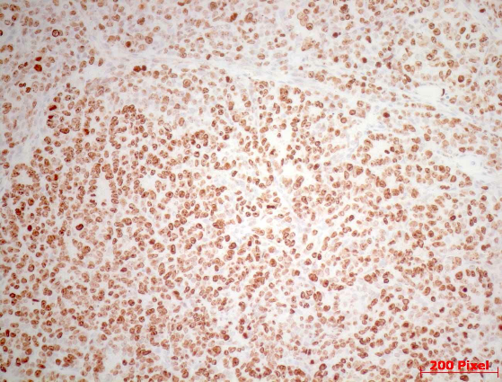
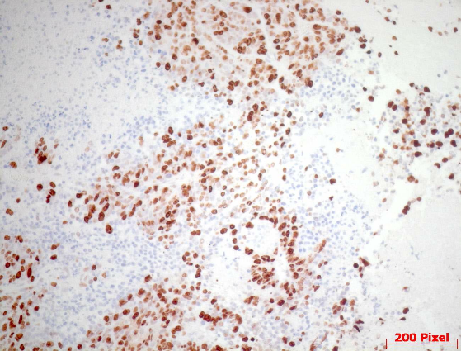
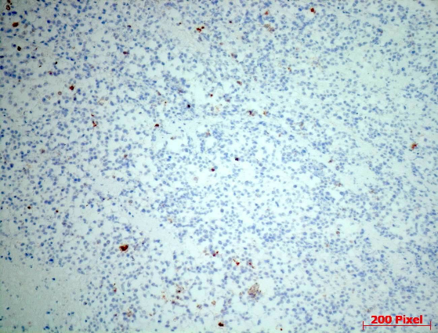
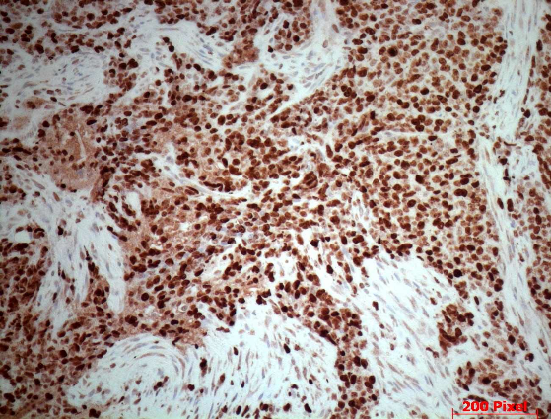
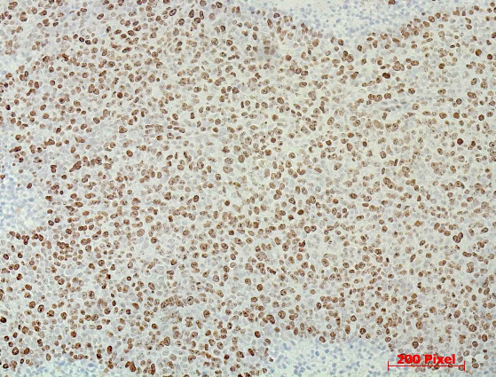
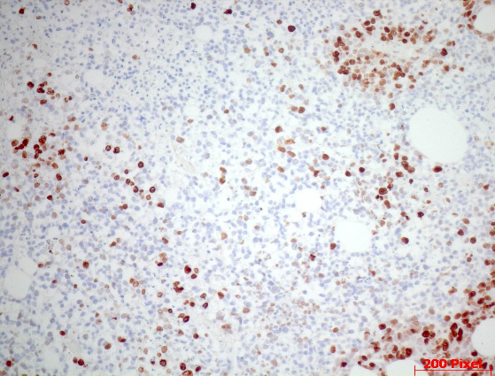
Vehicle
NOSH-ASA
78.4 ± 8%
25.2 ± 3%
Proliferation
3.4 ± 0.3%
83.9 ± 3%
Apoptosis
63.6 ± 7%
14.7 ± 3%
NF-κB

Slide 8
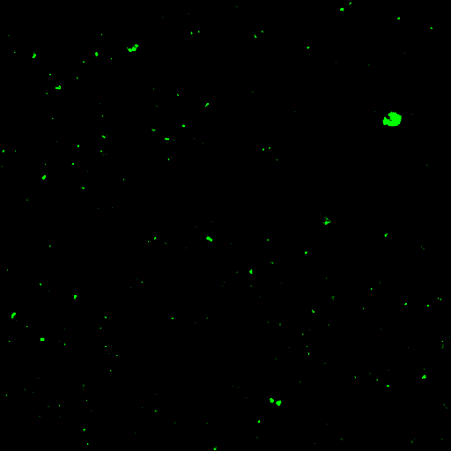
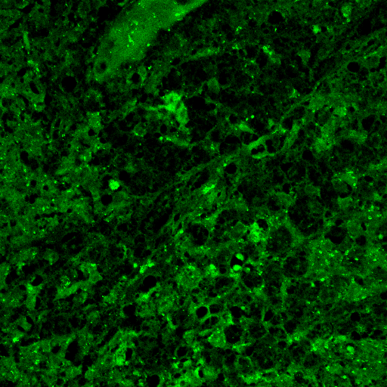
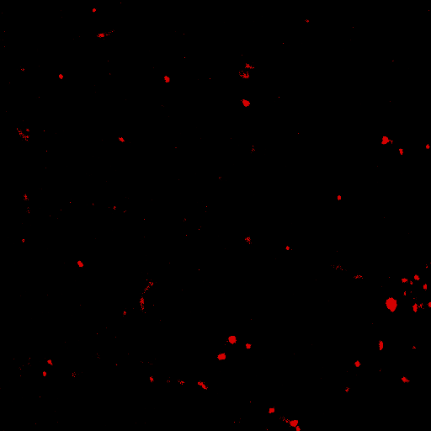
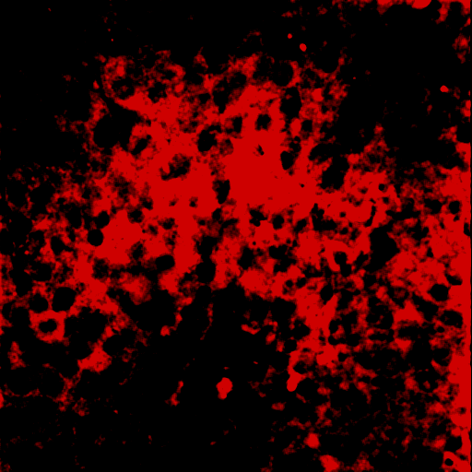
NOSH-ASA Induces ROS Within the Tumors
Vehicle
NOSH-aspirin
H₂O₂
7 ± 1 %
90 ± 2 %
•O₂⁻
9 ± 1 %
84 ± 3 %

Slide 9
Trends: Advances in Preclinical Models
• Expansion of PDX models to preserve tumor heterogeneity and predict clinical outcomes more accurately
Use of 3D organoids and microfluidic platforms to represent complex tumor microenvironments
Opportunities??

Slide 10
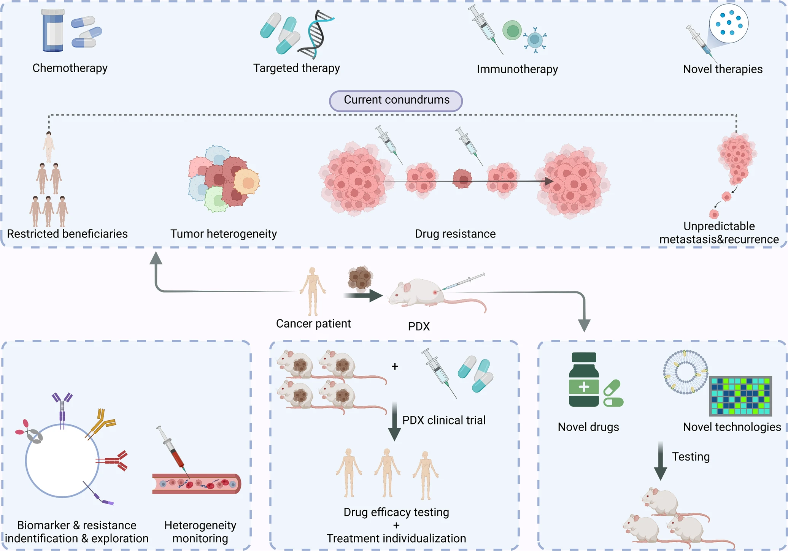

Slide 11
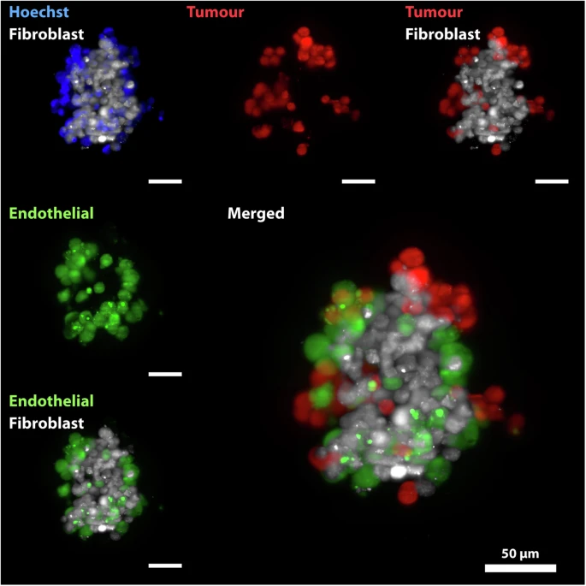
Opportunities: High-resolution 3D imaging for organoids and PDX models
Can apply light-sheet, multiphoton, and expansion microscopy to capture tumor architecture and cell–cell interactions.
Figure: Click- Diosdi, A., Piccinini, F., Boroczky, T. et al. Single-cell light-sheet fluorescence 3D images of tumour-stroma spheroid multicultures. Sci Data 12, 492 (2025).
Light-sheet 3D rendering of an organoid with labeled tumor and stromal compartments.

Slide 12
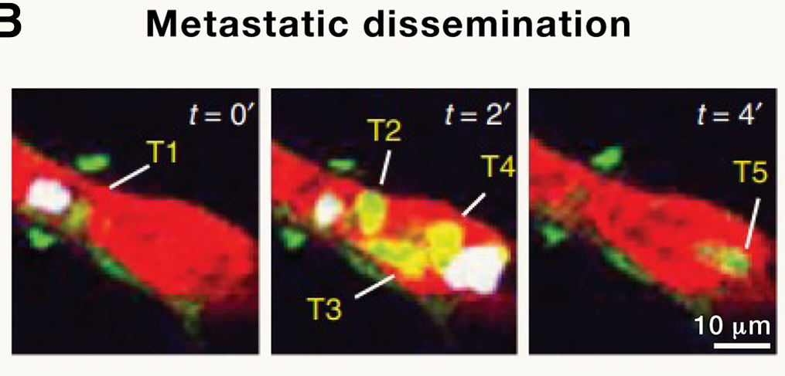
Opportunities Contd: High-resolution 3D imaging for organoids and PDX models
Can Perform volumetric imaging by Time-lapse multiphoton of drug penetration and distribution in organoids/PDX ex vivo. These figures are NOT drug tracer but the technique can be used.
Arrival of individual or clustered circulating tumor cells in lung vessels prior to metastatic colonization. Images depict a time series of cells moving along the same vessel.
Multiphoton fluorescence microscopy for in vivo imaging
Xu, Chris et al.
Cell, Volume 187, Issue 17, 4458 – 4487
Notes:
Speaker notes:
These modalities reveal spatial drug distribution and heterogeneity that 2D assays miss.
Note compatibility with fluorescent reporters and small-molecule tracers to quantify penetration and cell viability over time.
High-content 3D datasets are ideal for downstream AI analysis and biomarker discovery.

Slide 13
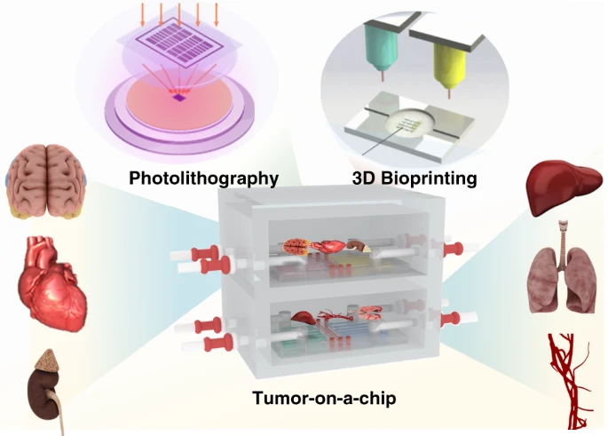
Opportunities: Contd
Microsystems & Nanoengineering volume 7, Article number: 50 (2021)
Can enable longitudinal live imaging in microfluidic tumor-on-chip platforms for dynamic response assessment.
A tumor-on-chip device is a microfluidic platform designed to mimic the tumor microenvironment for cancer research. It includes a chamber for a 3D tumor model, microchannels for media flow, and imaging access ports for real-time observation.
Schematic of tumor-on-chip with imaging access ports.
Tumor-on-a-chip platforms can be generally prepared by photolithography and 3D bioprinting and applied in cancer biology and anticancer therapy research.

Slide 14
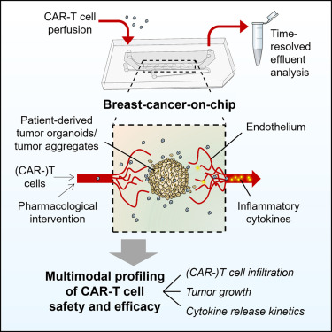
Opportunities Contd: High-resolution 3D imaging for organoids
Maulana, Tengku Ibrahim et al. 2024
Cell Stem Cell, Volume 31, Issue 7, 989 - 1002.e9
Another example :
live imaging possible in microfluidic tumor-on-chip platforms for dynamic response assessment

Slide 15
Trends : Integration of AI and Computational Tools in Preclinical Studies
AI applications in biomarker discovery, drug response prediction, and model selection, e.g., Prov-GigaPath, HistoPathXplorer
Machine learning aiding in analyzing multiomics data and optimizing experimental design.

Slide 16
Immunotherapy in Preclinical Models
Development of immunotherapy strategies tested in sophisticated models for checkpoint inhibitors and combinations with modalities such as focused ultrasound 3 8.
Exploring the tumor immune microenvironment’s role in therapy response.

Slide 17
Slide 5: Challenges in Preclinical Research
High cost, resource intensity, and ethics concerns with certain models like PDX 2.
Limited throughput compared to simpler models; difficulty in fully recapitulating tumor complexity 4 6.
Need for better models for rare cancers and metastatic disease 4.

Slide 18
Overall Opportunities in Preclinical Research
•Enhanced predictive power of humanized and organoid models could improve clinical trial success .
Also Opportunities for Rare Cancers and Personalized Models
    New models enabling better research into rare malignancies and personalized therapies.
    Use of multiomics and patient data to tailor preclinical drug testing.

Slide 20
Recent Trends in Clinical Cancer Research 2025
Growing use of precision medicine integrating genomics and biomarkers
Expansion of clinical trials with innovative designs and patient-centric approaches

Slide 21
Advances in Immunotherapy and Targeted Therapies
FDA approvals accelerating for immunotherapies such as TILs, TCR-engineered therapies, and IL-15 agonists 3.
Progress with antibody-drug conjugates (ADCs) focusing on target specificity and payload safety 1.

Slide 22
Role of AI in Clinical Trials and Treatment Monitoring
AI is improving trial design, recruitment, and analysis
For treatment decisisons, ctDNA emerging as a biomarker in early-phase trials to guide treatment decisions .
Circulating tumor DNA (ctDNA) : fragments of DNA that are released into the bloodstream from tumor cells. These fragments can be detected in a blood sample and provide valuable information about the presence, characteristics, and progression of cancer.
Notes:
Explain how AI reduces manual burden and increases reproducibility across large 3D datasets.
Emphasize cross-validation with orthogonal assays (viability, molecular readouts) to avoid overfitting.
Recommend building diverse training sets from multiple models (PDX, organoids) to improve generalizability.

Slide 23
Slide 11: Challenges in Clinical Cancer Research
Toxicities from some therapies (e.g., ADC payloads) and need for safer options 1.
Issues in trial design, patient recruitment, and heterogeneity of treatment response.

Slide 24
Slide 12: Clinical Opportunities
Incorporation of ctDNA and spatial technologies to identify new predictive biomarkers and refine immunotherapy targets 1.
Moving therapies to earlier treatment stages to increase cure rates 1.
Expanding indications for novel drugs, including "undruggable" targets coming into reach 5 12.

Slide 25
Slide 13: Opportunities from Innovative Therapeutic Modalities
• Development of cancer vaccines and combination therapies to overcome resistance and improve outcomes 1 16.
• Use of real-world data and advanced analytics to tailor treatment plans and support regulatory decisions

Slide 26
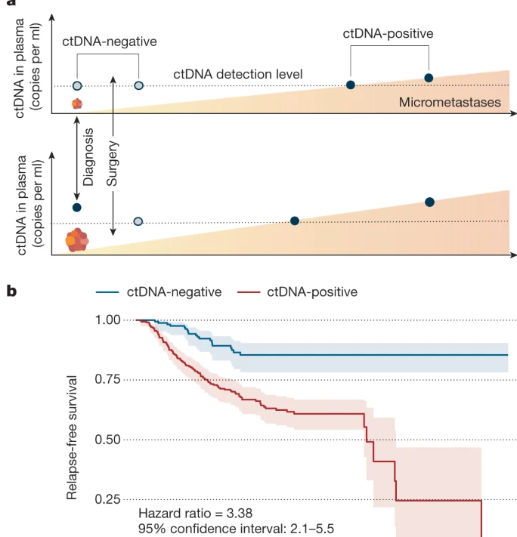
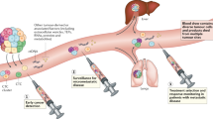
Clinical Imaging opportunity
Liquid-biopsy–guided imaging for early detection & monitoring
Liquid biopsy can be sensitive and reduce unncessary scans
Can use ctDNA/ctRNA signals to trigger targeted imaging (PET, MRI) for localization of minimal residual disease (MRD).
  PET image should be confirmed by ctDNA.
  ctDNA levels alongside imaging response metrics can be assessed
Combine serial liquid biopsies with temporal imaging to monitor early response or relapse.
Inform image-guided interventions and adaptive therapy decisions.
Notes:
Stress sensitivity of liquid biopsy for signaling when to image, reducing unnecessary scans.
Discuss examples: MRD detection post-surgery, early metastasis localization, or tracking oligo-progressive disease.
Note challenges: spatial resolution limits, need for tumor-specific assays and validated ctDNA thresholds.

Slide 27
Clinical Opportunities: AI-enabled multimodal imaging for trial design and response assessment
Can fuse radiology, pathology (digital whole-slide imaging), and molecular data (ctDNA, genomics) using AI to create composite predictive models.
Develop imaging-derived surrogate endpoints (radiomics + pathology features + molecular markers) for earlier readouts in trials.
Can use AI to stratify patients, optimize inclusion criteria, and enable adaptive trial arms.
Multimodal scheme could involve CT/PET image, digital pathology tile, and ctDNA timeline feeding into an AI model
Multi-modal approach for personalized cancer care.

Slide 28
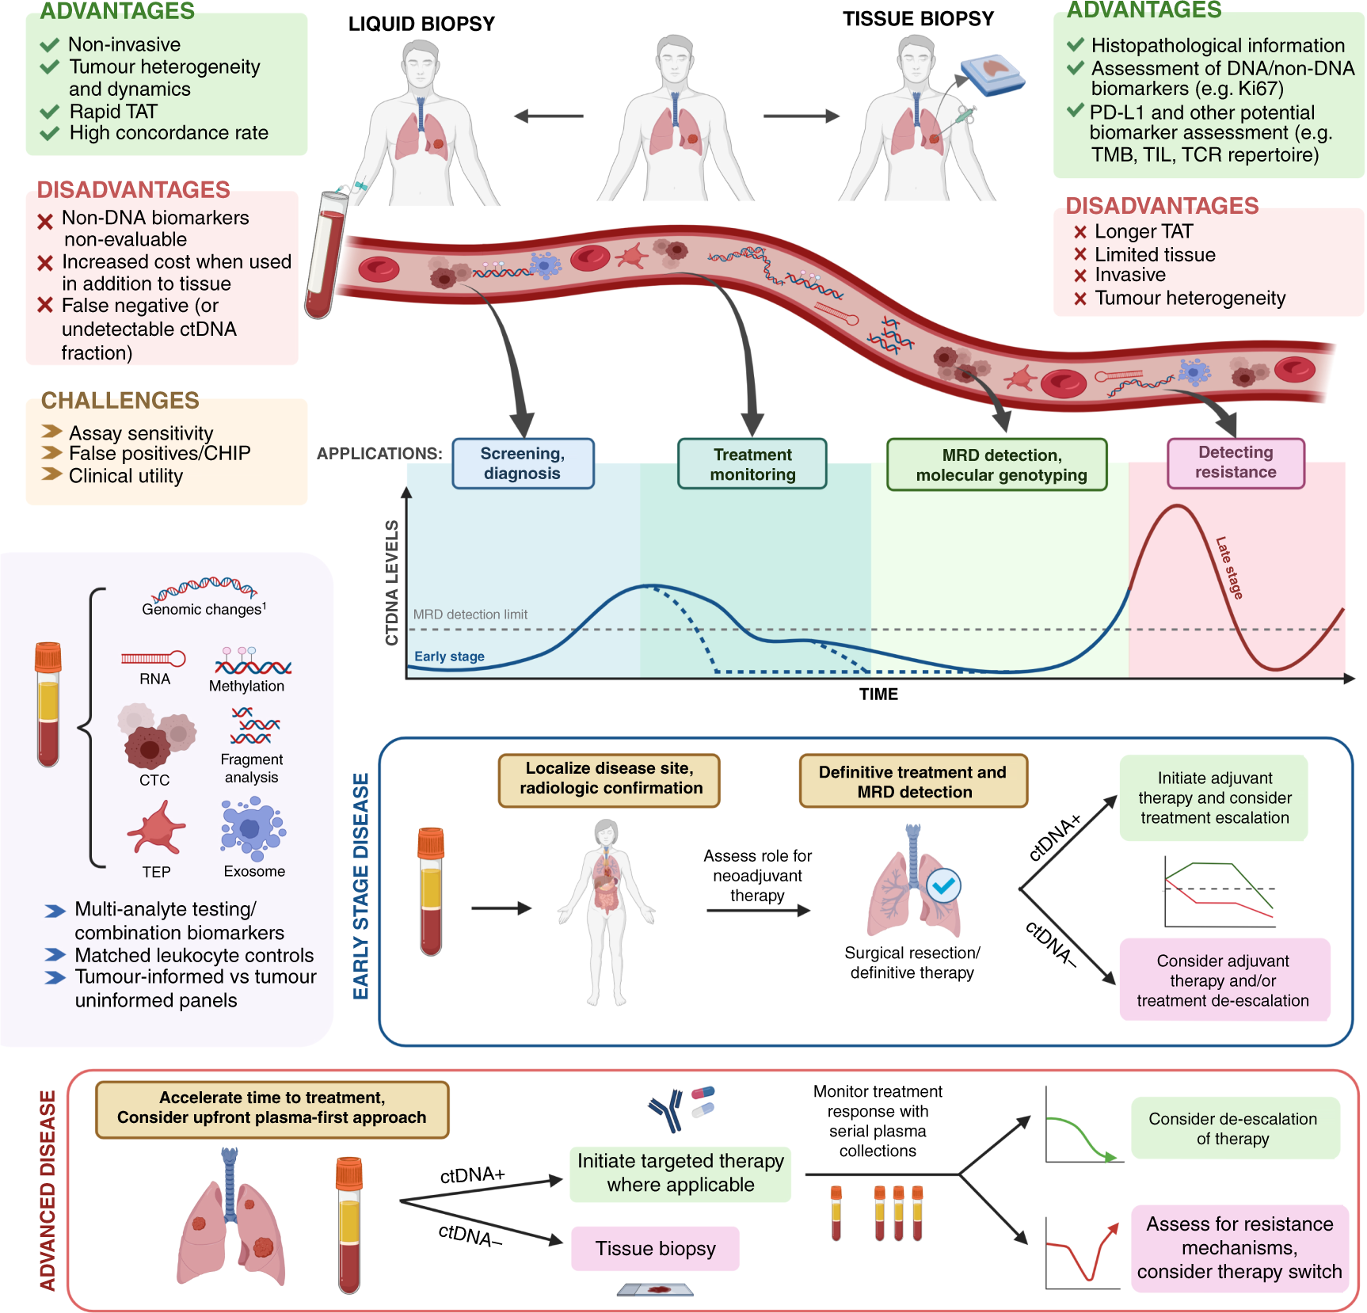

Slide 29
Thank you

